Slide 1
Dissimilar ligands bind in a similar fashion: guiding the binding mode prediction
Xianjin Xu and Xiaoqin Zou
Dalton Cardiovascular Research Center, Department of Physics and Astronomy, Department of Biochemistry & Informatics Institute
University of Missouri - Columbia

Slide 2
Outline
Systematic analysis the binding modes of different ligands on the protein
AutoPLI: A fully automated server for predicting protein-ligand interactions
Application of AutoPLI to the CELPP exercise

Slide 3
Molecular Similarity Principle
Similar structures
Molecular Similarity Principle
Similar properties
In protein-ligand binding studies:
Similar structures
Similar binding fashion
Similar bioactivities
What about the dissimilar molecules, which are most common for small molecules?
Bender, A.; Glen, R. C. Org. Biomol. Chem. 2004, 2: 3204-3218.
Willett, P. Mol. Inform. 2014, 33: 403-413.
Boström, J.; Hogner, A.; Schmitt, S. J. Med. Chem. 2006, 49: 6716-6725.
Martin, Y.C.; Kofron, J.L.; Traphagen, L.M. J. Med. Chem. 2002, 45: 4350-4358.

Slide 4
Few studies on comparing the binding modes of dissimilar molecules. Why?
Inference of the molecular similarity principle:
Difficulty in automated comparison of the binding
modes of ligands that have distinct structures.
Dissimilar structures
Dissimilar binding fashion
Dissimilar bioactivities
True for many cases, but dissimilar ligands may also have similar bioactivities.

Slide 5
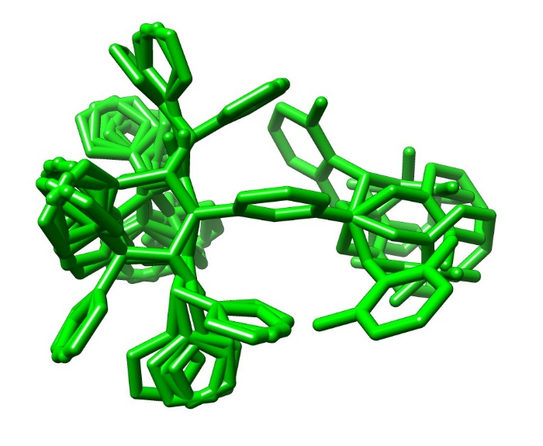
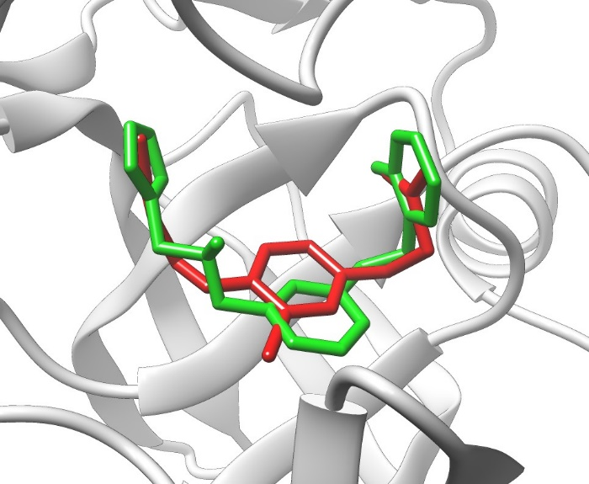
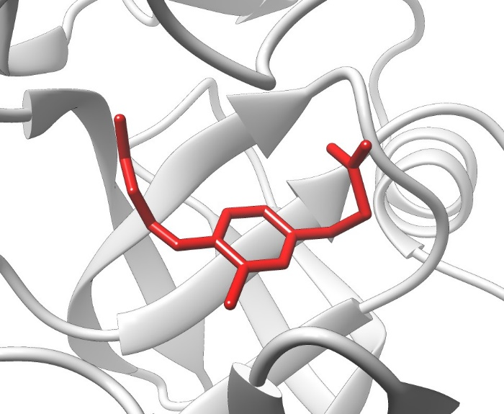
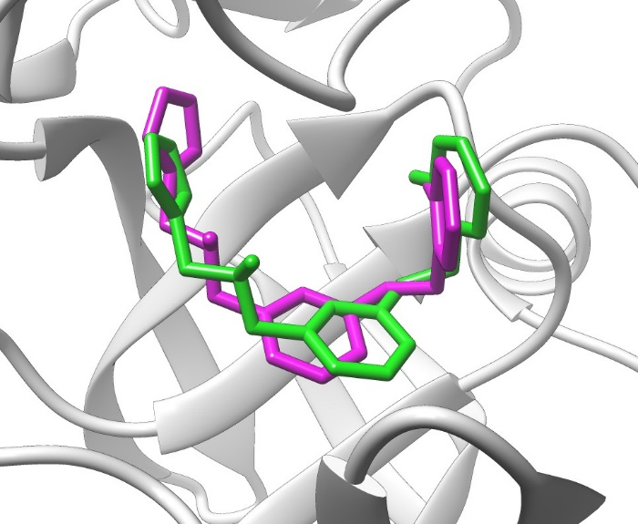
An intercomparison strategy comparing the binding modes of ligands with different molecular structures
Query ligand A
Conformer ensembles
Superimpose
ligand A
onto ligand B
Best superimposition
Calculate ligand RMSD
Template ligand B
Crystal structure of B bound with the protein
Crystal structure of A bound with the protein
PDB ID: 3kmx
(PDB ID: 3kn0)
3D similarity between A and B: SHAFTS score = 1.1
The SHAFTS score ranges between 0 and 2.
Cutoff of similar and dissimilar ligands: 1.2
RMSD = 1.42 Å

Slide 6
A newly constructed protein-ligand complex structure dataset for systematic analysis
The dataset consists of 17 different proteins with a total of 2752 protein-ligand PDB entries:
One peptidase A1 protein (BACE1, 330 PDBs),
Three peptidase S1 proteins (THRB, 141 PDBs; TRY1, 118 PDBs; FA10, 108 PDBs),
Five protein kinases (CDK2, 296 PDBs; MK14, 165 PDBs; PIM1, 128 PDBs; CHK1, 121 PDBs; AURKA, 83 PDBs),
One heat shock protein (HS90A, 220 PDBs),
Two nuclear hormone receptors (ESR1, 210 PDBs; PPARG, 116 PDBs),
Six other proteins (a total of 583 PDBs)
Peptidase A1
(330 PDBs)
Others
(583 PDBs)
Peptidase S1
(367 PDBs)
HSP90
(220 PDBs)
Nuclear receptors
(326 PDBs)
Protein kinases
(793 PDBs)

Slide 7
RMSD vs 3D similarity
For each protein in the dataset, a leave-one-out cross validation strategy was used for calculations of the molecular 3D similarities (SHAFTS score) and the corresponding RMSDs among the ligands.
Cases with higher similarity scores tend to have lower RMSD values, which is consistent with the molecular similarity principle.
Two high-density centers:
at around SHAFTS score 1.0 and RMSD 6.0 Å: Dissimilar ligands bind in dissimilar fashion;
at around SHAFTS score 1.1 and RMSD 1.0 Å: dissimilar ligands bind in a similar fashion.
Dissimilar ligands bind in dissimilar fashion
Dissimilar ligands bind in similar fashion

Slide 8
Percentage of the cases in which at least one good template ligand were successfully found (structurally similar or dissimilar) with the RMSD lower than a threshold (Lowest RMSD).
Importantly, 95.6% of the query ligands had at least one dissimilar template ligand with lowest RMSD ≤ 2.0 Å, suggesting that dissimilar ligands binding in a similar fashion is common in protein-ligand complexes.
similar ligands
dissimilar ligands

Slide 9
The relationship between the SHAFTS score and the minimum number of template ligands among which at least one good template ligand (RMSD ≤ 2.0 Å) can be found.
The minimum number of template ligands having at least one good template decreases with the increase of the SHAFTS score.

Slide 10
Challenge:
For a query ligand, how to distinguish good template ligands from a number of co-bound ligands of a protein, especially when only dissimilar co-bound ligands are available?

Slide 11
Solution: considering the protein-ligand interactions
Refine the superimposed modes using AutoDock Vina.
Models with low RMSD values tended to have lower Vina binding scores.

Slide 12
Scoring: a hybrid scoring function
The hybrid scoring function considers both the protein-ligand binding score (Vina score) and the molecular similarity score (SHAFTS score):
Hybrid_Score = Vina_score +α*SHAFTS_score , α = min(Vina scores)/2
Top model
Success rates using the hybrid score.
Using 2.0 Å as a threshold:
85.8% for SHAFTS score ≥ 1.2;
63.2% for SHAFTS score < 1.2.
Success rate of bound docking: 44.5%

Slide 13
Success rates vs SHAFTS scores
Success rates for the cases using template ligands with different ranges of qualities (SHAFTS scores).
The RMSD value of 2.0 Å as the threshold. The broken line corresponds to the success rate of bound docking.

Slide 14
Summary on Part 1
An intercomparison strategy was introduced to compare the binding modes of different ligands.
From systemic analysis of a newly constructed dataset, we found that similar ligands tend to have a similar binding mode, which is consistent with the molecular similarity principle.
Although dissimilar ligands tend to bind in dissimilar fashions, we could always find at least one template ligand (dissimilar with the query ligand) with a similar binding mode for a query ligand.
The findings inspired us to develop a new method for protein-ligand binding mode prediction. The method has the capability to achieve a higher success rate than the bound docking method!

Slide 15
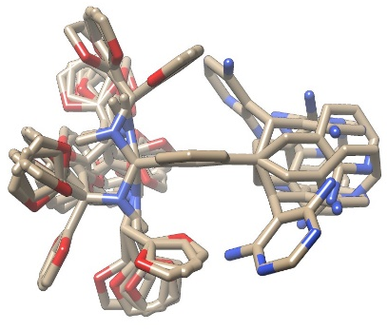
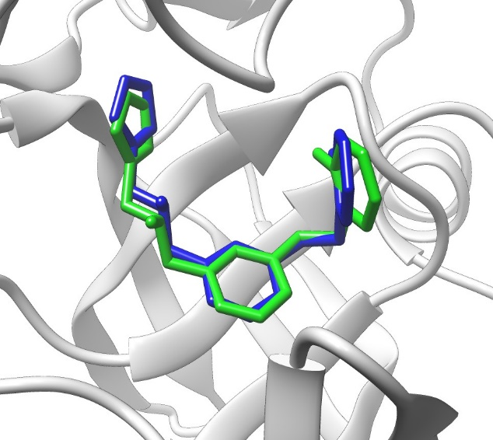
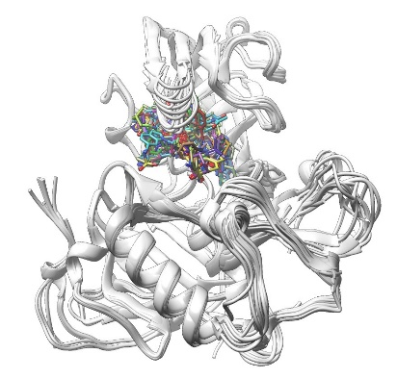
AutoPLI: A Fully Automated Server for Predicting Protein-Ligand Interactions
Conformer ensembles
···
Conformer
generation
Best superimposition
for each template
Query ligand
Flowchart
Superimposition of the query ligand
onto the templates
Refinement/
Hybrid scoring
Protein-ligand
complex structures
from PDB
MRETDEEPEEPGRRGSFVEMVDNLRGKSGQGYYVEMTVGSPPQTLNILVDTGSSNFAVGAAPHP
…
Search of
co-bound structures
Target protein
Input: a ligand (in SMILES string, mol2, mol, or sdf format) and a protein sequence
Output: top (up to) 5 predicted binding modes

Slide 16
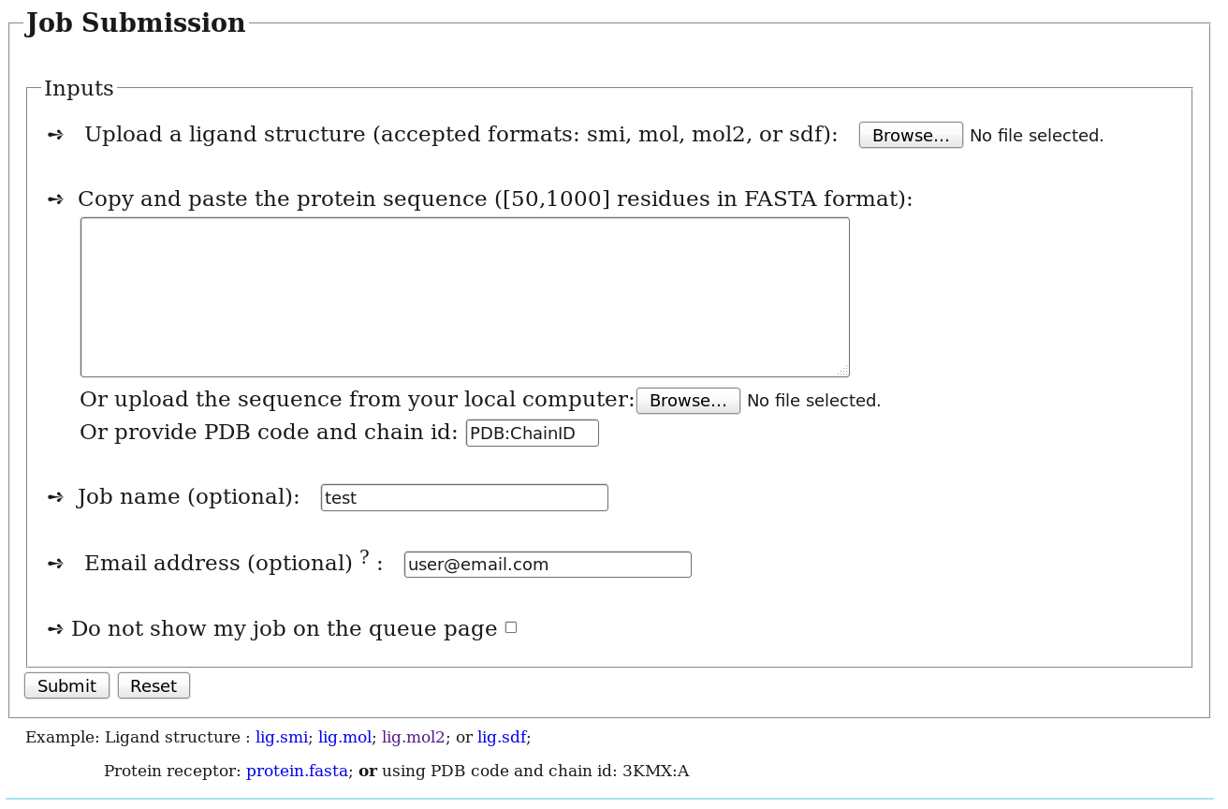
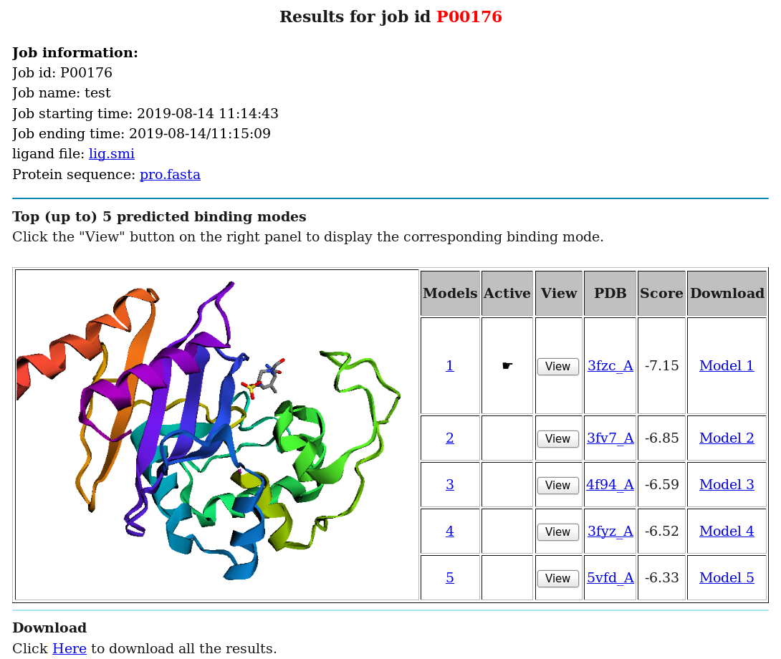
AutoPLI is free and open to all users without registration.
Web site: http://zougrouptoolkit.missouri.edu/autopli

Slide 17
Results on CELPP targets The new method (AutoPLI) has been applied to the CELPP targets since week8_2019
Success rates of the binding mode prediction for CELPP targets (473 targets from week8_2019 to week28_2019).
Docking-based methods were employed for LMCSS, SMCSS, hiResHolo, hiResApo, and bound protein structures.

Slide 18
Highlights of our AutoPLI server
AutoPLI is a fully automated server for predicting protein-ligand interactions;
AutoPLI requires only two inputs: a ligand (2D or 3D structure) and a protein sequence;
AutoPLI has the capability to achieve a higher success rate than the bound docking method;
The protein-ligand complex structural dataset in AutoPLI is automatically updated weekly;
AutoPLI is free and open to all users without registration.

Slide 19
THANKS FOR YOU ATTENTION!
Current Lab Members:
Dr. Rui Duan
Benjamin Merideth
Zhiwei Ma Dr. Liming Qiu Dr. Xianjin Xu Dr. Shuang Zhang
OpenEye Scientific Software, Inc.
Zou lab: http://zoulab.dalton.missouri.edu/
Supported by:
NIH [R01GM109980 (PI), R01HL126774 (co-PI), R01HL142301(co-I), R01DK055835(co-I)]

Slide 21
Switch query ligands and template ligands
R = 0.71
R = 0.9

