Slide 1
Orion
Christopher Bayly
D3R Workshop
August 2019

Slide 2
Orion: a Serverless Cloud platform for CADD
“Serverless computing is… referring to a cloud-computing execution model in which the cloud provider runs the server…” –Wikipedia
Bring the advances of cloud computing to drug discovery
  Elastic parallelism
  Fault tolerance
  Software defined infrastructure

Slide 3
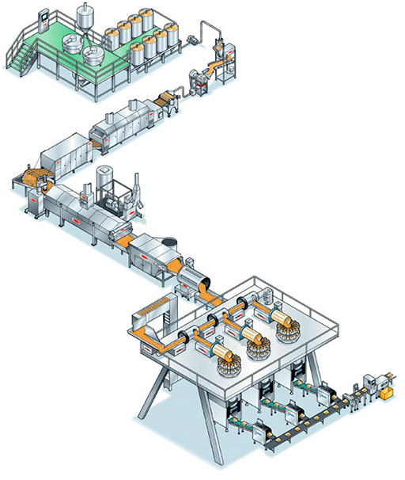
Flow-Based Programming
Independent units of work (Cube)
  Data flows through
Assemble units for a specific task
  (Floe)
Inherent parallelism, reusable components, ease of programming

Slide 4

Basic Unit of Work: Cube
Performs a single, general task
Python class
  Run OE code, other code,
  call out to executables…
You define:
  How to process data
  Parameters
  Input/Output ports
Cube
begin(…)
In
process(…)
end(…)
Param1
Param2
Out

Slide 5
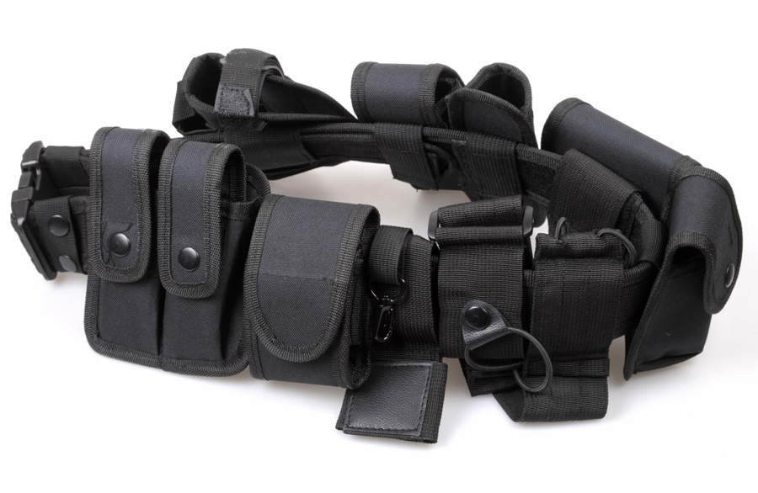
Datasets are made up of OERecords
OERecord: a general container for data
OERecords contain Fields
  Strongly typed
  Many types – POD and objects
Fields remain packed unless/until needed
Molecules are data, they don’t contain data
Metadata
Notes:
Out of the crucible of lots of discussion/arguing came the OERecord
Dataset now means a bunch of records, every rowson Analyze Spreadsheet is a record

Slide 6

Large-scale Parallel I/O
Scaling up always results in new issues
I/O Challenges in Large-Scale Search
  Very large amounts of data (e.g. 10¹¹ conformers)
  Data-hungry application (e.g. FastROCS)
Solution – Use S3
  Accumulate records into a chunk (Shard) in S3
  Keep making shards until done (Collection)
  10¹⁰ molecules -> 1 collection: 10k shards of 1M molecules

Slide 7
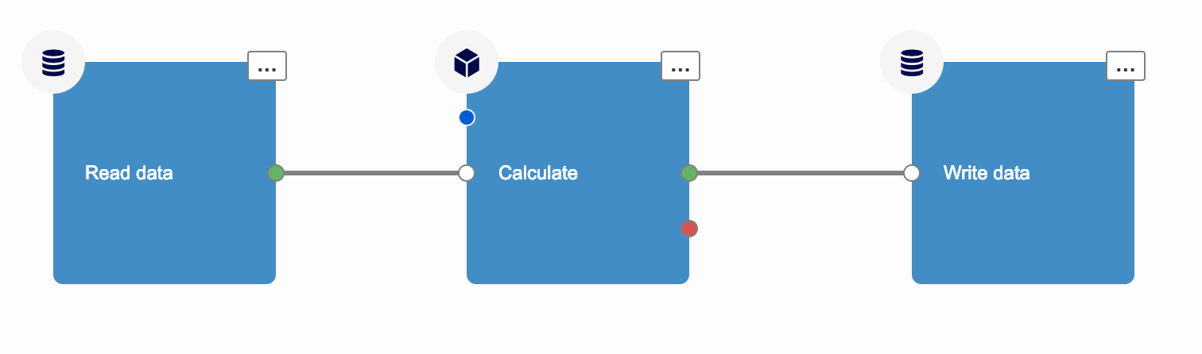
A Floe: Directed Graph of Cubes
Perform a specific complex task
Define cubes and connections between cubes
  Structured data: Python, JSON, UI
Cycles 👍

Slide 8
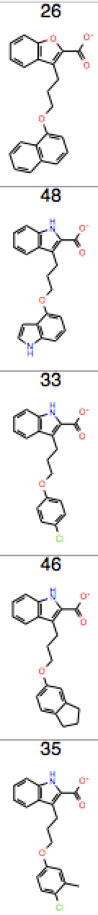
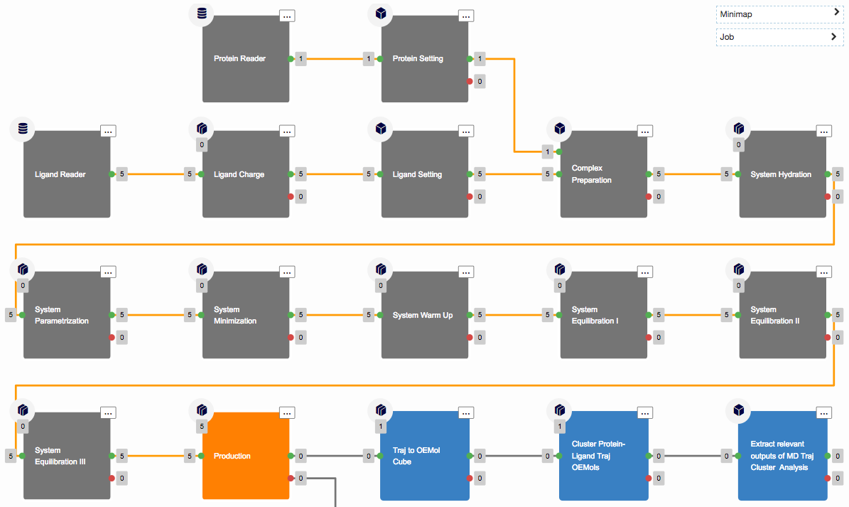
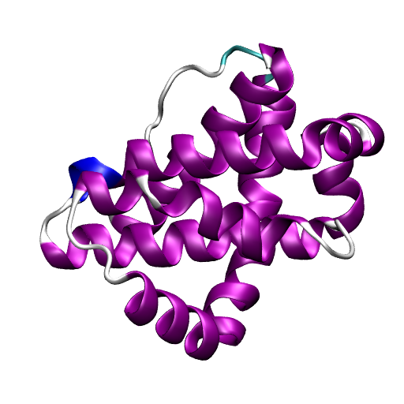
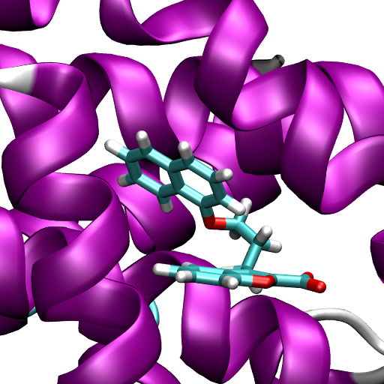
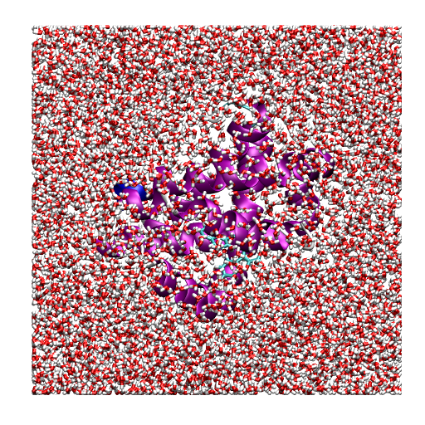
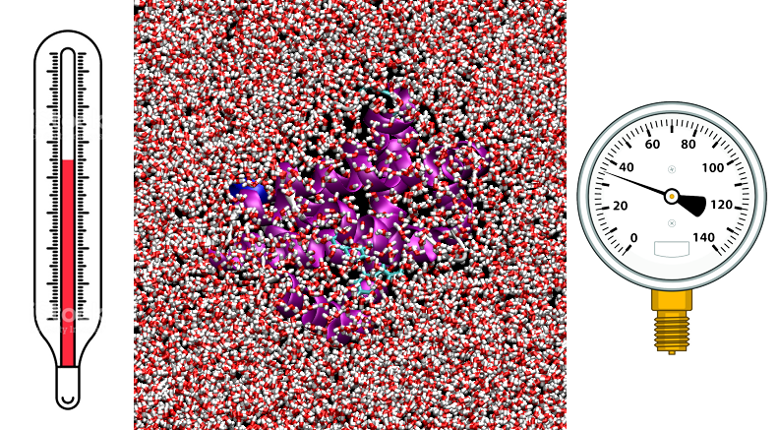
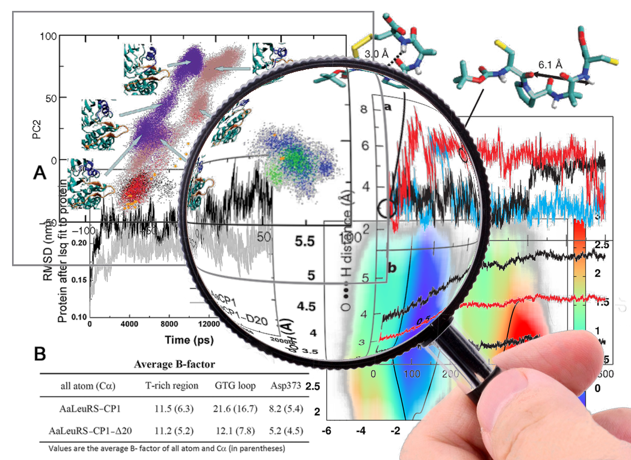
Short Trajectory MD in Orion: The Floe
Spruce
SMIRNOFF
GROMACS
2 ns

Slide 9


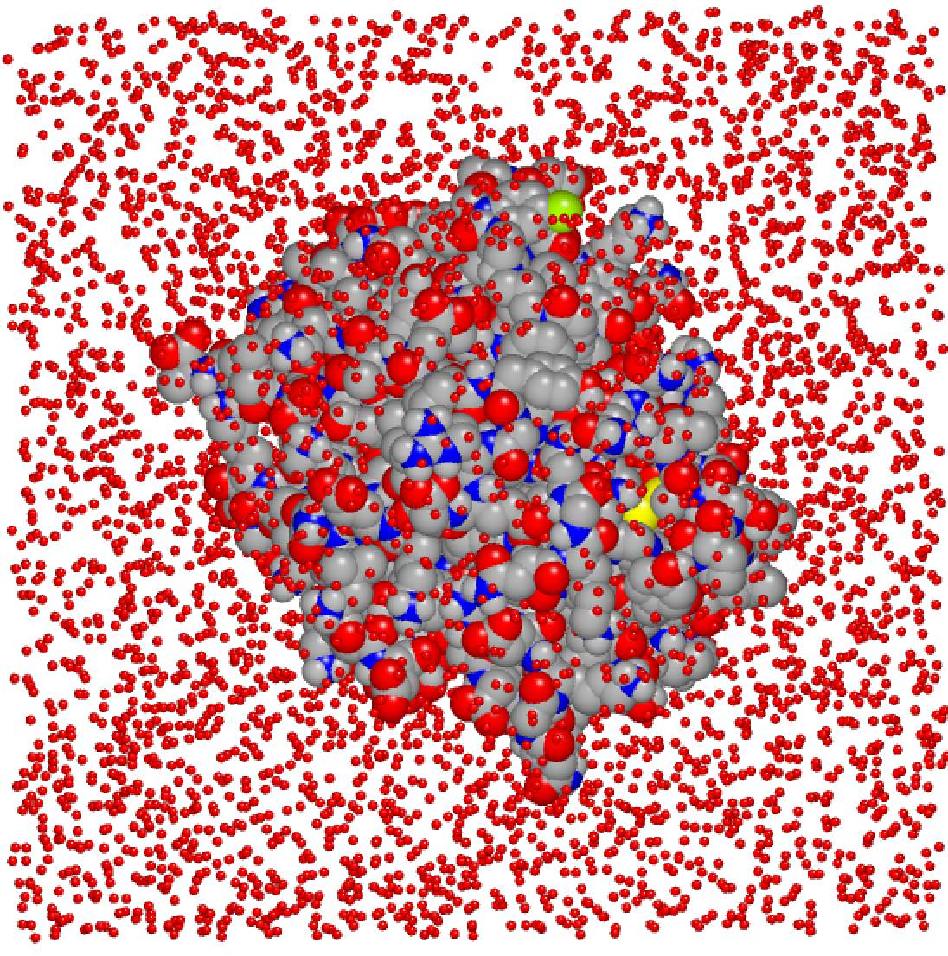
The System Parameterization Cube: SMIRNOFF
SMIRNOFF
AMBER
GROMACS
ParmEd
CHARMM
NAMD
LAMMPS
Implemented via OpenMM
Interoperability through ParmEd

Slide 10
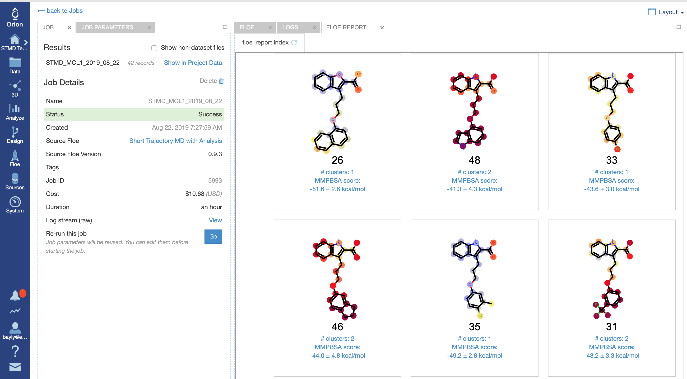
bla
MCL1 Dataset
42 ligands
J. Am. Chem. Soc. 2015, 137, 2695−2703

Slide 11
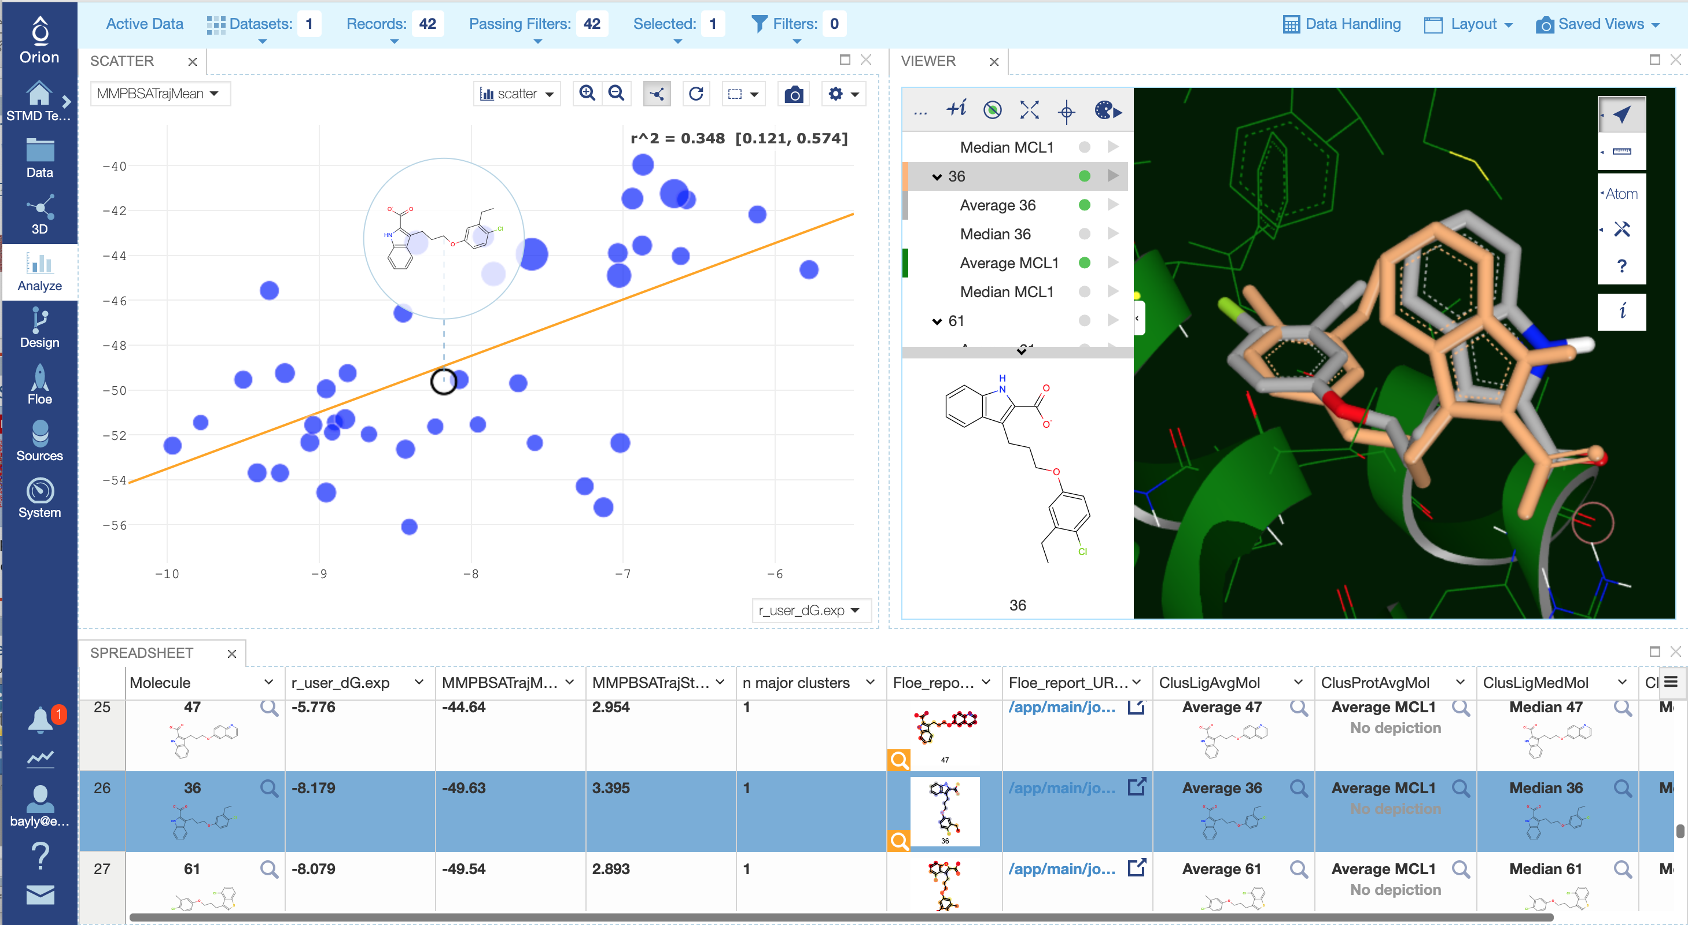
bla

Slide 12
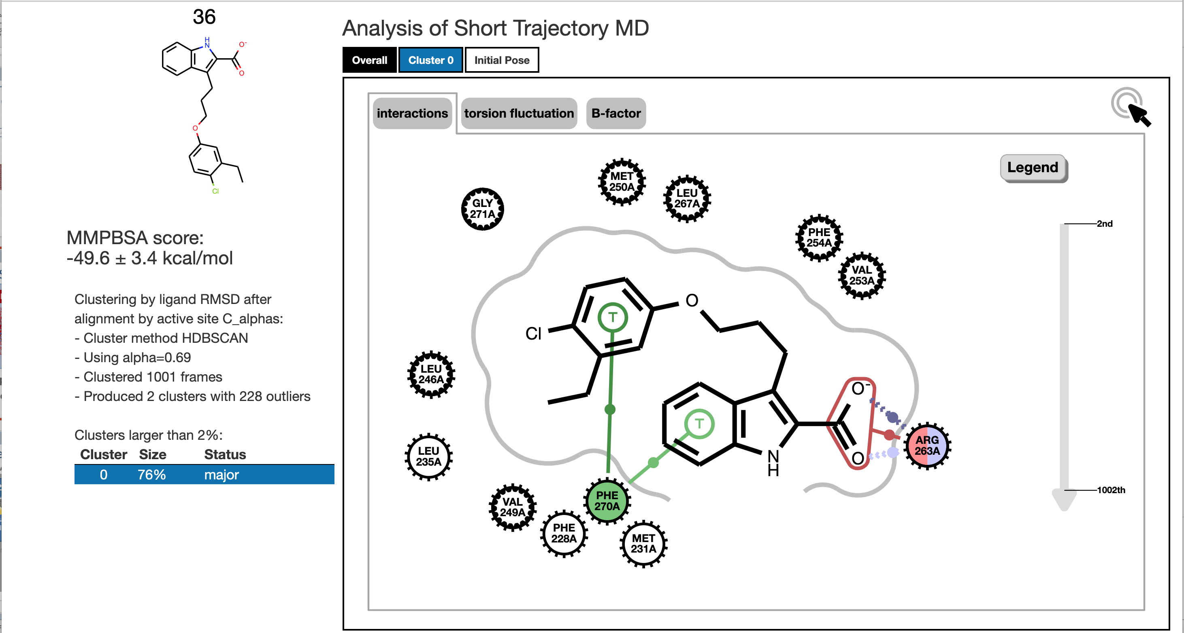
bla

Slide 13
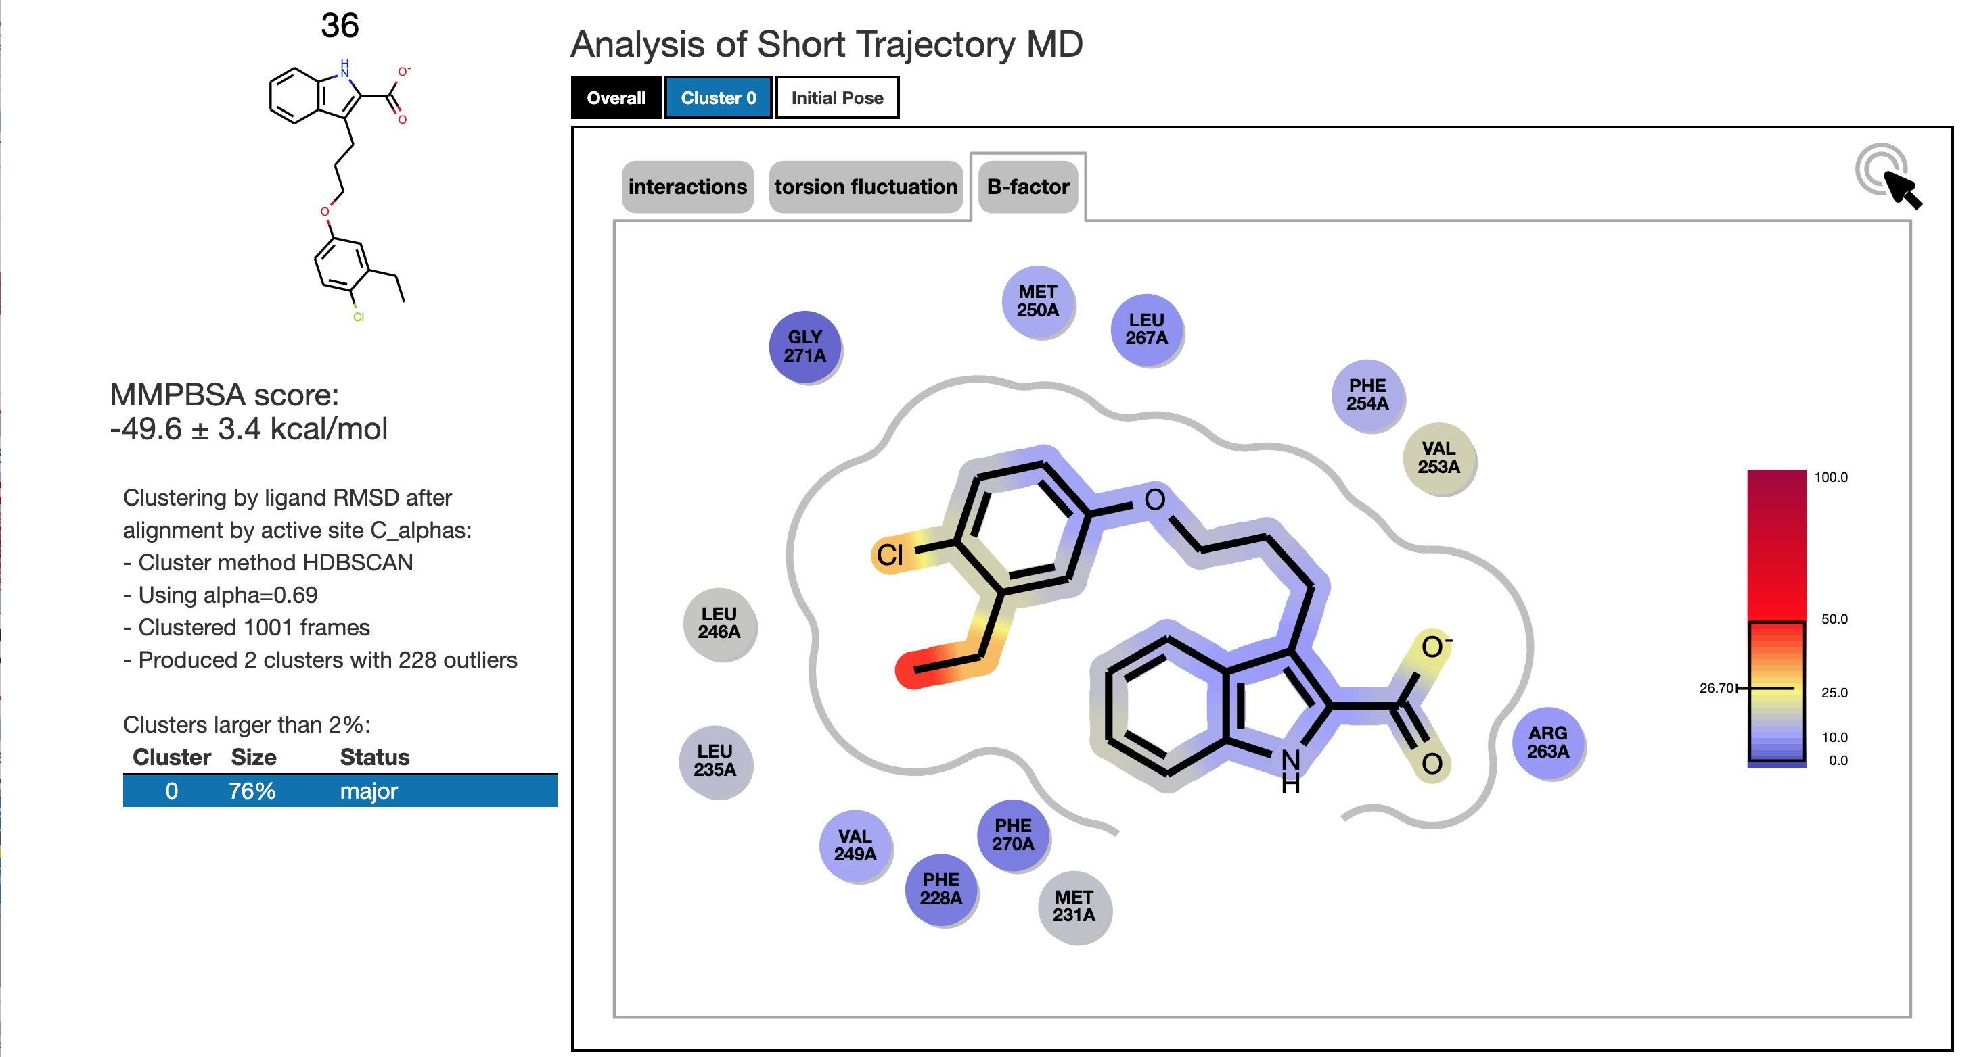
bla

Slide 14


Development: Deploying Cubes/Floes
Local
Cubes
Floes
…
Dev Iteration
Testing

Slide 15
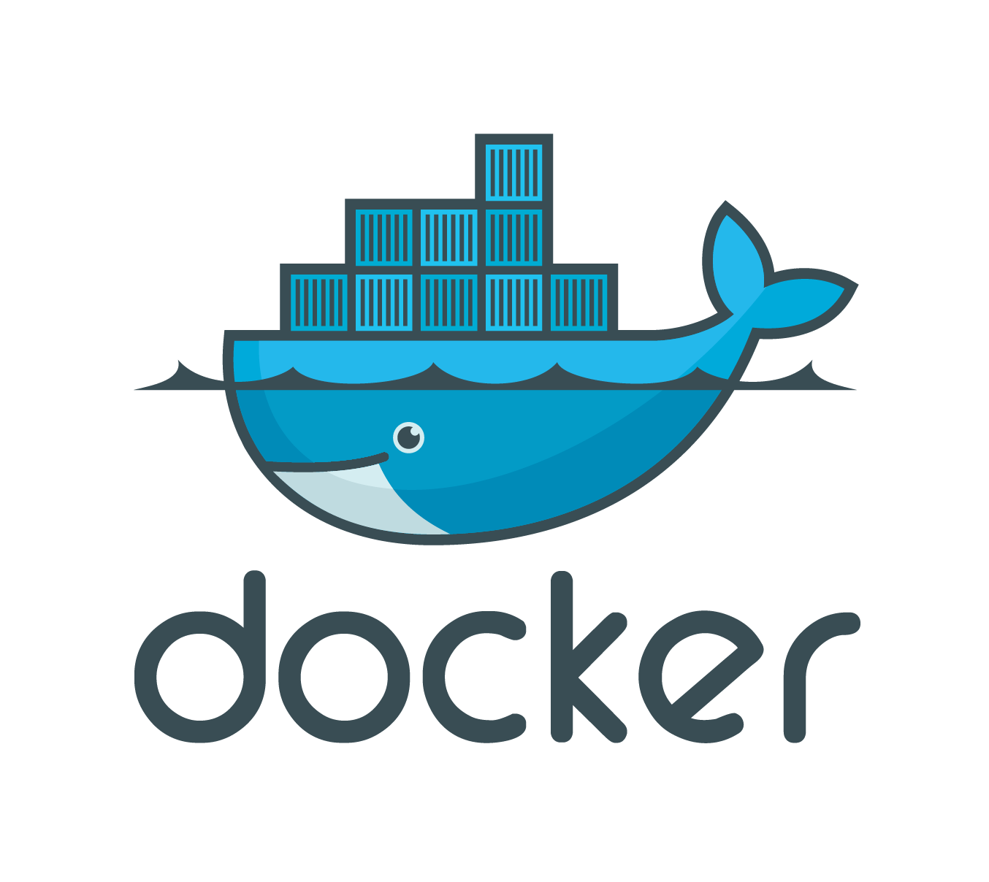

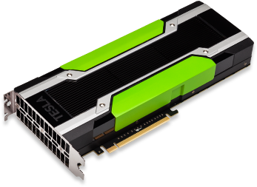
Development: Deploying Cubes/Floes
Local
Cubes
Floes
…
Build
Package
Upload
Dev Iteration
Testing

Slide 16
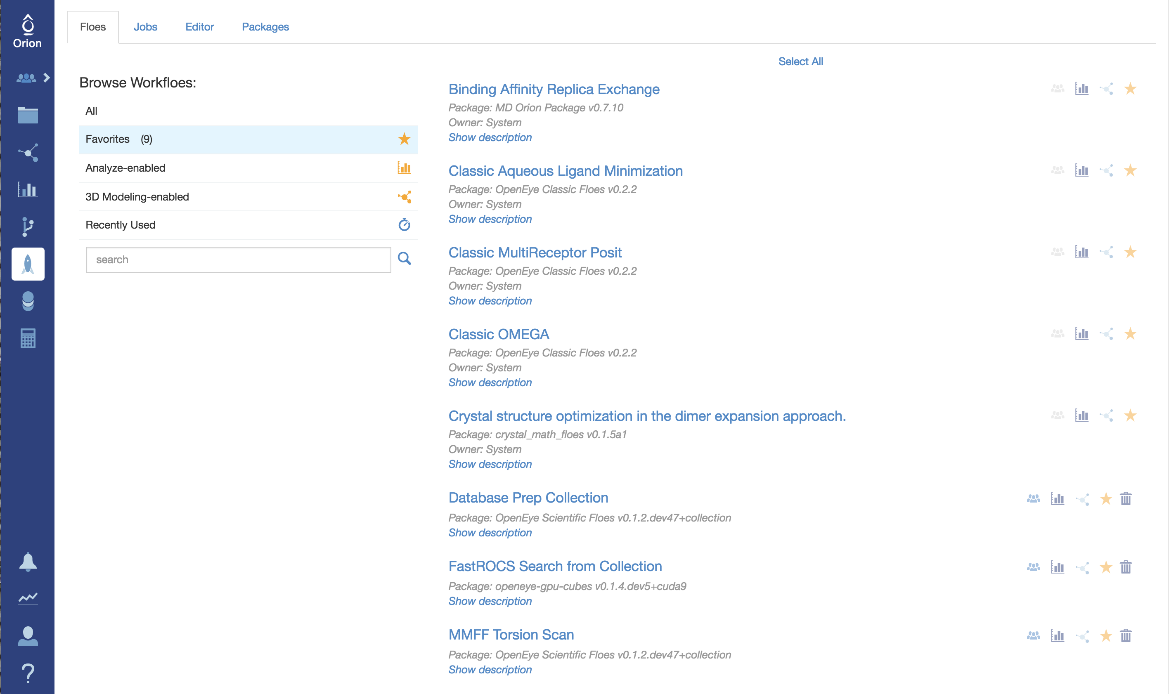
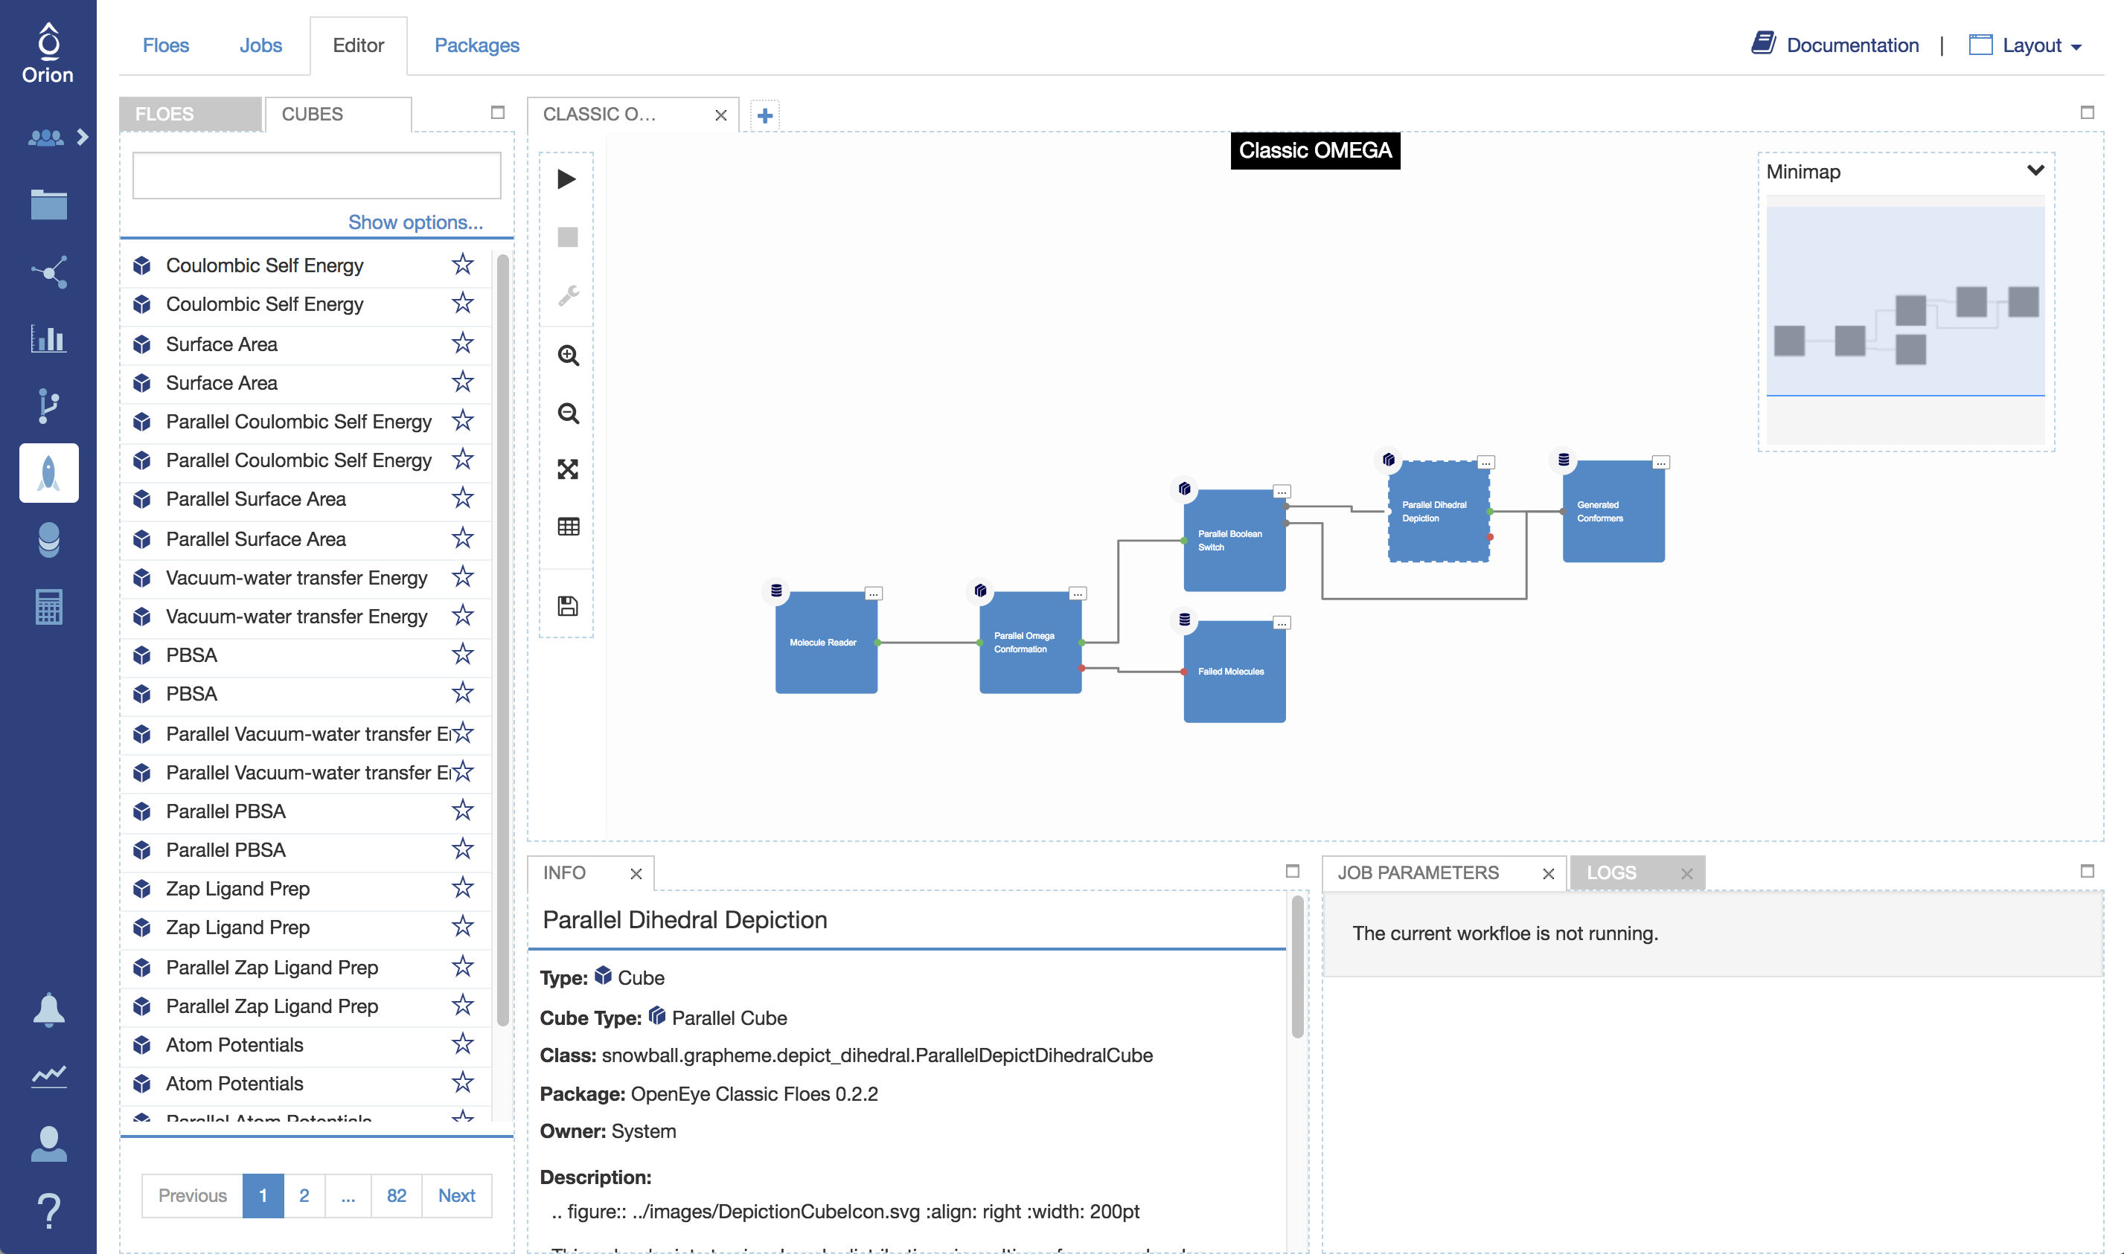
Development: Deploying Cubes/Floes
Local
Cubes
Floes
…
Floes
Build
Package
Upload
Inspect
Dev Iteration
Testing
Cubes

Slide 17
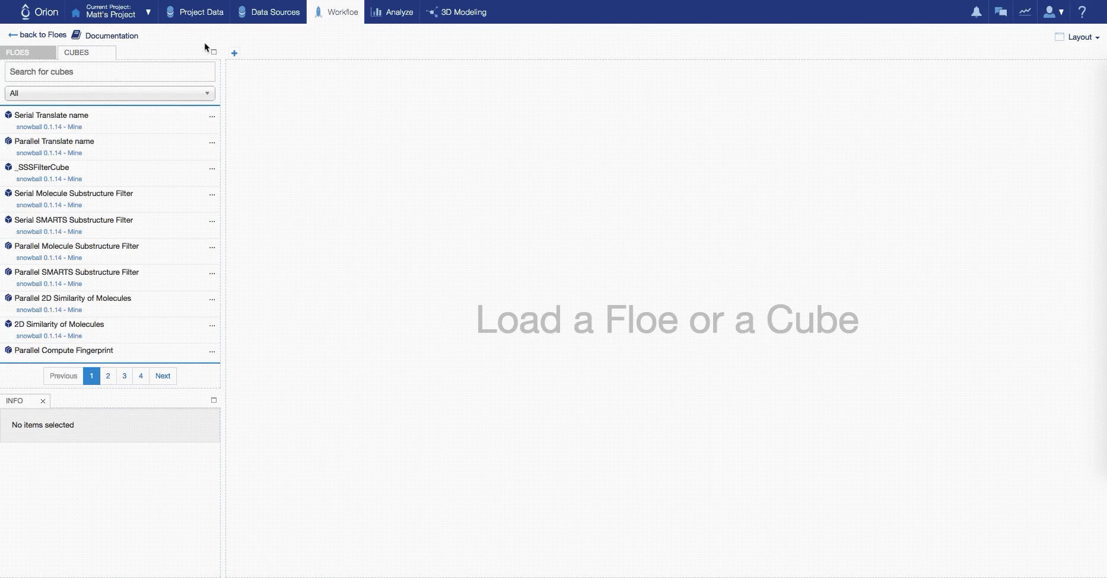
UI for Floe building

Slide 18
What is Orion doing?
Workflow Tool: Floe
Application (or FaaS)
Platform: Orion
Containers (Docker, runc, rkt, …)
Orchestrators (Kubernetes, ECS, OpenShift, …)
Distributed Consensus (Paxos/Raft)

Slide 19
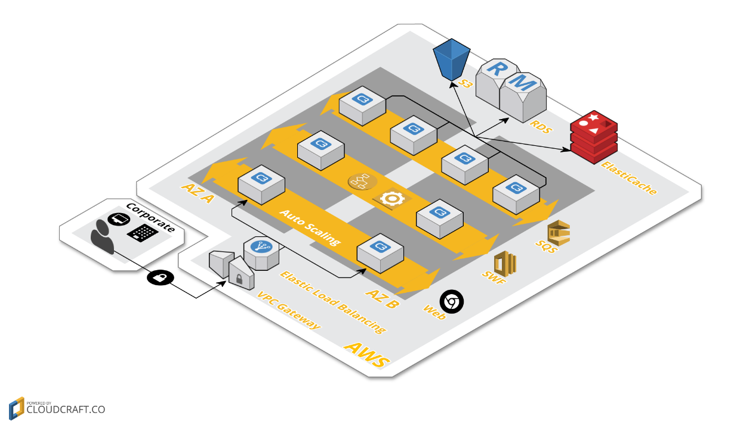
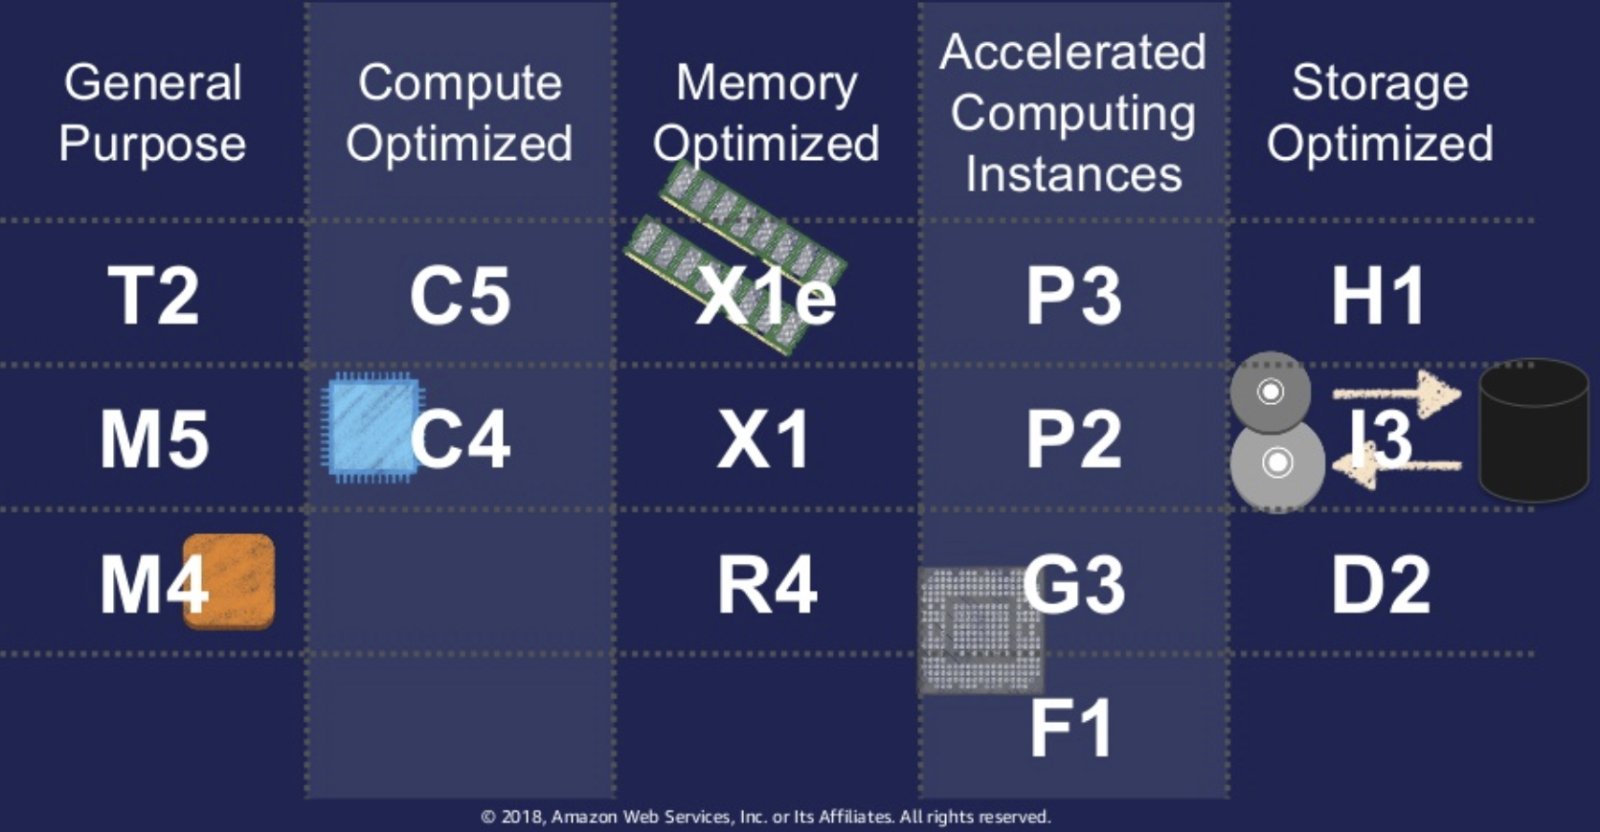
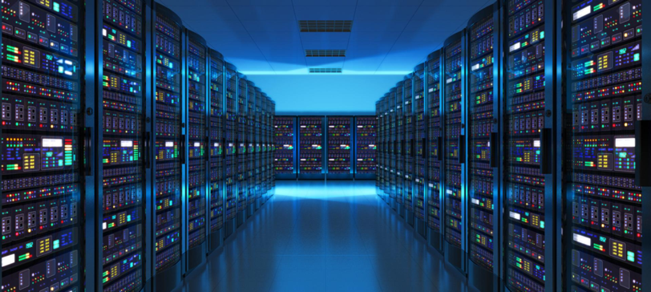
Orion weaves together Cloud Complexity

Slide 20
Scheduler/Orion Engine
Decides when/where everything in Orion runs
  Pools of Autoscaling Groups
Per-Cube
  HW requirements
  Scaling parameters
Fair Share

Slide 21
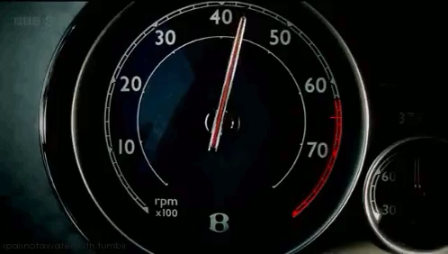
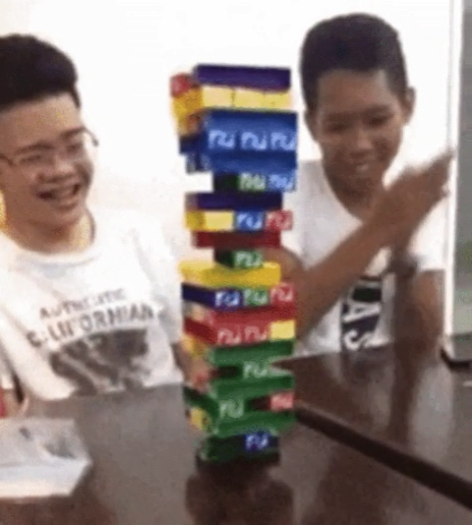

Cloud Native Computing
Scalability
  From 1 instance to 10,000’s of CPUs
    Peak usage easily managed
Elasticity
  Automatically and reliably adapt to workload
    Pay only for what you use
Fault Tolerance
  Continue operating when some components fail

Slide 22
Does Orion make our CADD world better?
Virtual Screening
  Structure-based: GigaDocking
  Ligand-based: FastRocs
Lead optimization
  Short-trajectory MD
  Large-scale torsion scan
Process
  Crystal Structure Prediction

Slide 23
GigaDocking in Orion: Enamine Real
Enamine Real : Vendor Database
  Available – ~85% in 3-4 weeks
  >200,000 reagents in stock
  137 reaction protocols
1.43 Billion stereo enumerated
  738 Million unenumerated
Ultra-large library docking for discovering new chemotypes.
Lyu et al., Nature (2019) 566, 224-229. (170 Million compounds)

Slide 24
Target: Purine Nucleoside Phosphorylase (PNPH)
142
DUD-E Actives
(Omega Confs)
1.43Billion
Real Enamine
(Omega Confs)
Docking: FRED (all defaults)
Run (Wall) Time : 24 hours
CPU Time : 47.5 Years
Max CPUs used 27K
Orion Compute Cost $12,000
FRED
Receptor
Docked Molecules
Real Enamine + Actives

Slide 25
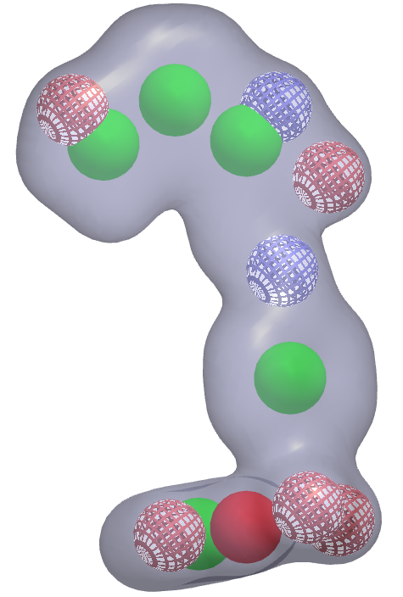
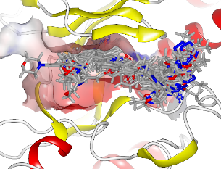
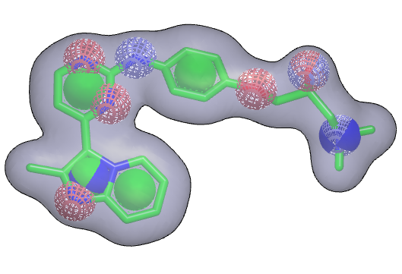
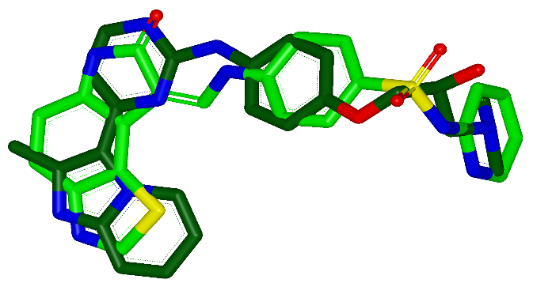
Alternative Computation: FastROCS
Docking Enamine Real
Structure Based
Runtime 24Hours
Cost : $12000
FastROCS on Enamine Real
3D Ligand Based
Runtime < 30min
Cost < $50
Enamine Real 1.43Billion
Ligand
Query
+
3D Tanimoto
Similarity

Slide 26
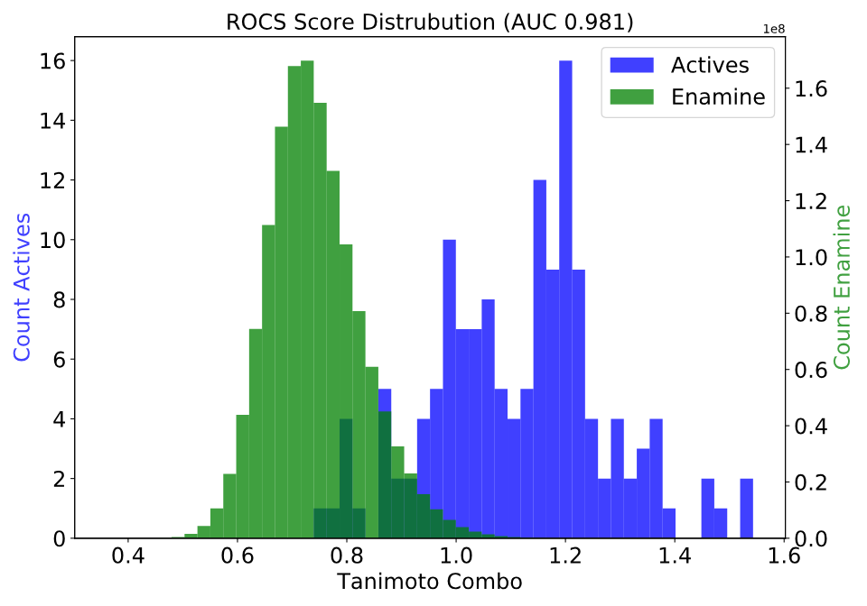
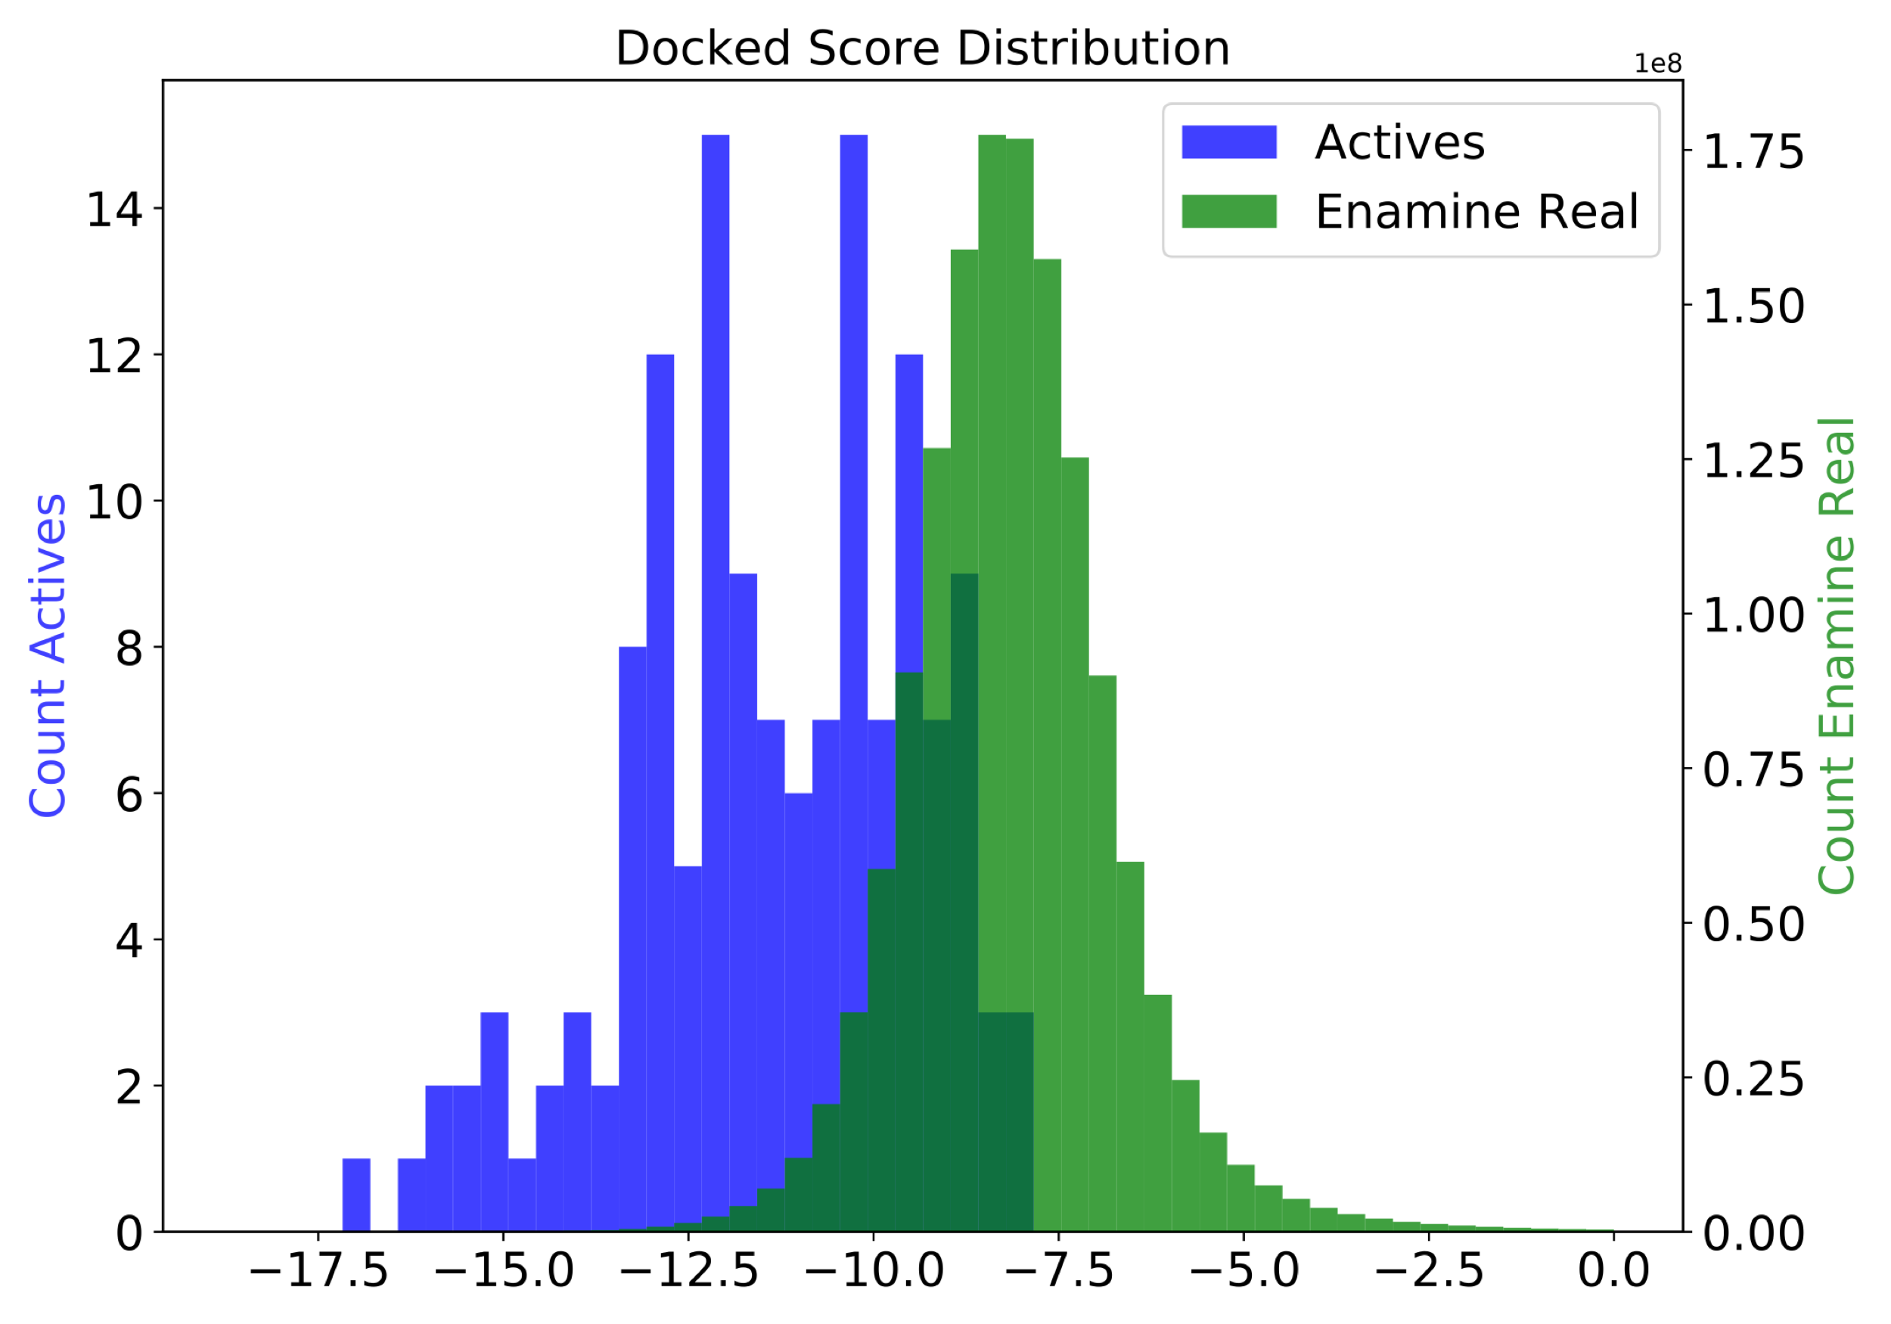
ROCS vs Docking Screening Enamine Real
ROCS - AUC 0.98
Docking – AUC 0.93
Better Scores
Better Scores
The known actives score very well for both Docking and ROCS

Slide 27
Customer + GigaDocking + Fault Tolerance
Beacon Discovery: “Routine” GigaDocking
  Enamine Real
AWS problem
  No more instances
“The process ran seamlessly without intervention…”
Carleton Sage (Beacon Discovery)

Slide 28
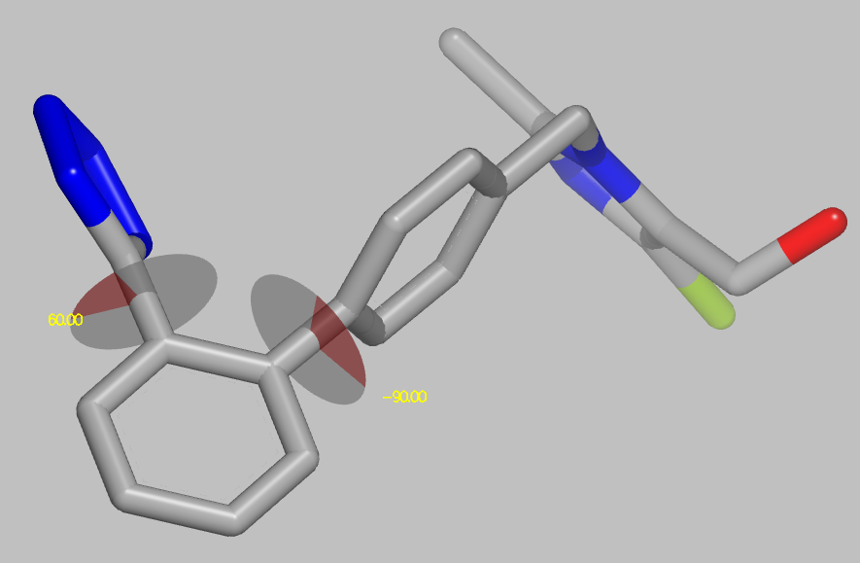
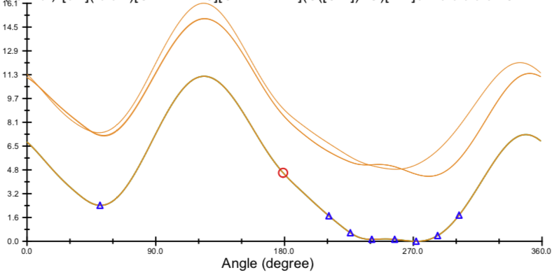
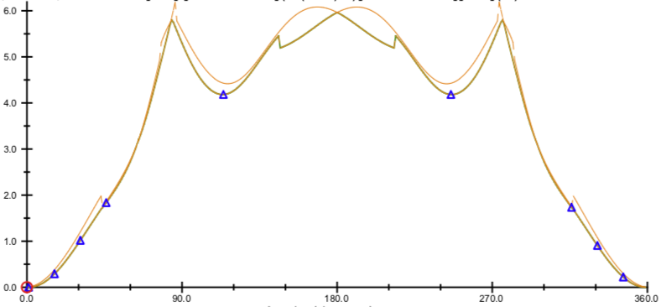
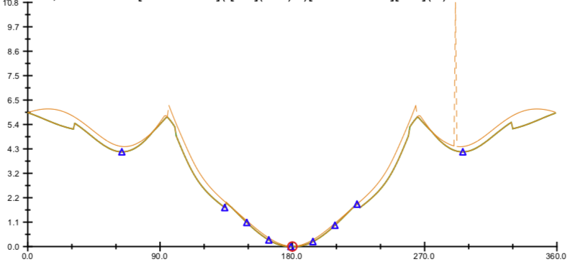
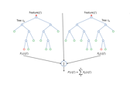



Improving torsion potentials of corporate collection
1.7M QM optimizations
Torsion Energy
Profiles
DFT
energies
100k
Torsions
5.5M
Torsion
Library
Generate
fragments
Machine learning
Torsion energy lookup
Corporate
Library
QM-level
Molecular mechanics FF
  Peak = 184,000 CPUs
  (spot market rates)
Notes:
Pfizer wanted to have broad design impact by understanding ligand strain
Molecular conformation and shape is primarily a function of the constituent energetics of the torsional degrees of freedom. Pfizer – approaching quantitative molecular mechanics FF; conventional MMFFs are qualitative

Slide 29
Pfizer take-home messages
ML >75% of molecules MAE close to DFT
  MMFF & OPLS < 50%
CSD structures have very low median strain
  0.05 kCal/M/torsion → 0.25 kCal/M (4-6 rotatable bonds)
PDB structures median strain
  0.3 kCal/M/torsion → 1.5 kCal/M
  Better resolution structures have lower strain
Vishnu Sresht, Brajesh Rai & Greg Bakken (Pfizer)
Notes:
1. Three pieces of data that show Pfizer got the value/insight they were hoping for.

Slide 30
Large-scale Ligand-based screening at AZ
Estimate of 10¹⁵ AZ accessible compounds
  Frameworks, reactions, reagents
How large a library could be enumerated?
How many could be searched in 3D?
Currently: 10¹⁰ molecules, 10¹¹ conformers
Goal: 10¹² molecules, 10¹³ conformers
Christoph Grebner
Notes:
1. Focus rest of the talk on AZ’s large scale project was about 3D searching very large virtual library

Slide 31
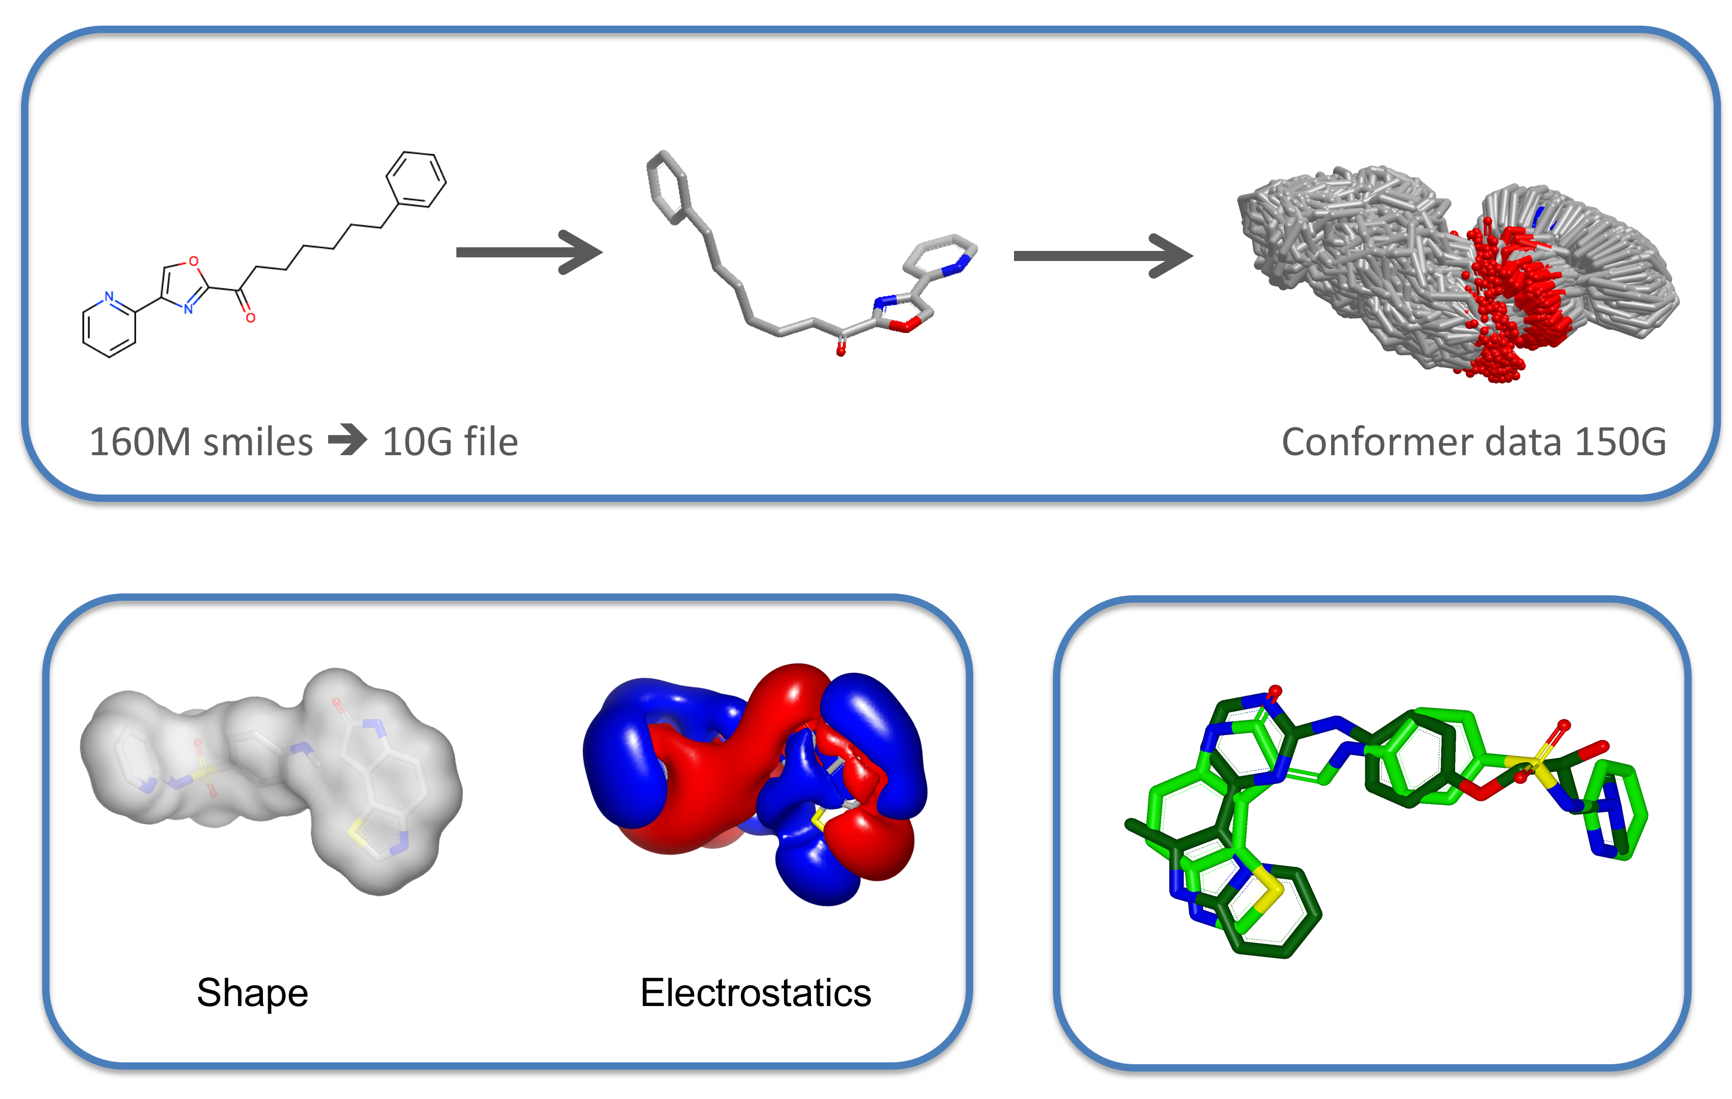
Enumerated Omega & ROCS at Scale 1x10⁸⁻¹⁰
Notes:
This slide is for anyone not familiar with OE.
Our 3D searching involves generating an ensemble of conformers, comparing their shape & electrostat

Slide 32

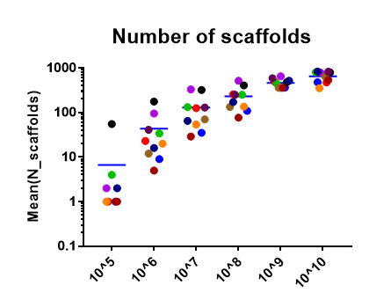
More scaffolds with larger libraries
12 project
1400 libraries
10000 hits
How big is big enough?
Christoph Grebner, AZ
Notes:
WHAT value do you get & IS bigger better

Slide 33
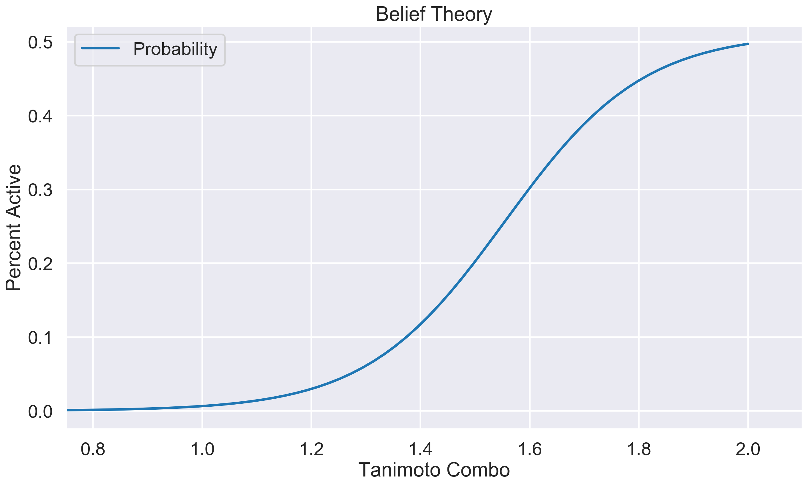
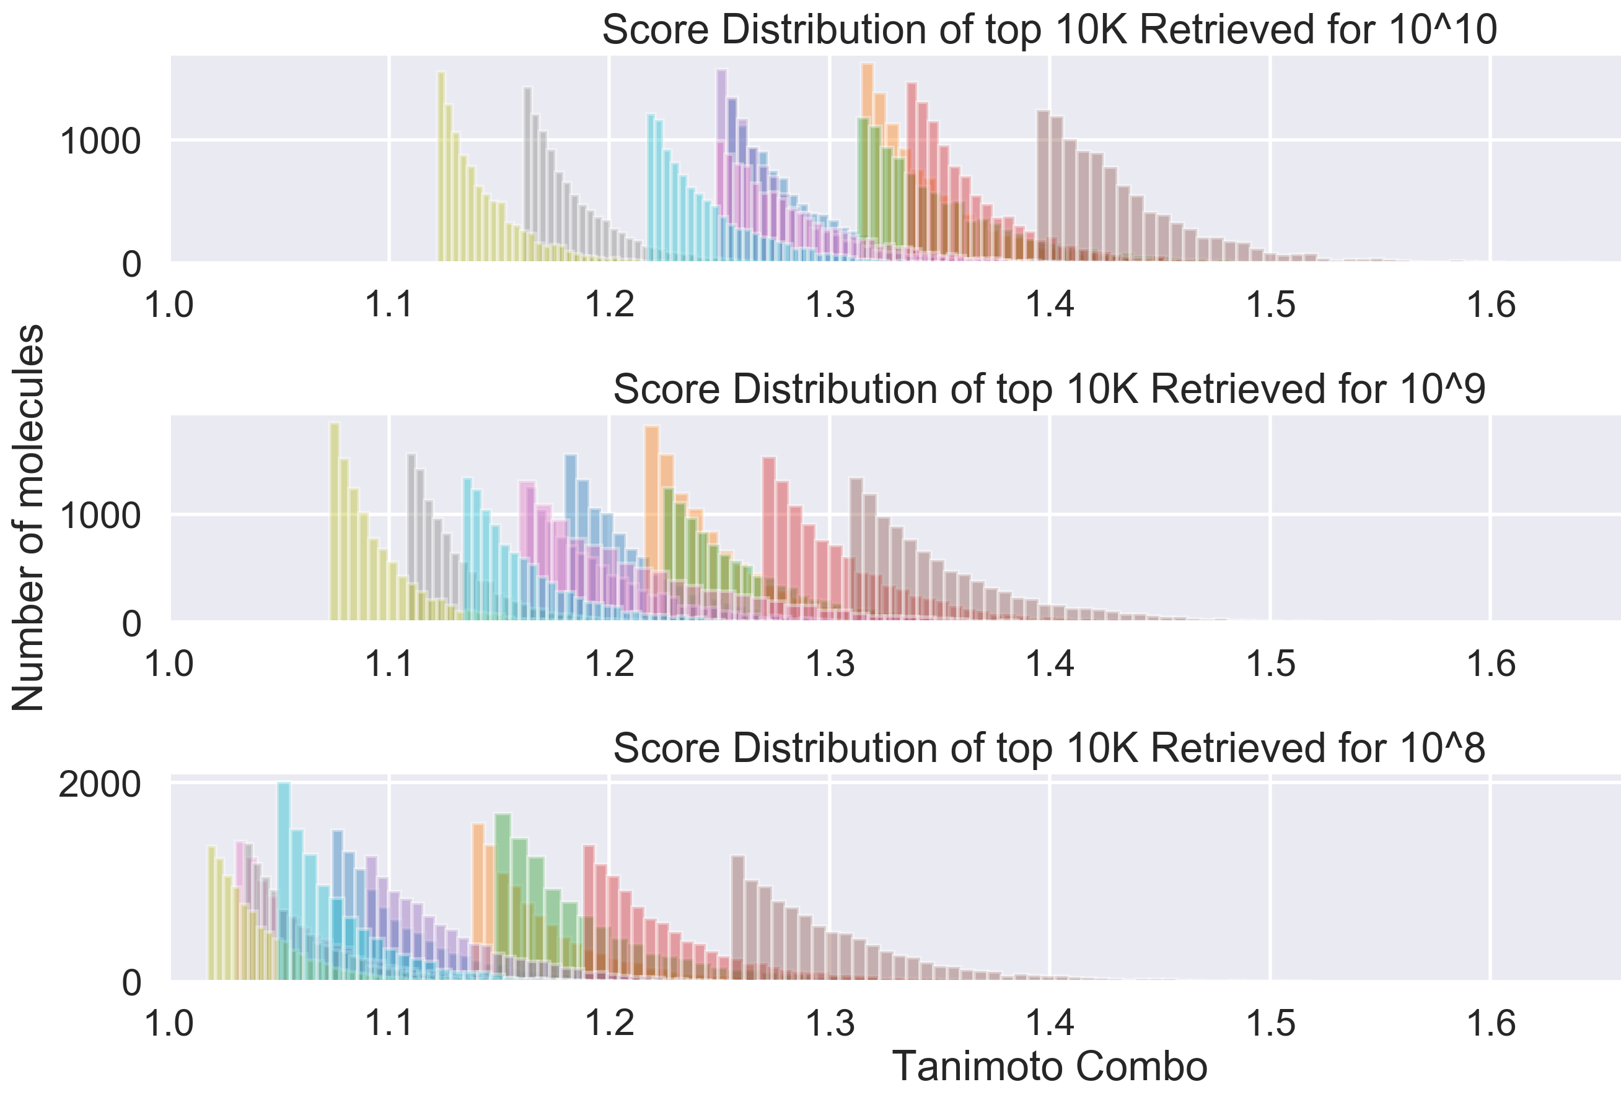
Hit distributions from top 10K of 10⁸, 10⁹, 10¹⁰
Muchmore et al, JCIM, 2008, 49:941, personal communication
Swann et al, JMD, 2011, 54:1223
Notes:
Now we can estimate the advantage of larger databases

Slide 34
Hit distributions from top 10K of 10⁸, 10⁹, 10¹⁰
Muchmore et al, JCIM, 2008, 49:941, personal communication
Swann et al, JMD, 2011, 54:1223
Notes:
Now we can estimate the advantage of larger databases

Slide 35
Hit distributions from top 10K of 10⁸, 10⁹, 10¹⁰
Muchmore et al, JCIM, 2008, 49:941, personal communication
Swann et al, JMD, 2011, 54:1223
Notes:
Now we can estimate the advantage of larger databases

Slide 36
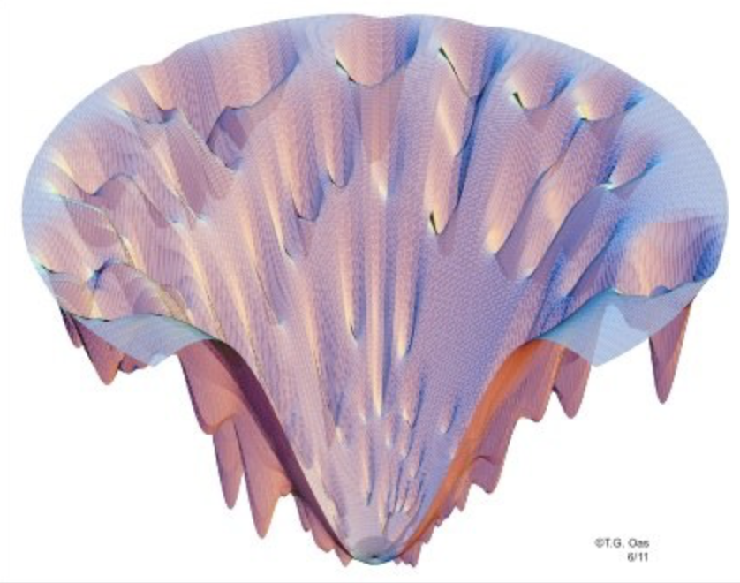
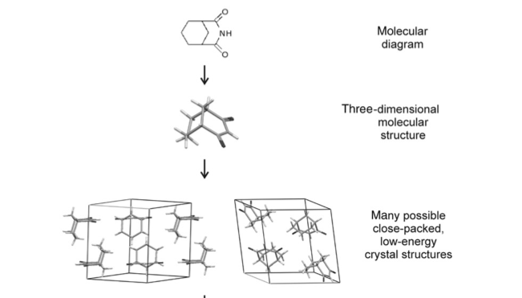
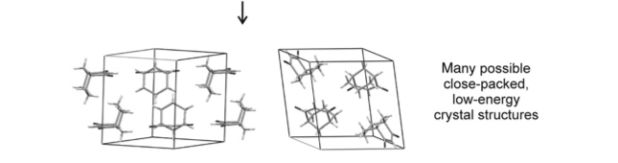
Crystal Structure Prediction
Start with 2D structure
(10-100)
Conformer generation
Rigid packing -> FF minimization -> FF ranking
(10⁵-10⁶)
Re-rank top FF packings using QM
(100)

Slide 37
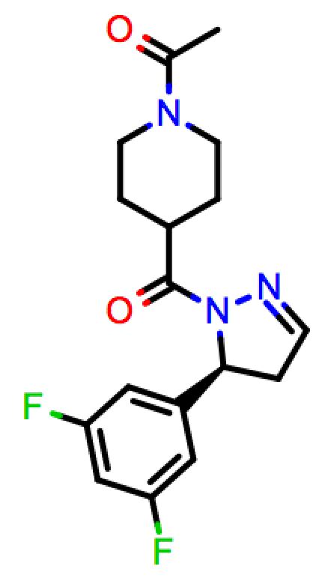
OE-GSK 1st Blind Prediction Challenge
Conformers
200
Pack
4 million packings
Optimize
IEFF optimization
Overall:
7 CPU years
22 hours wall time
Score
IEFF scoring
Re-optimize
Top 100 IEFF packings
IEFF@LR + DFT@SR
Re-score
Rank = 1, RMS_20 = 0.18 A

Slide 38
Orion: a Serverless Cloud platform for CADD
“Workfloes” built from “cube” components
  Pre-existing floes
  Build your own floes from existing cubes
  Write your own cubes (3rd-party software)
Cloud power made easy
  Scalability, elasticity, fault tolerance
We can do a lot now… but we have only just begun!
Notes:
Overhaul necessary to provide fuller development capabilities.
Continue to make Orion your new cloud computer

Slide 39
Thank You
Openeye colleagues
Academic collaborators: Chodera Lab, Mobley Lab
Clients: Pfizer, AstraZeneca, GSK, Beacon Discovery

Slide 40
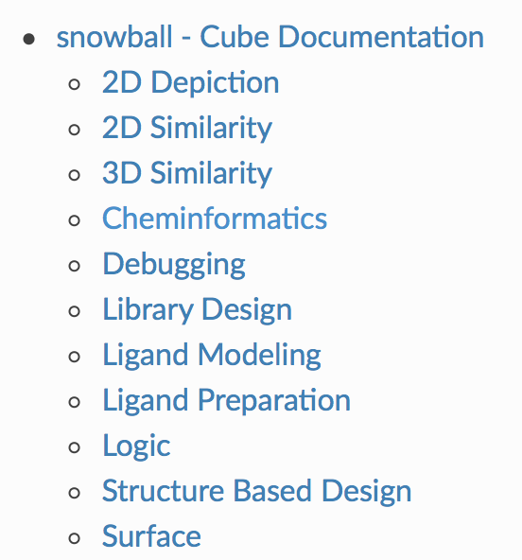
OpenEye Building Blocks
OE Cubes Library
“Classic” Floes
Large Scale LBVS
DB Prep, Torsion Scanning
MD Floes
Crystal Math Floes
Import/Export Floes (ETL)

Slide 41
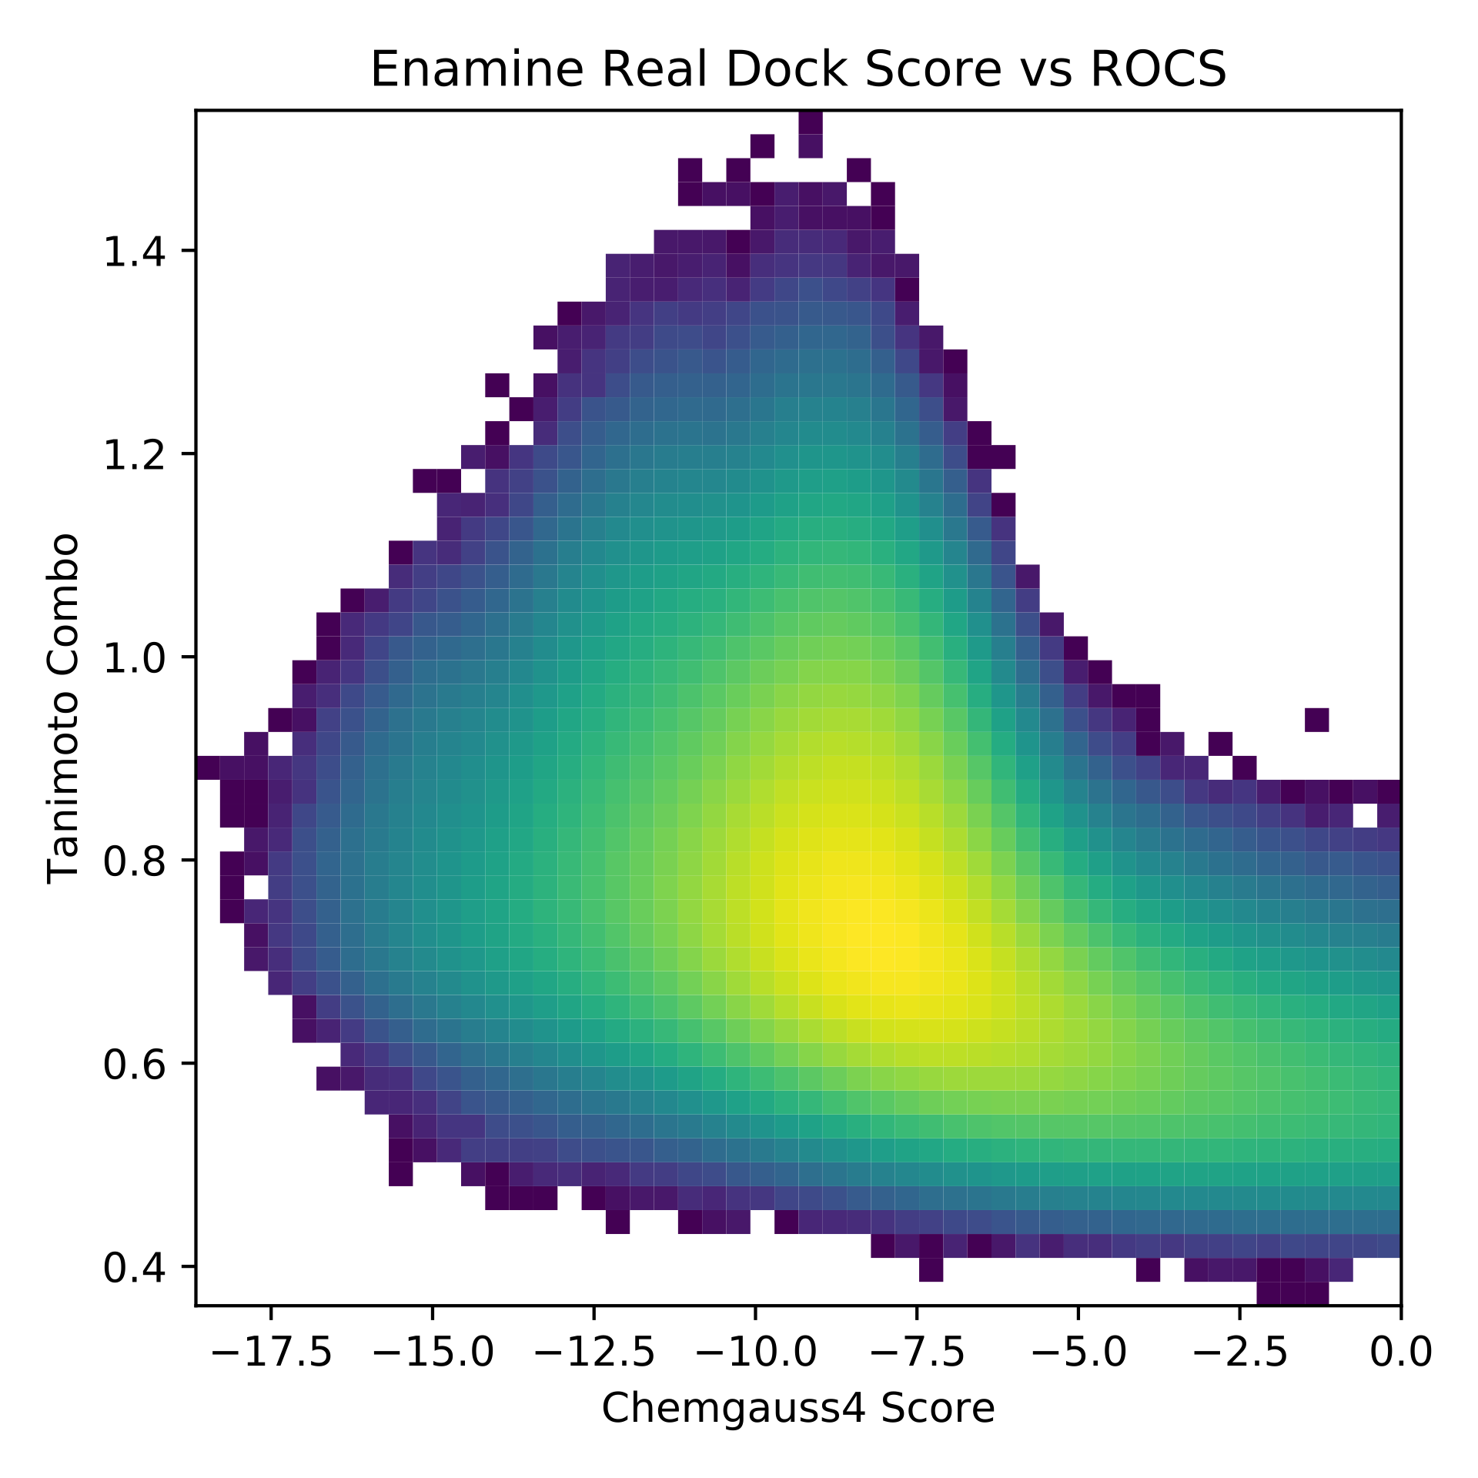
Docking and ROCS Find Different Molecules
Better ROCS Scores
Better Docking Scores

