Slide 1
Reproducible research workflows with
Bio
Sim
Space
Julien Michel
EaStCHEM School of Chemistry, University of Edinburgh
D3R 2019 workshop, San Diego – 23/08/19

Slide 2
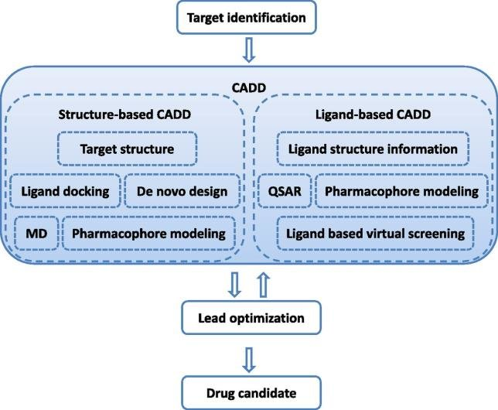
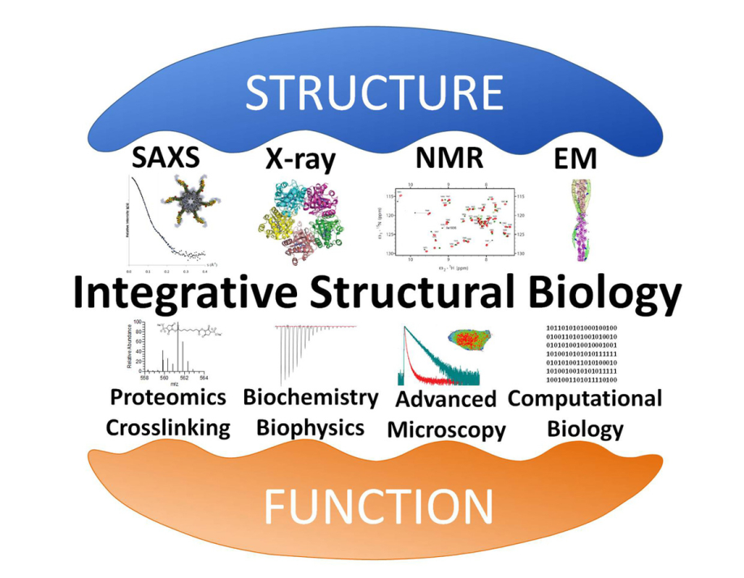
The field of biomolecular simulations faces challenges
Current scientific drivers require combining multiple tools together
CADD
Integrative structural biology
Pharmacological Reviews January 2014, 66 (1) 334-395
https://www.phd-structural-biology.at/about-us/about-us.html

Slide 3
But our tools lack interoperability
Within the field
With related fields
GROMACS
AMBER
CHARMM
RDkit
Rosetta
CCP4
Tensor
flow
CASTEP

Slide 4
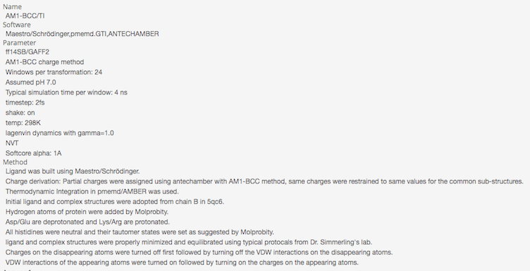
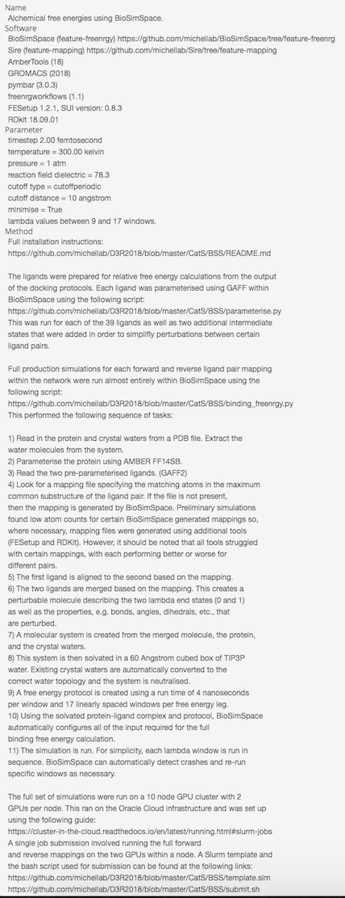
We lack standards for sharing data & best-practices
D3R submission protocol
D3R submission protocol
Standards for reporting protocols vary widely
e.g. D3R submissions
Practitioners are often unaware of key decisions made that influence reproducibility
Implementation details (integrator, thermostat, …)
Version of the software used
Execution environment

Slide 5
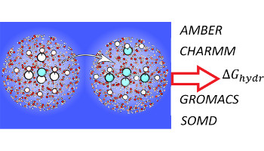
This represents an enormous cost for the field
A personal story
Consequences
We waste time re-implementing similar algorithms in different packages
We do not know why our methods work when they do, leading us to chase the wrong problems
Industry has to invest significant efforts to replicate academic work and embed code in R&D processes
4 groups
3 years
Endless confusions
Loeffler et al. JCTC, 14, 5567- 5582, 2018

Slide 6
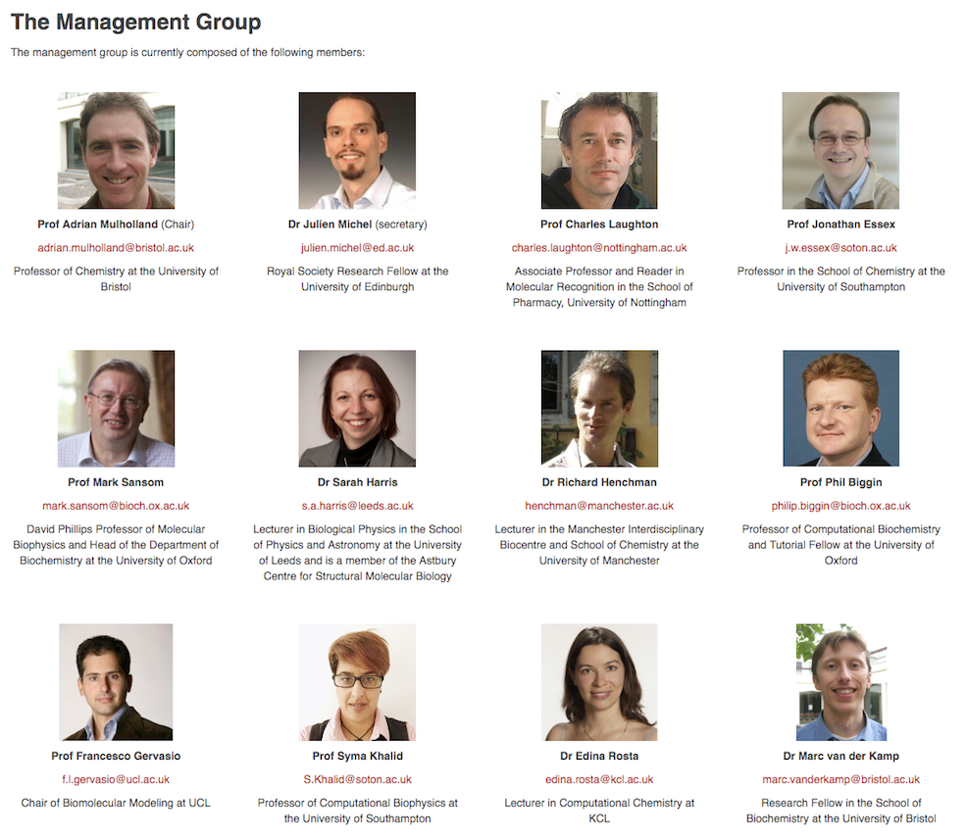
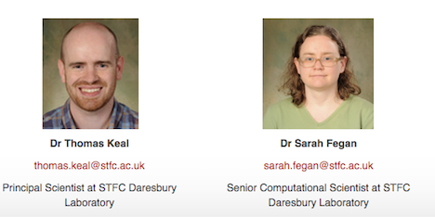
CCPBioSim is working on improving practices
http://www.ccpbiosim.ac.uk

Slide 7
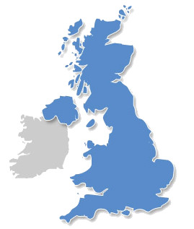
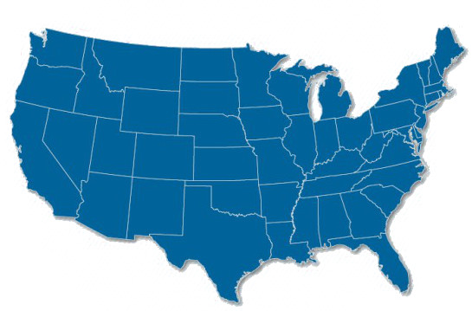
BioSimSpace is CCPBioSim’s flagship software project
Vision→ ‘’An ecosystem of easily sharable and interoperable workflow components that can be assembled into robust, reproducible research workflows’’
Bio
Sim
Space
Julien Michel
Edinburgh
Michael Shirts
U Colorado
John Chodera
MSKCC
Charlie Laughton
Nottingham
Cresset
Syngenta
MolSSI
Chris Woods &
Adrian Mulholland
Bristol
Francesco Gervasio
UCL
Mike Gilson &
Rommie Amaro
San Diego
Evotec

Slide 8
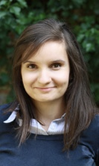
BioSimSpace developers
Antonia Mey
Researcher Co-Investigator
University of Edinburgh
Lester Hedges
Research Software Engineer
University of Bristol

Slide 9
The software problem we aim to address
FESetup
pmemd.cuda
ligandswap
pymbar
antechamber
MDAnalysis
gmx
PyEMMA
charmm
ProtoMS
Difficult to know what exists, or how to plug existing tools into a workflow – lack of interoperability
Result - Lots of bespoke and brittle workflows

Slide 10
We take a bottom-up approach to interoperability
FESetup
pmemd.cuda
ligandswap
pymbar
antechamber
MDAnalysis
gmx
PyEMMA
charmm
ProtoMS
Work with the existing formats and software we have
Make it easier for this software to plug together
Make it easier to translate one format into another
Make it easier to write the “shims”

Slide 11
BioSimSpace’s design philosophy
1. Read and write
pdb, parm7, rst7, gro, mol2
pdb, parm7, rst7, gro, mol2
Bio
Sim
Space
2. Information is preserved
3. Don’t be too clever
Don’t add hydrogens, or automatically assume pH
4. Don’t change anything
do some stuff
5. Units are important
6. Store general /write specific
Everything is stored in an internal ‘system’
7. Don’t assume ask!
Understandable error messages and ask for missing things!

Slide 12
Prototype scripts in a Jupyter notebook
Works out that input is an Amber file format
Works out what best MD engine is available locally to apply the protocol to the system
Saved in same file format as input

Slide 13
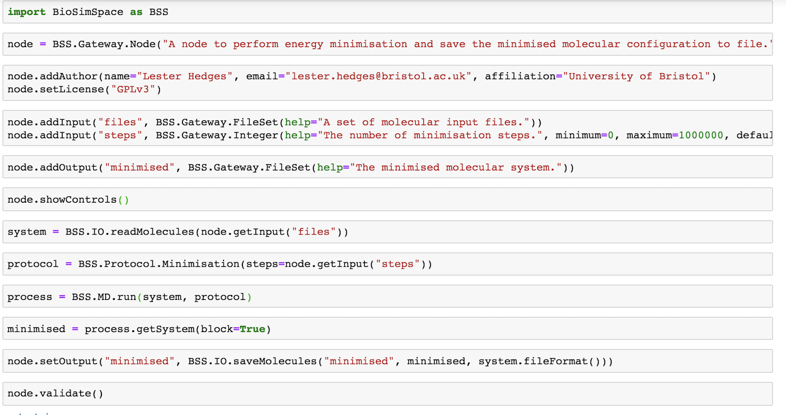
Turn the notebook into a BSS node
Specify what the input and outputs are
Validate that the node completed without errors

Slide 14
BSS nodes are portable across execution environments
Execute node from within Jupyter
Export as a python script and run from the command line
Execute the node from within a python script
Execute the node in KNIME via Python extension (beta)

Slide 15
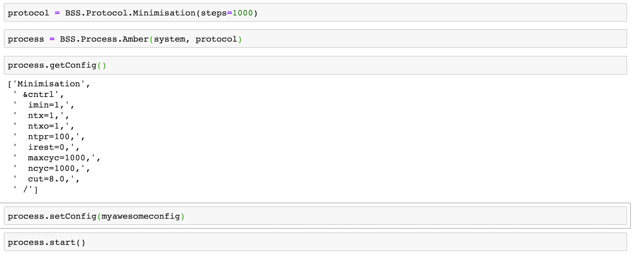
BSS nodes capture best practices
Default ‘best practices’ protocol
translated into config parameters for the specific MD engine picked
Default config may be overridden by power users

Slide 16
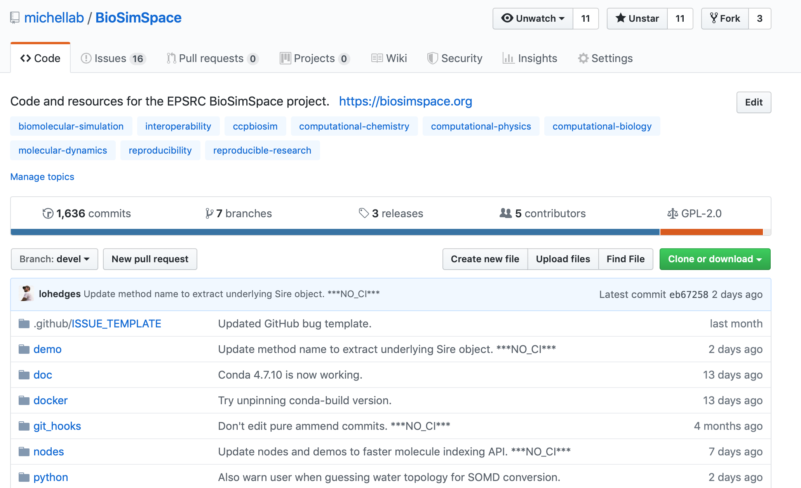
BSS is an open development project
https://github.com/michellab/BioSimSpace/

Slide 17
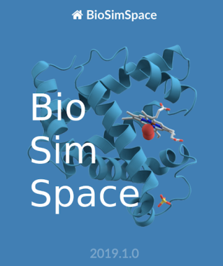
Try BioSimSpace yourself
Read the docs website
http://www.biosimspace.org
conda install –c conda-forge –c omnia –c michellab/label/dev/biosimspace
JupyterHub server
notebook.biosimspace.org

Slide 18
BioSimSpace demo
Hydration free energy calculation setup
notebook.biosimspace.org
demo/hydration_freenrg.ipynb

Slide 19
Developing with BSS: assemble nodes into workflows
Example: a binding free energy pipeline
Parameterise
Combine
Solvate
Equilibrate
benzene.mol2
lyzozyme.pdb
Parameterise
prepareFEP
o-xylene.mol2
Parameterise
Combine
Solvate
Equilibrate
Run Free Energy
Analyse Free Energy
leap
antechamber
gmx solvate
pmemd
pymbar
analyse_freenrg
rdkit
SOMD
gmx

Slide 20
Developing with BSS: assemble nodes into workflows
Specify or auto-detect an implementation
Parameterise
(gaff)
Combine
Solvate
(TIP3P)
Equilibrate
(AMBER)
benzene.mol2
lyzozyme.pdb
Parameterise
(ff14sb)
prepareFEP
(rdkit)
o-xylene.mol2
Parameterise
(gaff2)
Combine
Solvate
(TIP3P)
Equilibrate
(AMBER)
Run
(SOMD)
Analyse
(MBAR)
leap
antechamber
QUBE
TK
gmx solvate
pmemd
pymbar
analyse_freenrg
rdkit
SOMD
gmx

Slide 21
Developing with BSS: assemble nodes into workflows
Change the MD simulation engine
Parameterise
(gaff)
Combine
Solvate
(TIP3P)
Equilibrate
(AMBER)
benzene.mol2
lyzozyme.pdb
Parameterise
(ff14sb)
prepareFEP
(rdkit)
o-xylene.mol2
Parameterise
(gaff2)
Combine
Solvate
(TIP3P)
Equilibrate
(AMBER)
Run
(GROMACS)
Analyse
(MBAR)
leap
antechamber
QUBE
TK
gmx solvate
pmemd
pymbar
analyse_freenrg
rdkit
SOMD
gmx

Slide 22
Developing with BSS: assemble nodes into workflows
Change the free energy analysis
Parameterise
(gaff)
Combine
Solvate
(TIP3P)
Equilibrate
(AMBER)
benzene.mol2
lyzozyme.pdb
Parameterise
(ff14sb)
prepareFEP
(rdkit)
o-xylene.mol2
Parameterise
(gaff2)
Combine
Solvate
(TIP3P)
Equilibrate
(AMBER)
Run
(GROMACS)
Analyse
(TI)
leap
antechamber
QUBE
TK
gmx solvate
pmemd
pymbar
analyse_freenrg
rdkit
SOMD
gmx

Slide 23
Developing with BSS: assemble nodes into workflows
Change the setup pipeline
Parameterise
(qube)
Combine
Solvate
(TIP3P)
Equilibrate
(AMBER)
benzene.mol2
lyzozyme.pdb
Parameterise
(ff14sb)
prepareFEP
(rdkit)
o-xylene.mol2
Parameterise
(qube)
Combine
Solvate
(TIP3P)
Equilibrate
(AMBER)
Run
(GROMACS)
Analyse
(TI)
leap
antechamber
QUBE
TK
gmx solvate
pmemd
pymbar
analyse_freenrg
rdkit
SOMD
gmx

Slide 24
Example: TYK2 benchmarks
 | Cresset/ UoE SOMD (1) | FEP+ (2) | AMBER18 (3)
R | 0.87±0.02 | 0.89±0.07 | 0.57
MUE [kcal/mol] | 0.6±0.04 | 0.75±0.11 | 1.07
(1) Unpublished
(2) Schrodinger JACS 2-15
(3) AMBER JCIM 2019
Different pipelines
Input prep
Perturbation network
Forcefield
Simulation engine
Free energy estimator
Statistical analysis
What have we learned?

Slide 25
Benchmarking TYK2 with BSS
engine=‘GROMACS'
R = 0.91±0.02
MUE = 0.76±0.04 kcal/mol
R = 0.91±0.02
MUE = 0.67±0.05 kcal/mol
R = 0.92±0.02
MUE = 0.48±0.06 kcal/mol

Slide 26
Example: TYK2 benchmarks
 | Cresset/ UoE SOMD | FEP+ | AMBER18 | BSS SOMD | BSS Gromacs
R | 0.87±0.02 | 0.89±0.07 | 0.57 | 0.91±0.02 | 0.91±0.02
MUE [kcal/mol] | 0.64±0.04 | 0.75±0.11 | 1.07 | 0.67±0.05 | 0.76±0.05
Same pipeline
Only changed execution engine
ca. 0.5 kcal/mol limit to ‘protocol reproducibility’
No significant difference in predictive power between these two simulation engines

Slide 27
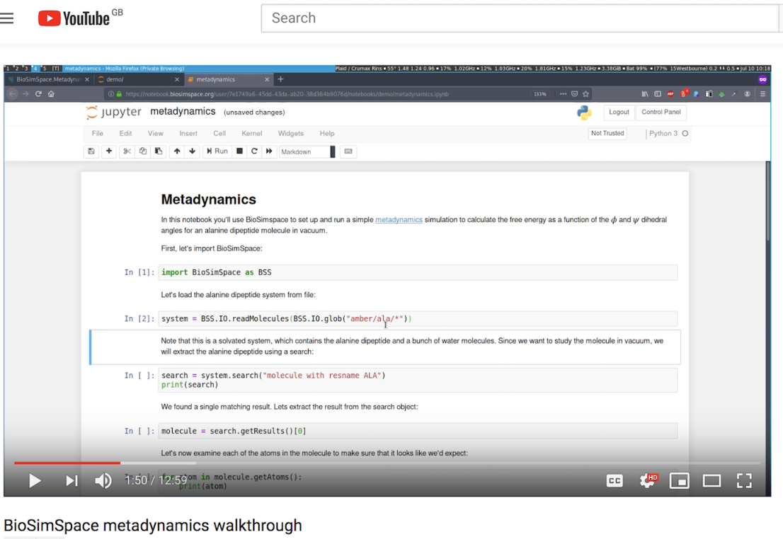
BioSimSpace supports other use cases beyond AFE
e.g. Metadynamics walkthrough
https://www.youtube.com/watch?v=iJ61TBVrT4Y

Slide 28
The future of BioSimSpace
Capturing best practices and distributing reproducible workflows
Benchmarking free energy methods with fully automated pipelines
Prototyping advanced FEP workflows
Validating interoperability with other workflow components/projects
Grow BSS nodes library with new functionality to address other scientific drivers put forward by the community
Setup
Simulate
Analyse

Slide 29
Questions?
Get in touch with me or Antonia Mey if you’d like a more detailed walkthrough or hands-on demo during D3R/ACS/OpenFF meetings
antonia.mey@ed.ac.uk

