Slide 1


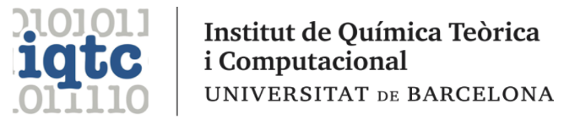
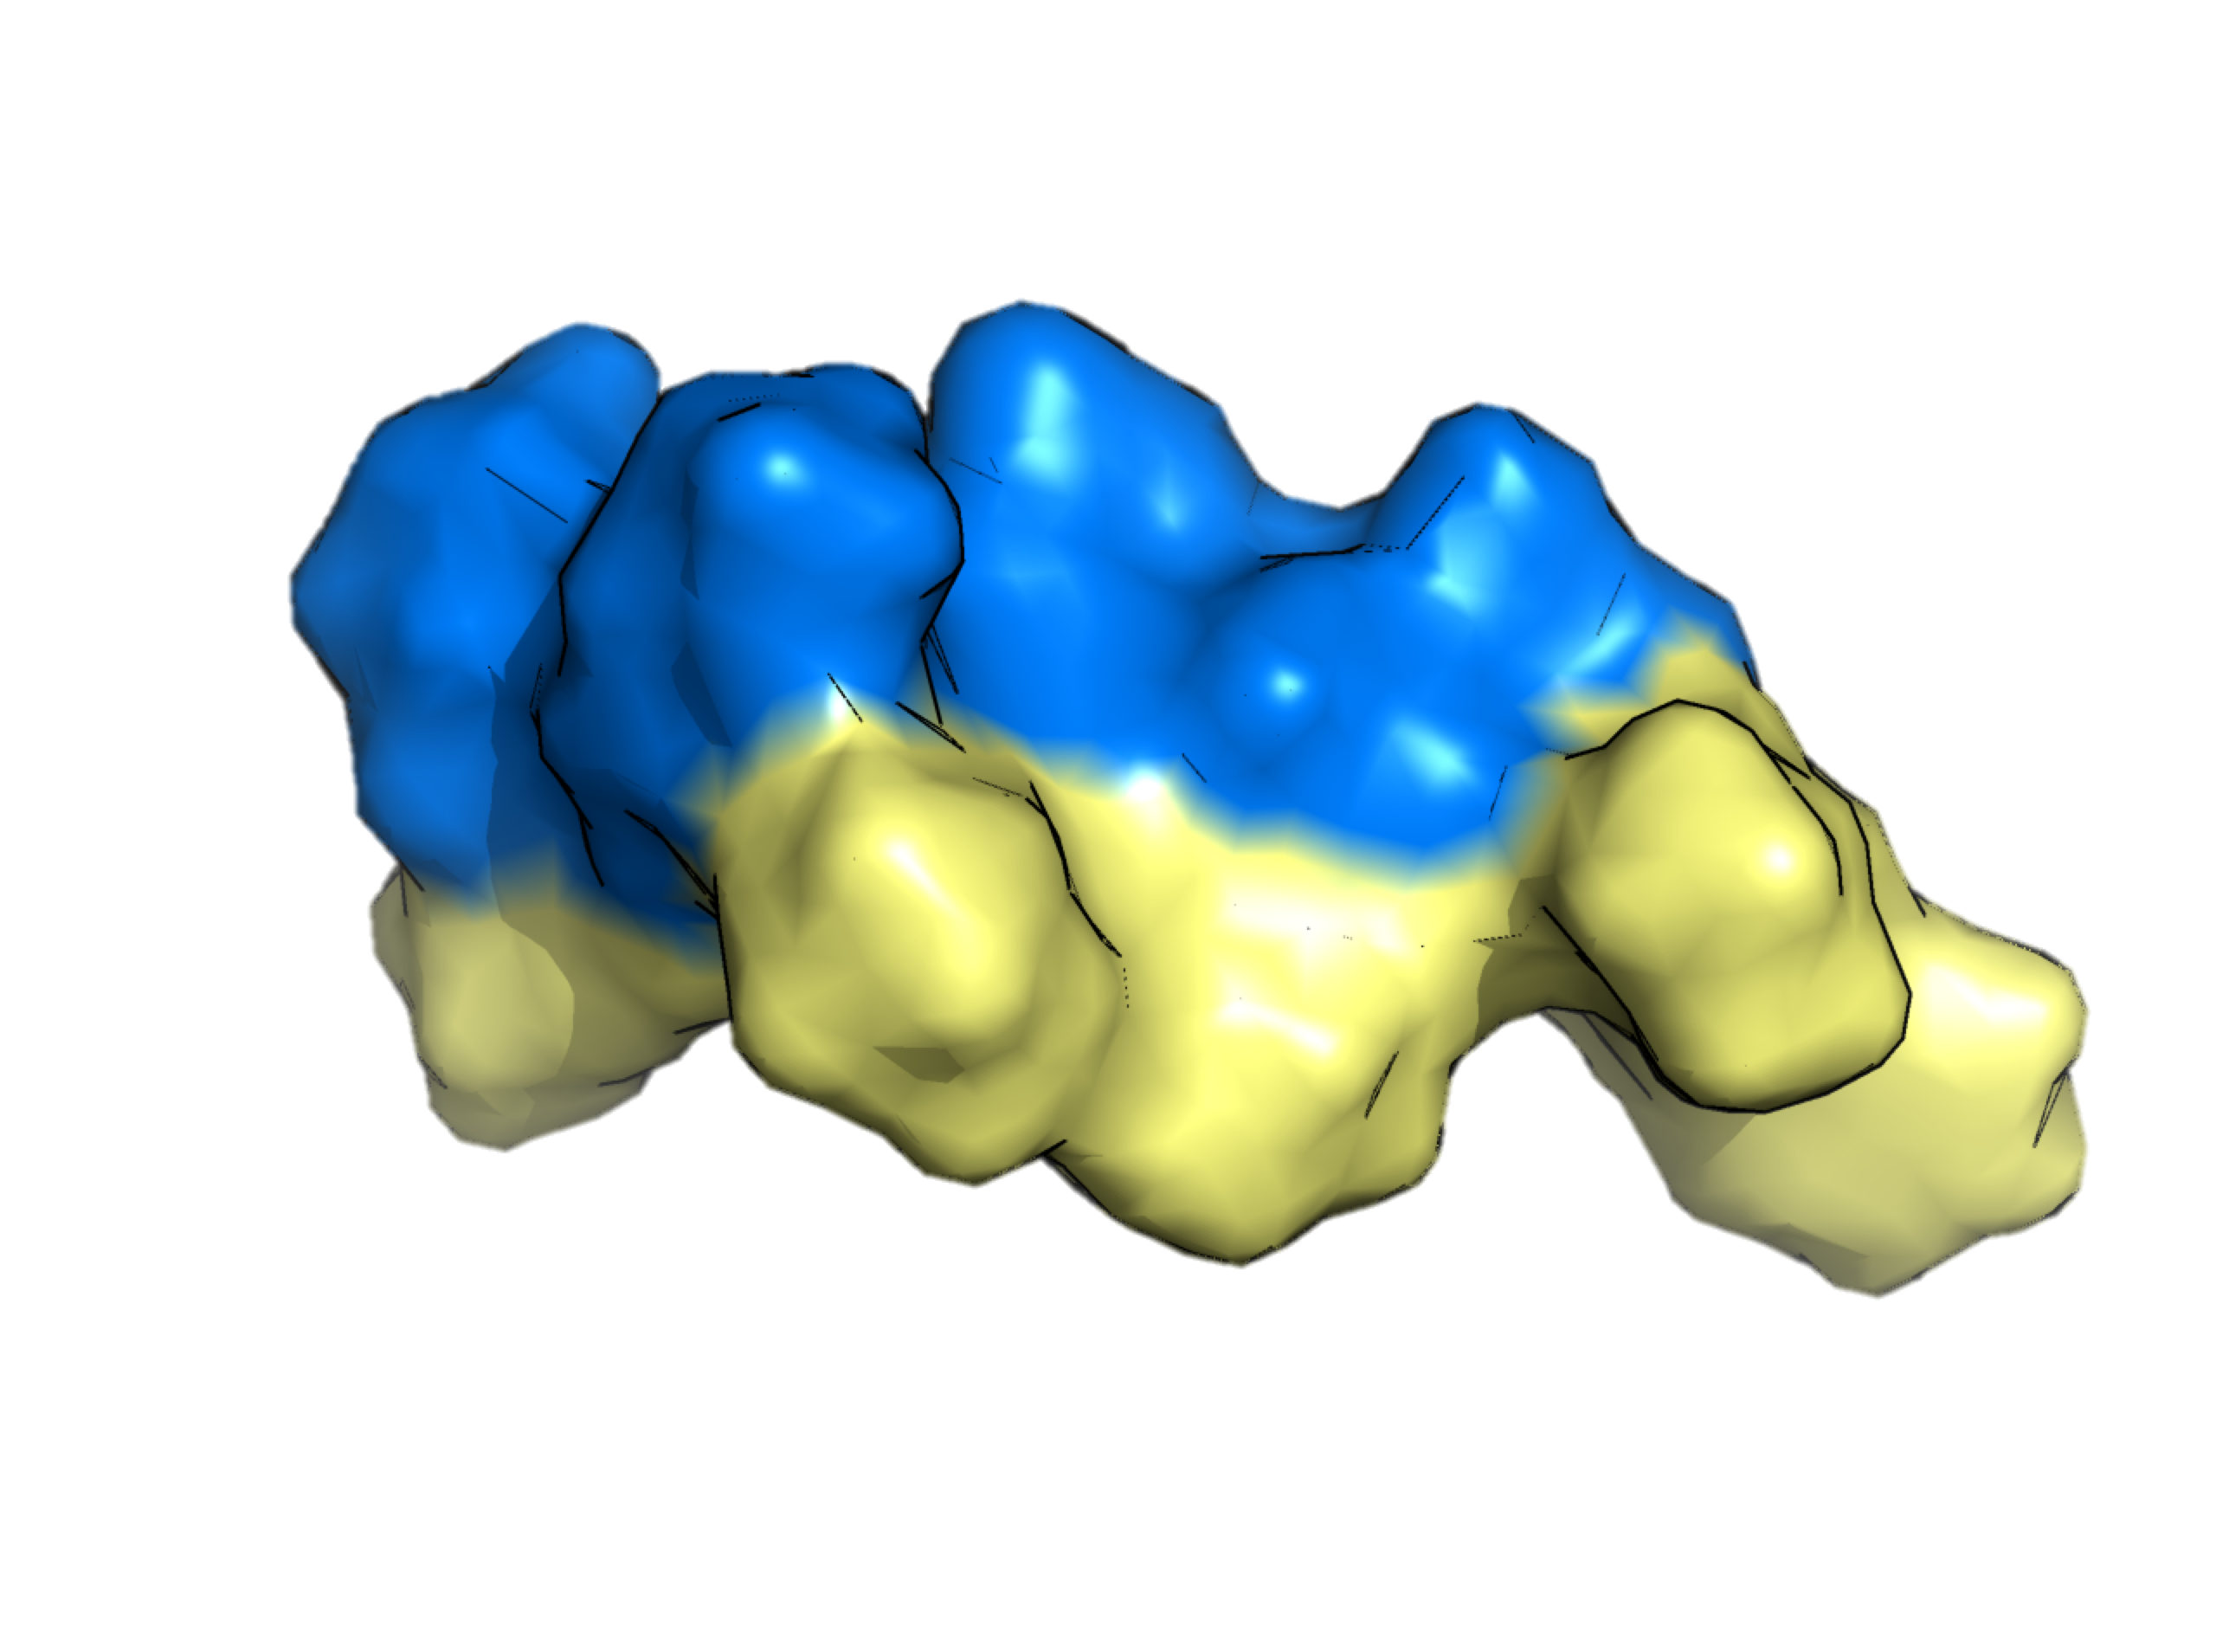
Prediction of the n-Octanol/Water Partition Coefficients in the SAMPL6 Challenge from MST Continuum Solvation Calculations
William J. Zamora R.
Collaborators:
Dra. Silvana Pinheiro
Prof. Carles Curutchet
Prof. Clara Ràfols
Mentor:
Prof. F. J. Luque
La Jolla, CA. Aug 2019

Slide 2
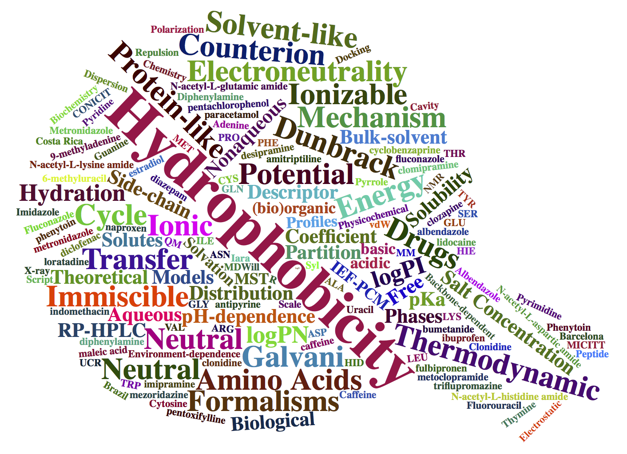
OUTLINE
INTRODUCTION
The MST Solvation Model for Solvation Computations.
Recent Lipophilic Computations using MST Model.
Refinement for Nitrogen-Containing Heterocyclic Compounds.
2. RESULTS
Our Performance in the SAMPL6 Challenge.
Analysis of the Main Outliers.
3. CONCLUSIONS
SAMPL6 CHALLENGE
Prediction of the n-Octanol/Water Partition Coefficients in the SAMPL6 Challenge from MST Continuum Solvation Calculations

Slide 3
INTRODUCTION
The MST Solvation Model for Solvation Computations
Continuum Solvation Model
QM Self-Consistent Reaction Field (SCRF)
﻿
SAMPL6 CHALLENGE
﻿Models
B3LYP/6-31G(d)
HF/6-31G(d)
Semiempirical AM1 and PM3
Solvents
water, dimethylsulfoxide,
n-octanol, chloroform and
carbon tetrachloride
Prediction of the n-Octanol/Water Partition Coefficients in the SAMPL6 Challenge from MST Continuum Solvation Calculations

Slide 4

INTRODUCTION
The MST Solvation Model for Solvation Computations
Pierotti’s scaled
particle theory
&
Claverie procedure
Solute
Solvent
Cav
Solvent
vdW surface
vdW surface
SAMPL6 CHALLENGE
λ
vdW
Ele
Prediction of the n-Octanol/Water Partition Coefficients in the SAMPL6 Challenge from MST Continuum Solvation Calculations

Slide 5
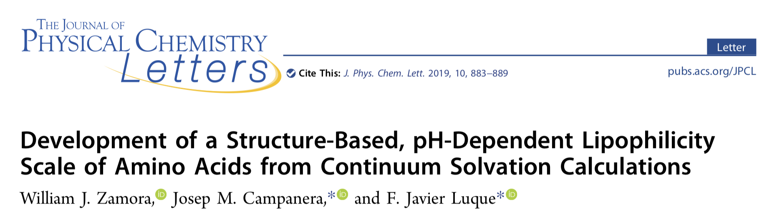
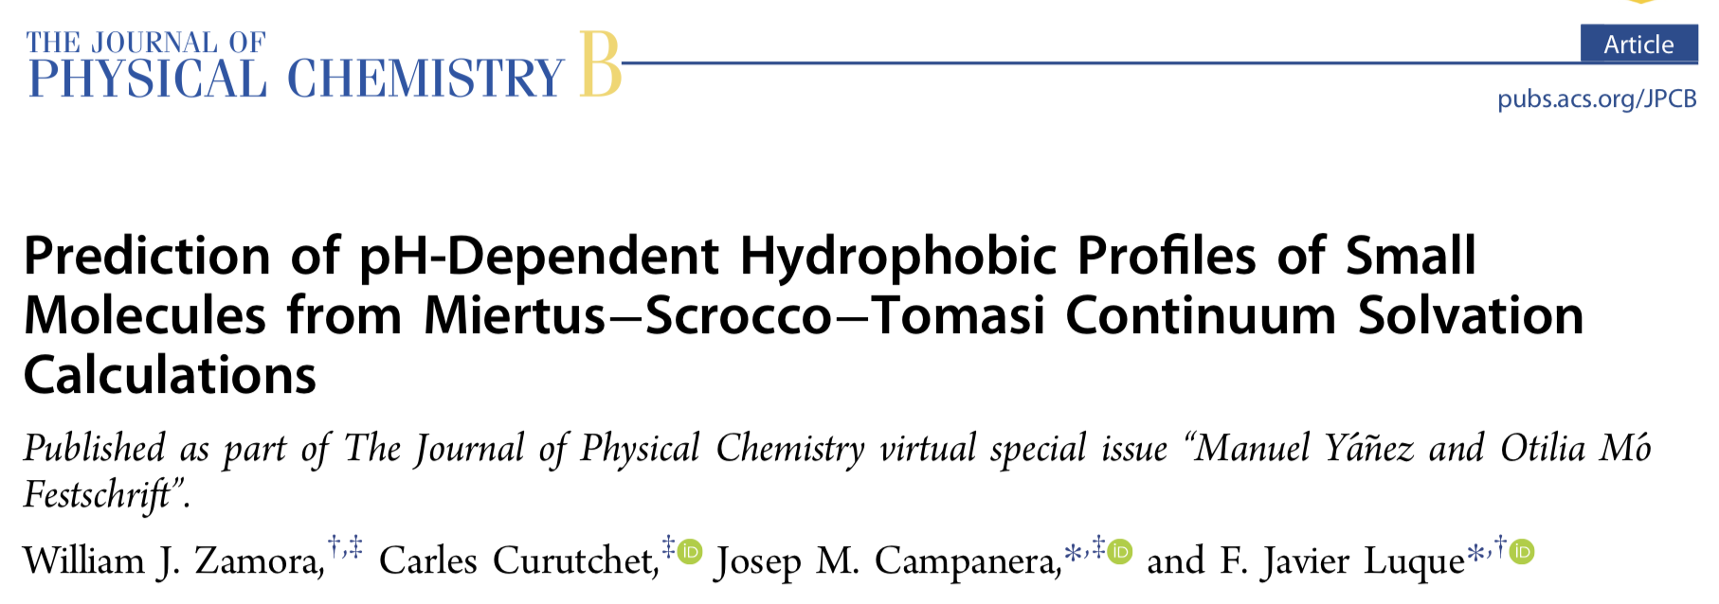
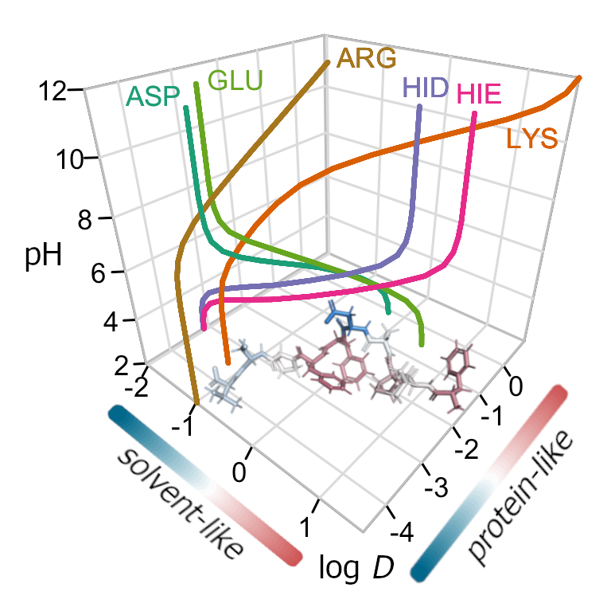
INTRODUCTION
Recent Lipophilic Computations using MST Model
SAMPL6 CHALLENGE
Prediction of the n-Octanol/Water Partition Coefficients in the SAMPL6 Challenge from MST Continuum Solvation Calculations

Slide 6
INTRODUCTION
Refinement for Nitrogen-Containing Heterocyclic Compounds
SAMPL6 CHALLENGE
Original
(kcal mol⁻¹Å⁻²)
Refined
(kcal mol⁻¹Å⁻²)
Prediction of the n-Octanol/Water Partition Coefficients in the SAMPL6 Challenge from MST Continuum Solvation Calculations

Slide 7
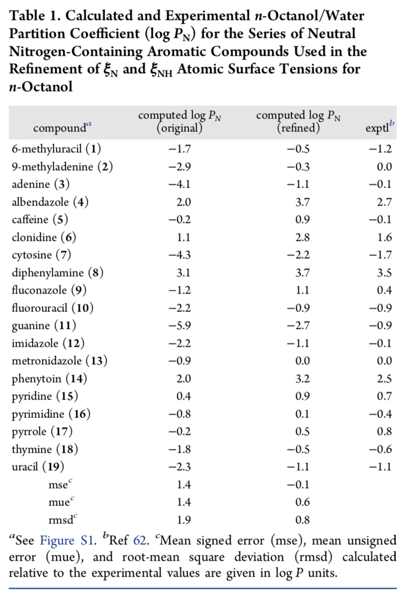
INTRODUCTION
Refinement for Nitrogen-Containing Aromatic Compounds
SAMPL6 CHALLENGE
rsmd = 0.8
Prediction of the n-Octanol/Water Partition Coefficients in the SAMPL6 Challenge from MST Continuum Solvation Calculations

Slide 8
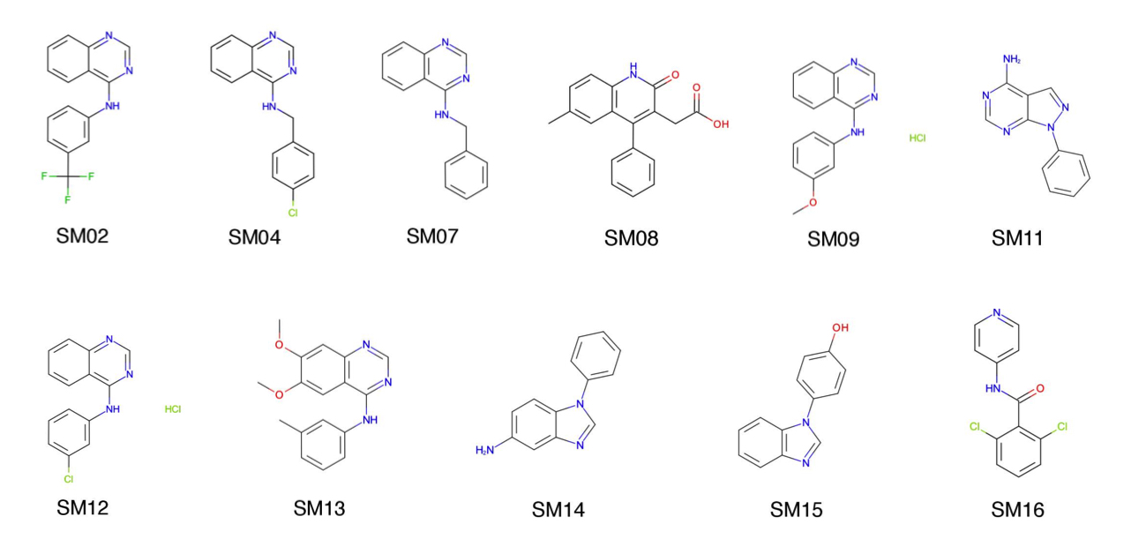
RESULTS
SAMPL6 Compounds
SAMPL6 CHALLENGE
Prediction of the n-Octanol/Water Partition Coefficients in the SAMPL6 Challenge from MST Continuum Solvation Calculations

Slide 9
RESULTS
Our Performance in the SAMPL6 Challenge
MST
CBDD Group
Barcelona
SAMPL6 CHALLENGE
Prediction of the n-Octanol/Water Partition Coefficients in the SAMPL6 Challenge from MST Continuum Solvation Calculations

Slide 10
RESULTS
Our Performance in the SAMPL6 Challenge
MST
CBDD Group
Barcelona
SAMPL6 CHALLENGE
Prediction of the n-Octanol/Water Partition Coefficients in the SAMPL6 Challenge from MST Continuum Solvation Calculations

Slide 11
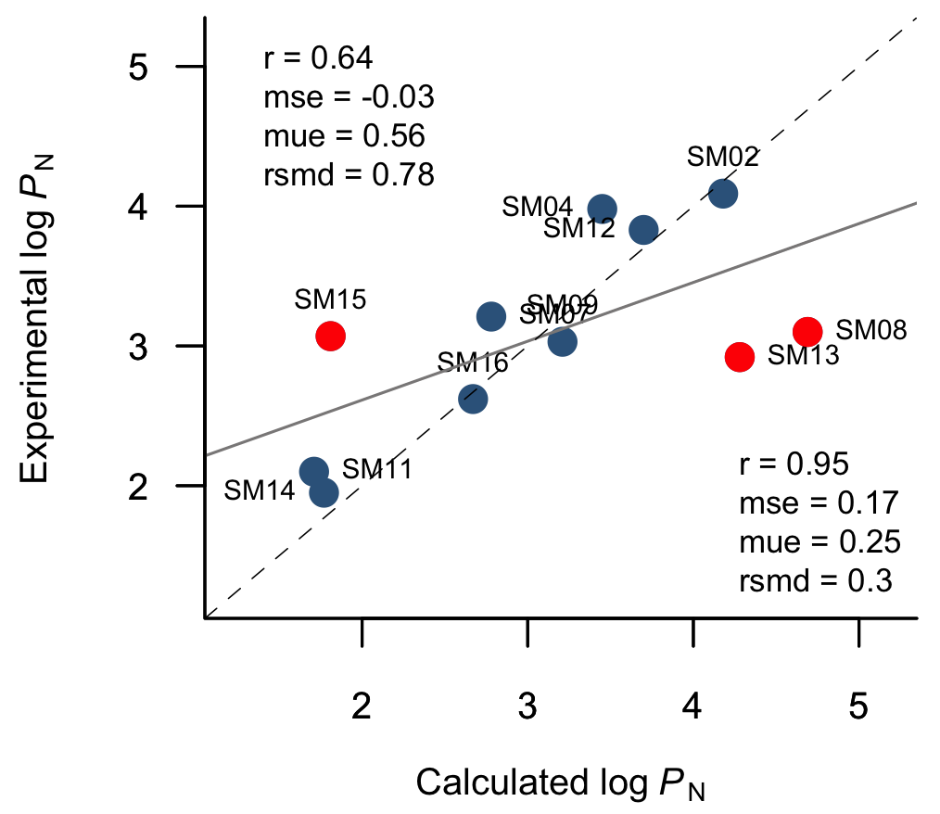
RESULTS
Our Performance in the SAMPL6 Challenge
SAMPL6 CHALLENGE
Prediction of the n-Octanol/Water Partition Coefficients in the SAMPL6 Challenge from MST Continuum Solvation Calculations

Slide 12
RESULTS
Our Performance in the SAMPL6 Challenge
SAMPL6 CHALLENGE
Prediction of the n-Octanol/Water Partition Coefficients in the SAMPL6 Challenge from MST Continuum Solvation Calculations

Slide 13
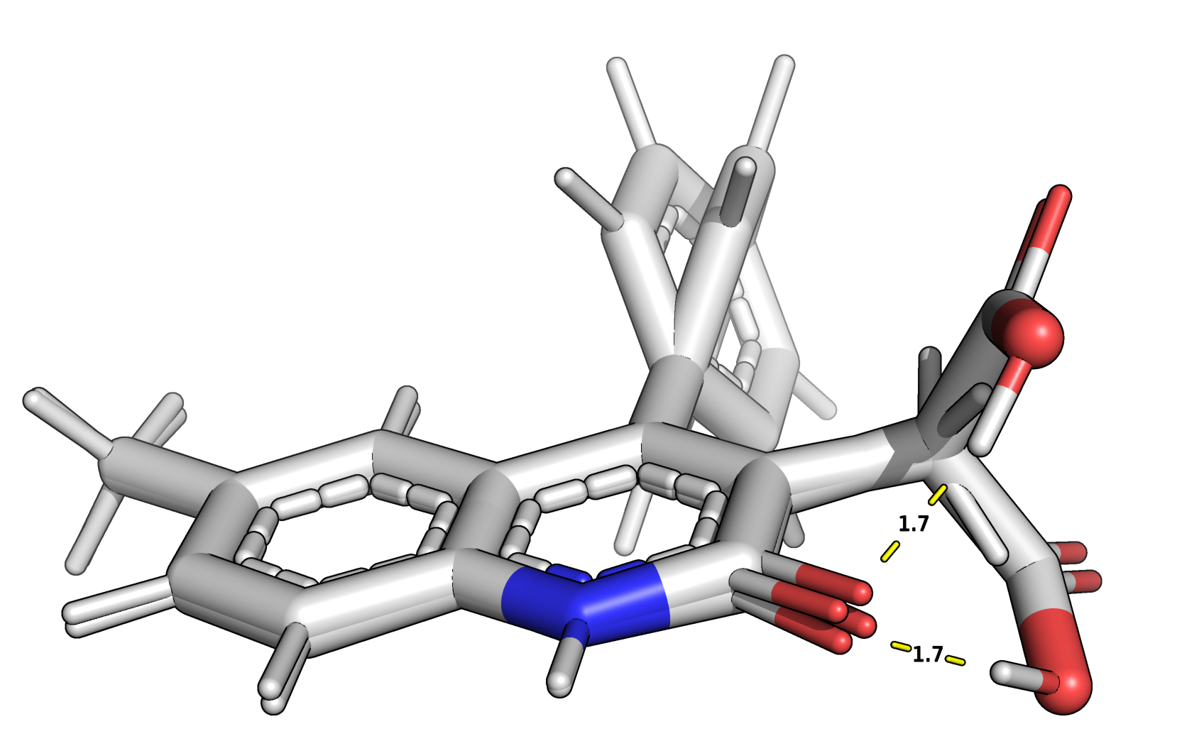
RESULTS
Analysis of the Main Outliers: SM08
SAMPL6 CHALLENGE
Exptl.
log P_{N}
3.10
Comp.
log P_{N}
4.69
3.87
Prediction of the n-Octanol/Water Partition Coefficients in the SAMPL6 Challenge from MST Continuum Solvation Calculations

Slide 14
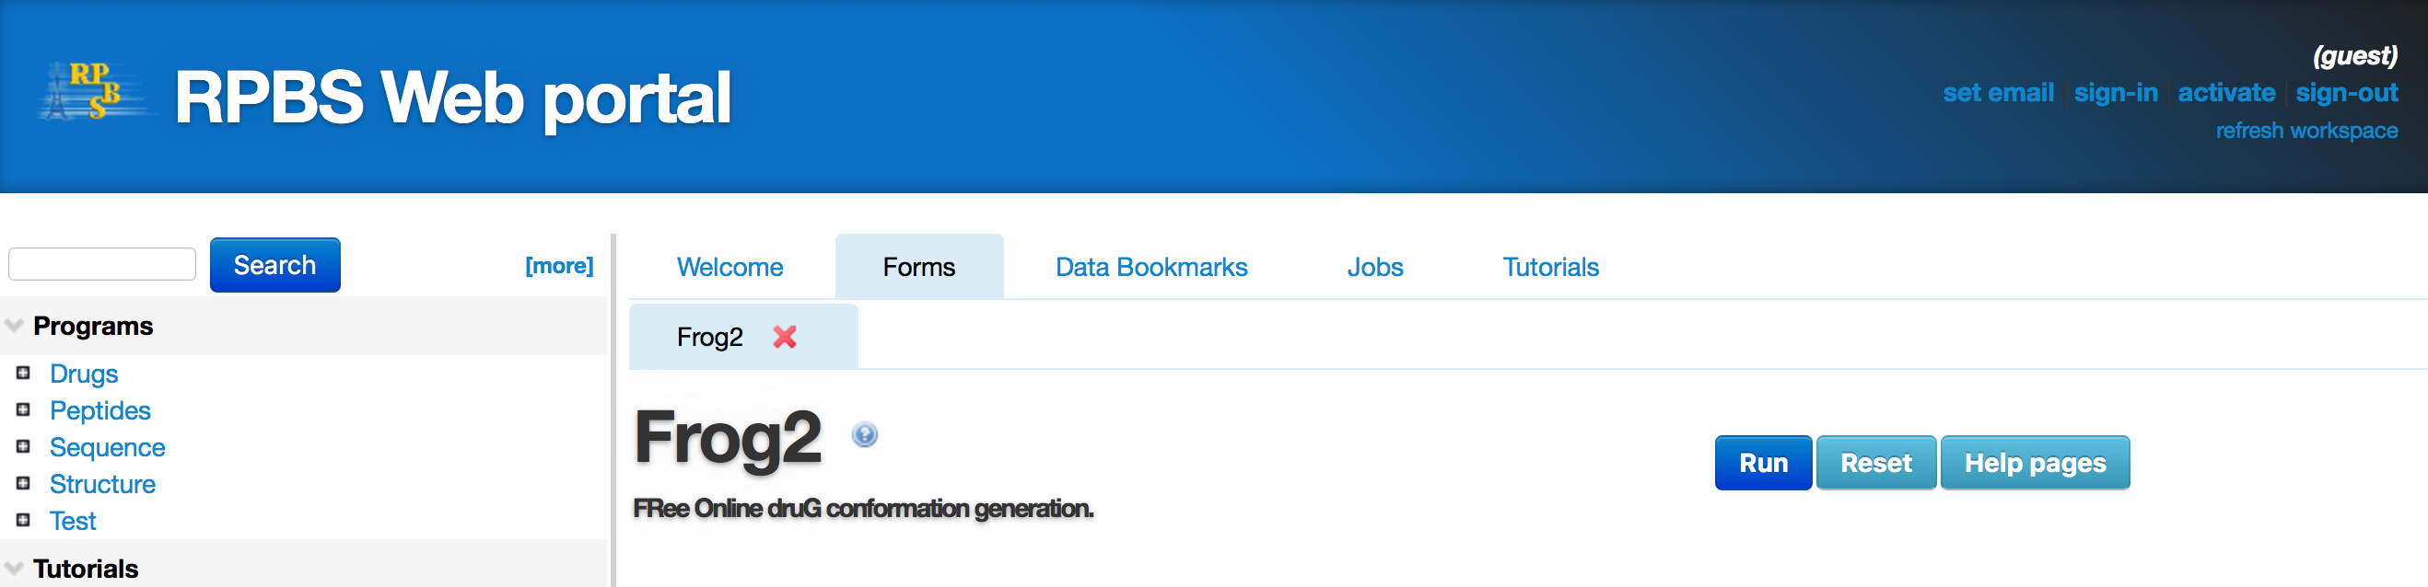
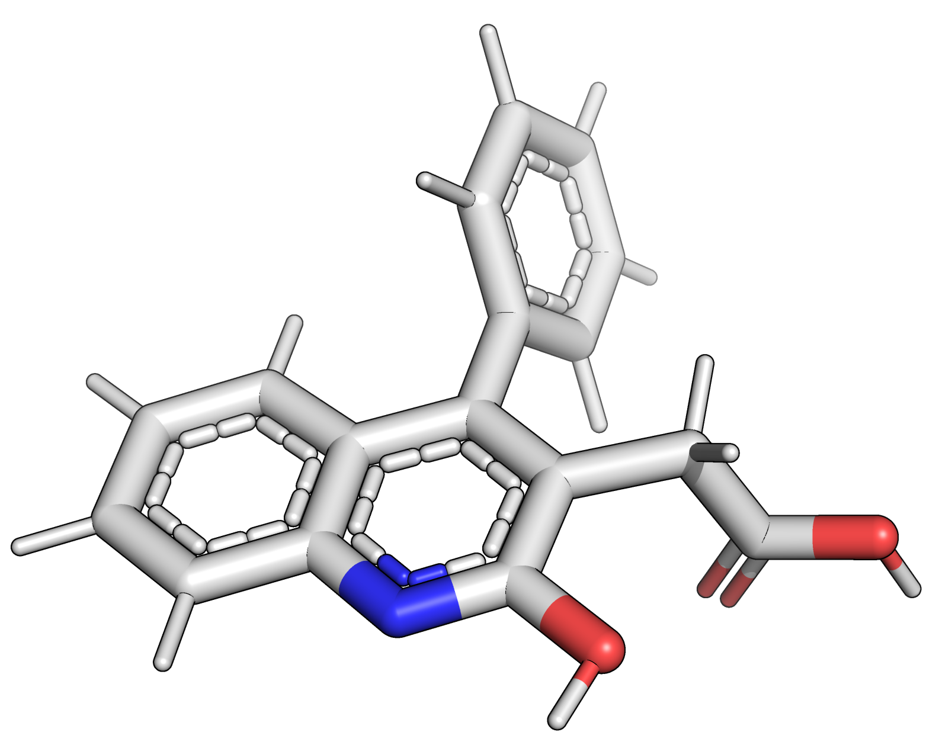
RESULTS
Analysis of the Main Outliers: SM08
SAMPL6 CHALLENGE
Prediction of the n-Octanol/Water Partition Coefficients in the SAMPL6 Challenge from MST Continuum Solvation Calculations

Slide 15
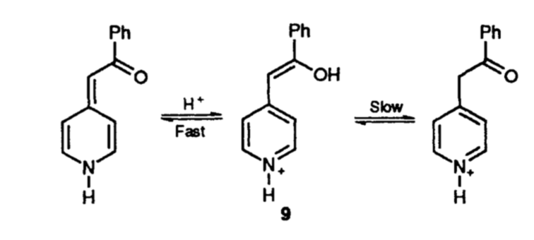
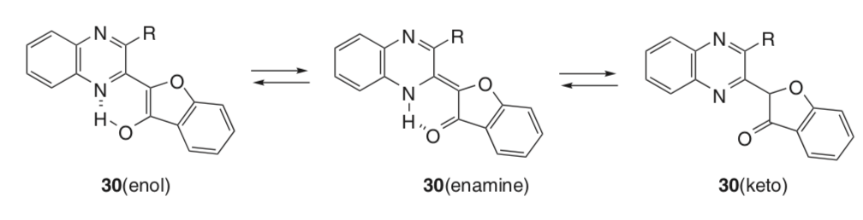
RESULTS
Analysis of the Main Outliers: SM08
SAMPL6 CHALLENGE
Exptl.
log P_{N}
3.10
Carey, A.R et al. Keto-Enol and Imine-Enamine Tautomerism of 2-, 3- and 4 Phenacylpyridines. . J. Chem. Soc. Perkin Trans. 2. 1993, 2285-2296
Kleinpeter, E. (2013). NMR Spectroscopic Study of Tautomerism in Solution and in the Solid State. Tautomerism, 103–143.
Prediction of the n-Octanol/Water Partition Coefficients in the SAMPL6 Challenge from MST Continuum Solvation Calculations

Slide 16
RESULTS
Analysis of the Main Outliers: SM13
SAMPL6 CHALLENGE
Exptl.
log P_{N}
2.92 3.03
Comp.
log P_{N}
4.28 3.21
Prediction of the n-Octanol/Water Partition Coefficients in the SAMPL6 Challenge from MST Continuum Solvation Calculations

Slide 17
RESULTS
Analysis of the Main Outliers: SM13
Table 2. Experimental conditions for the
potentiometric determination of log P_{N}
water (V_{w}, mL) | n-octanol (V_{o}, mL) | ratio (V_{w/} V_{o}) | mass (mg)
18 | 5 | 3.6 | 1.83
15 | 6 | 2.5 | 1.89
15 | 6 | 2.5 | 1.89
15 | 1.5 | 10 | 1.98
15 | 0.5 | 30 | 2.07
SAMPL6 CHALLENGE
Average ionic strength | 0.157 M
Average temperature | 32.1°C
Purity | 90 %
Prediction of the n-Octanol/Water Partition Coefficients in the SAMPL6 Challenge from MST Continuum Solvation Calculations

Slide 18
RESULTS
Analysis of the Main Outliers: SM13
SAMPL6 CHALLENGE
Exptl.
log P_{N}
4.57 ± 0.09
Comp.
log P_{N}
4.28
Prediction of the n-Octanol/Water Partition Coefficients in the SAMPL6 Challenge from MST Continuum Solvation Calculations

Slide 19
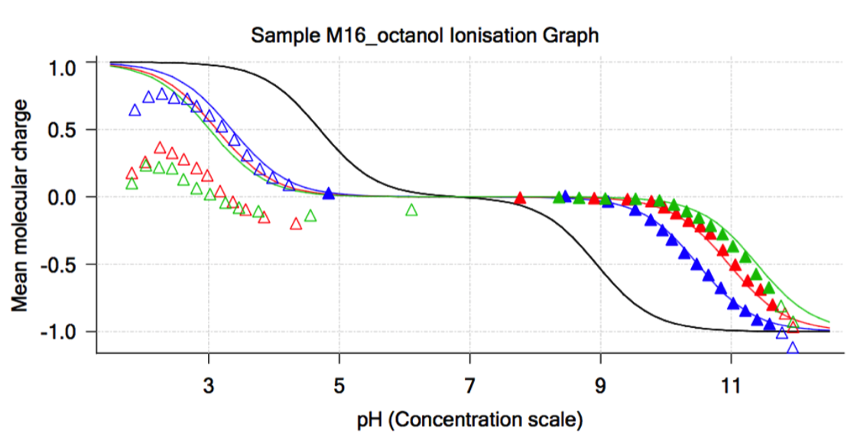
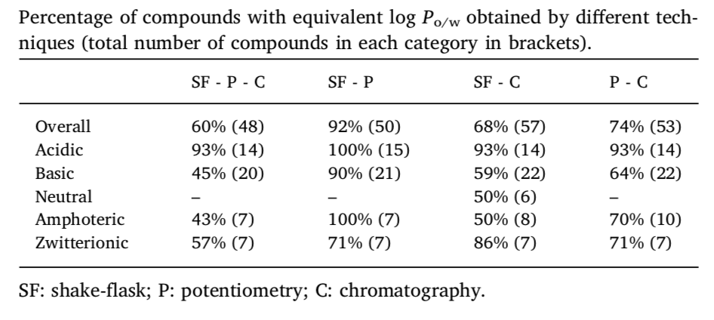
RESULTS
Analysis of the Main Outliers: SM15
pK_{a}s = 4.7 & 8.9
Exptl.
log P_{N}
3.07 1.95
SAMPL6 CHALLENGE
Comp.
log P_{N}
1.81 1.77
Ràfols, C et al. Critical comparison of shake-flask, potentiometric and chromatographic methods for lipophilicity evaluation (log Po/w) of neutral, acidic, basic, amphoteric, and zwitterionic drugs. Eur J Pharm Sci. 2018, 122, 331-340.
Prediction of the n-Octanol/Water Partition Coefficients in the SAMPL6 Challenge from MST Continuum Solvation Calculations

Slide 20
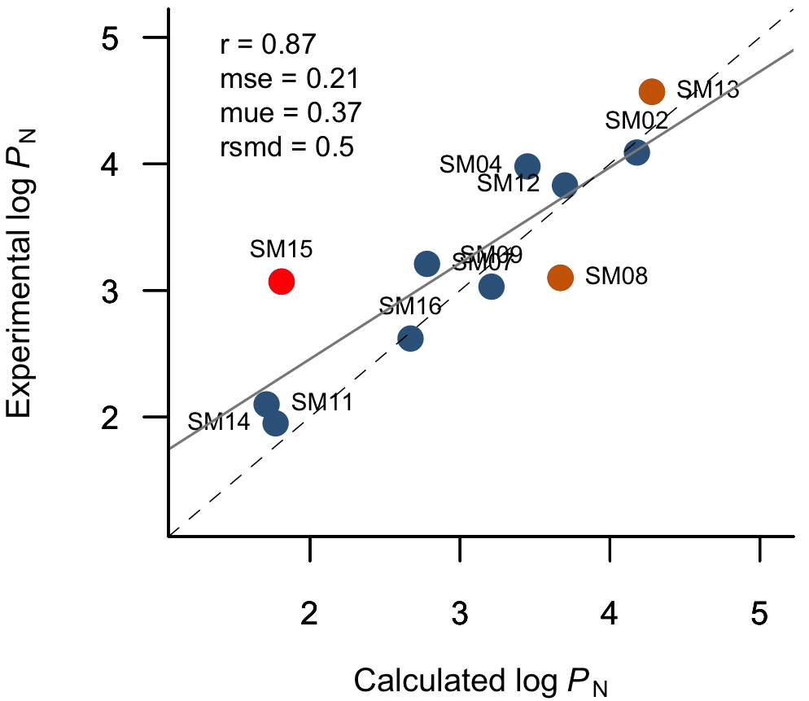
RESULTS
Analysis of the Main Outliers: SM13
SAMPL6 CHALLENGE
Prediction of the n-Octanol/Water Partition Coefficients in the SAMPL6 Challenge from MST Continuum Solvation Calculations

Slide 21
CONCLUSION
The refinements made in the MST method for the treatment of solutes in n-octanol improve the ability of the model for predicting partitionings of neutral compounds.
The performance of the MST model was successful and could be improved considering tautomeric forms and reviewing some experimental values
For the sake of validation and comparison, it is recommended for zwitterion compounds perform an extra measurement by a standard technique such as shake flask
SAMPL6 CHALLENGE
Prediction of the n-Octanol/Water Partition Coefficients in the SAMPL6 Challenge from MST Continuum Solvation Calculations

Slide 22
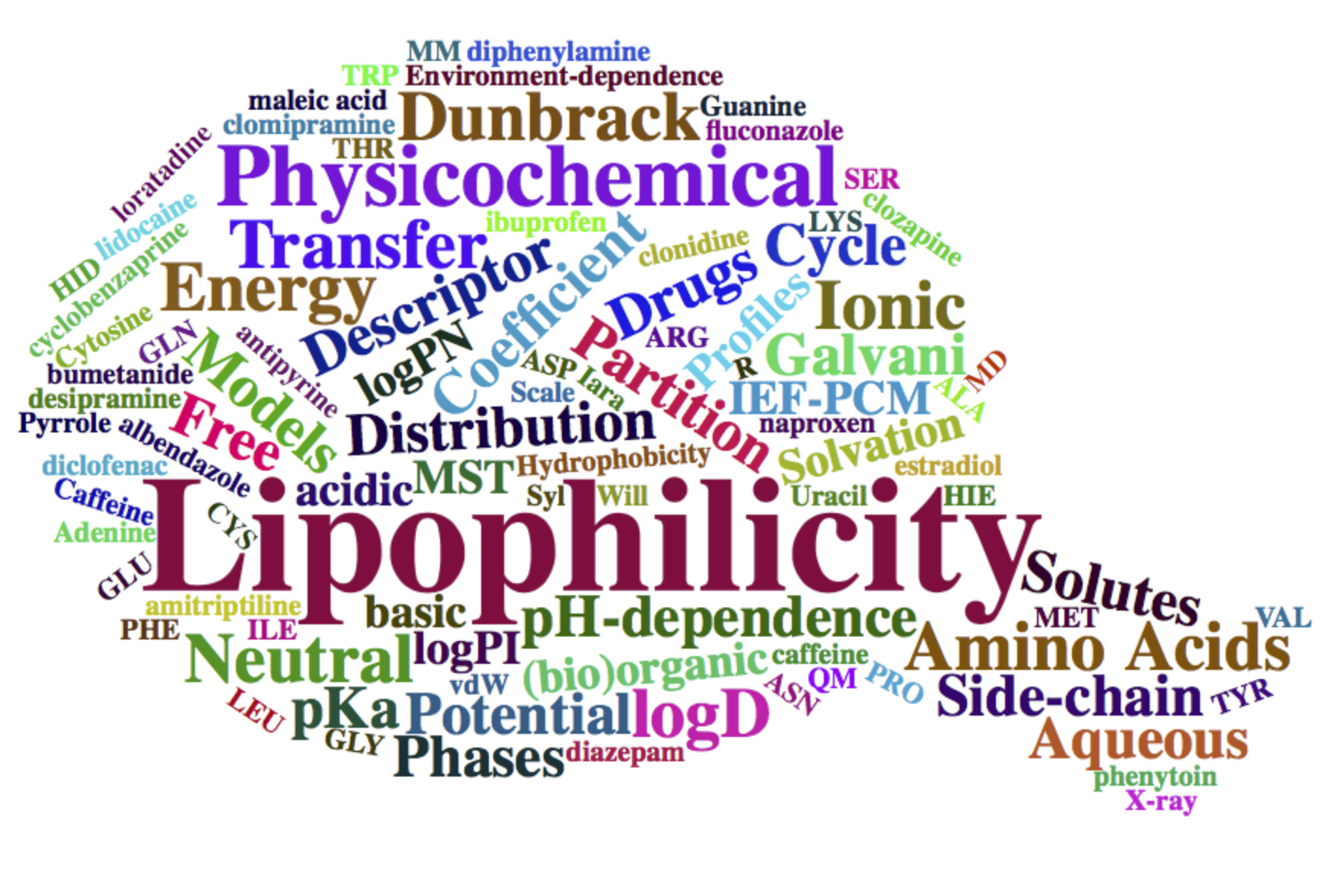


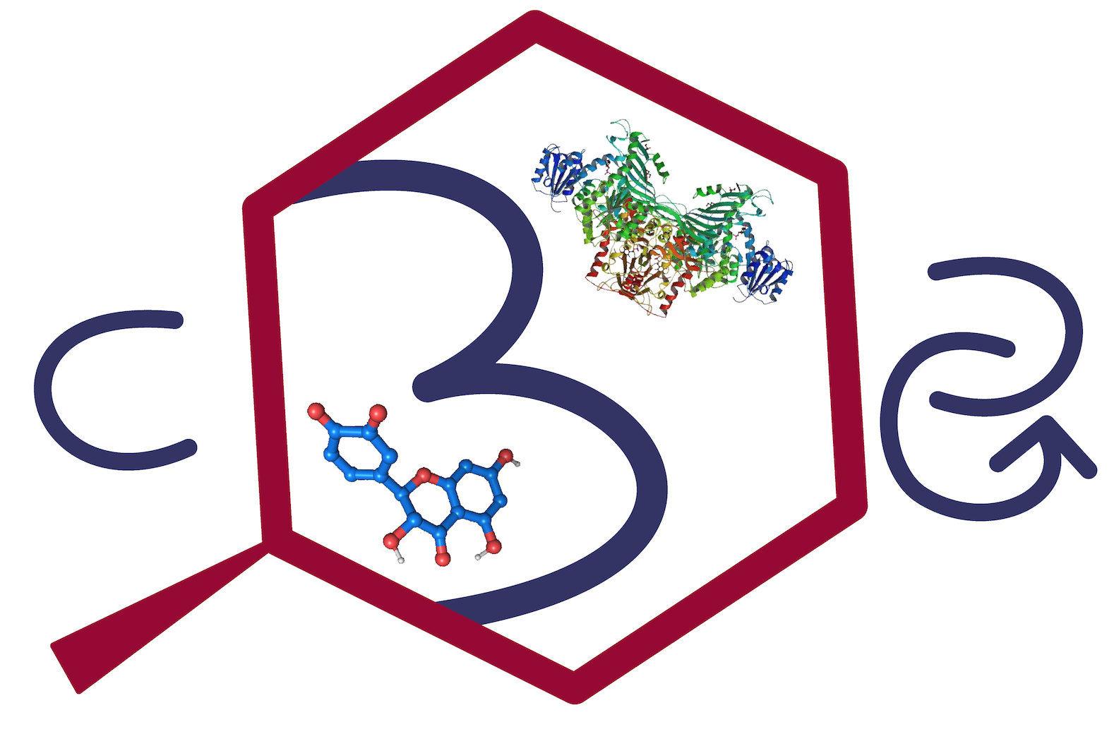

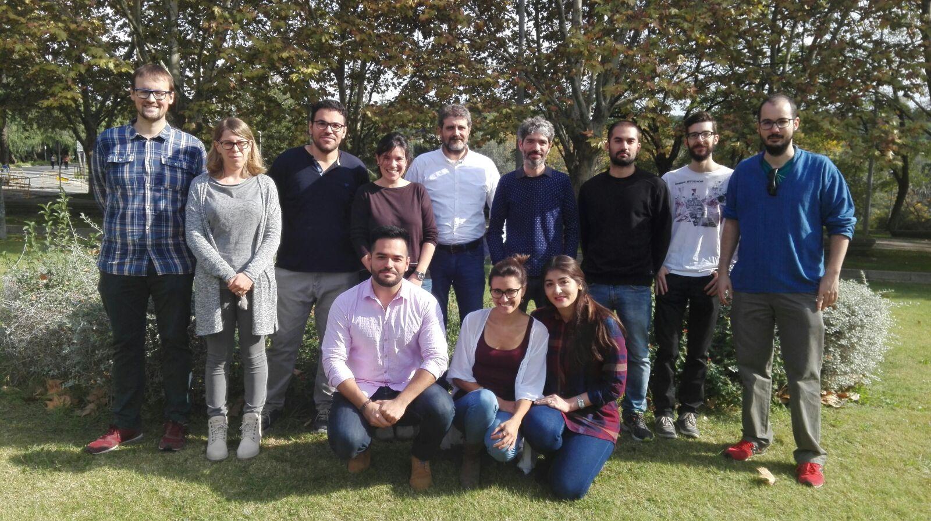



Acknowledgments
Mentor:
Dr. F. Javier Luque
Collaborators:
Dra. Silvana Pinheiro
Dr. Carles Curutchet
Dra. Clara Ràfols
Dr. Martí Rosés

Slide 23
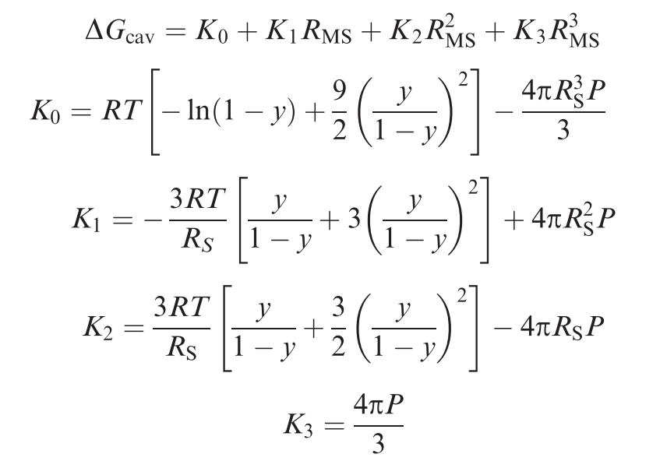
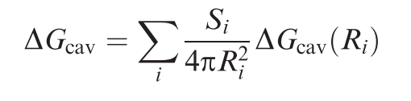
Hamiltonian of the Solute
﻿Ben-Naim’s definition of a solvation process
Assumptions ele + n-ele
The coupling between repulsion and electrostatics is expected to be small
﻿That dispersion is weakly coupled to electrostatics, at least for neutral solutes and polar solvents
Cavitation Energy
﻿Pierotti’s Scaled Particle Theory
﻿Claverie’s Scaled Particle Theory
Spheric molecules
Complex shape molecules

Slide 24
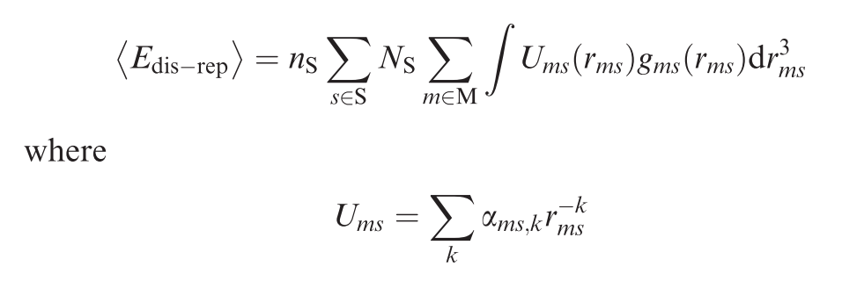
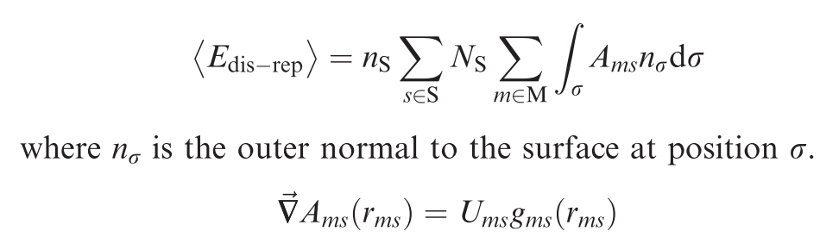
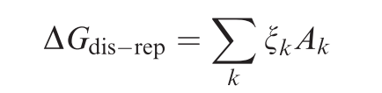
﻿Dispersion–Repulsion Energy

Slide 25
﻿Electrostatic Energy

