Slide 1
SAMPL6 Part II Partition Coefficient Challenge Overview
Mehtap Işık
D3R Workshop 2019
August 22nd , 2019
For more information
https://github.com/MobleyLab/SAMPL6

Slide 2

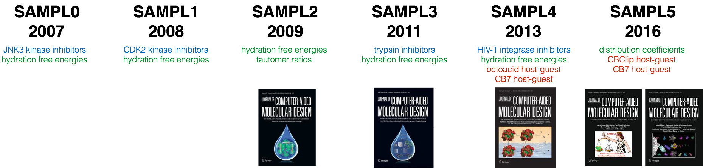
SAMPL blind challenges:
Statistical Assessment of the Modeling of Proteins and Ligands
SAMPL6
Part I - 2018
SAMPL6
Part II - 2019
Physical properties
To test of force field accuracy and to ^{isolate chemical effects.}
Host-guest systems Binding of small drug-like molecules without slow protein timescales.
^{Model protein-ligand systems}
Isolate individual physical challenges (e.g. binding of charged ligands).
pK_{a}
host-guest affinity
Sampling
partition coefficients
?
Notes:
SAMPL (Statistical Assessment of the Modeling of Proteins and Ligands) is a set of community-wide blind challenges aimed to advance computational techniques as standard predictive tools in rational drug design. A broad range of systems including proteins, host–guest complexes, and drug-like small molecules have been selected to test the latest modeling methods and force fields in SAMPL.
Model systems of intermediate complexity to focus community on challenges in blind tests
SAMPL (Statistical Assessment of the Modeling of Proteins and Ligands)
Focus on "stepping stone" problems that isolate individual challenges for quantitative accuracy
Provide targeted datasets as part of blind challenges to focus field on important problems
Release targeted datasets to the community (building the "steel tables" of drug discovery)
Share lessons among groups to accelerate progress

Slide 3
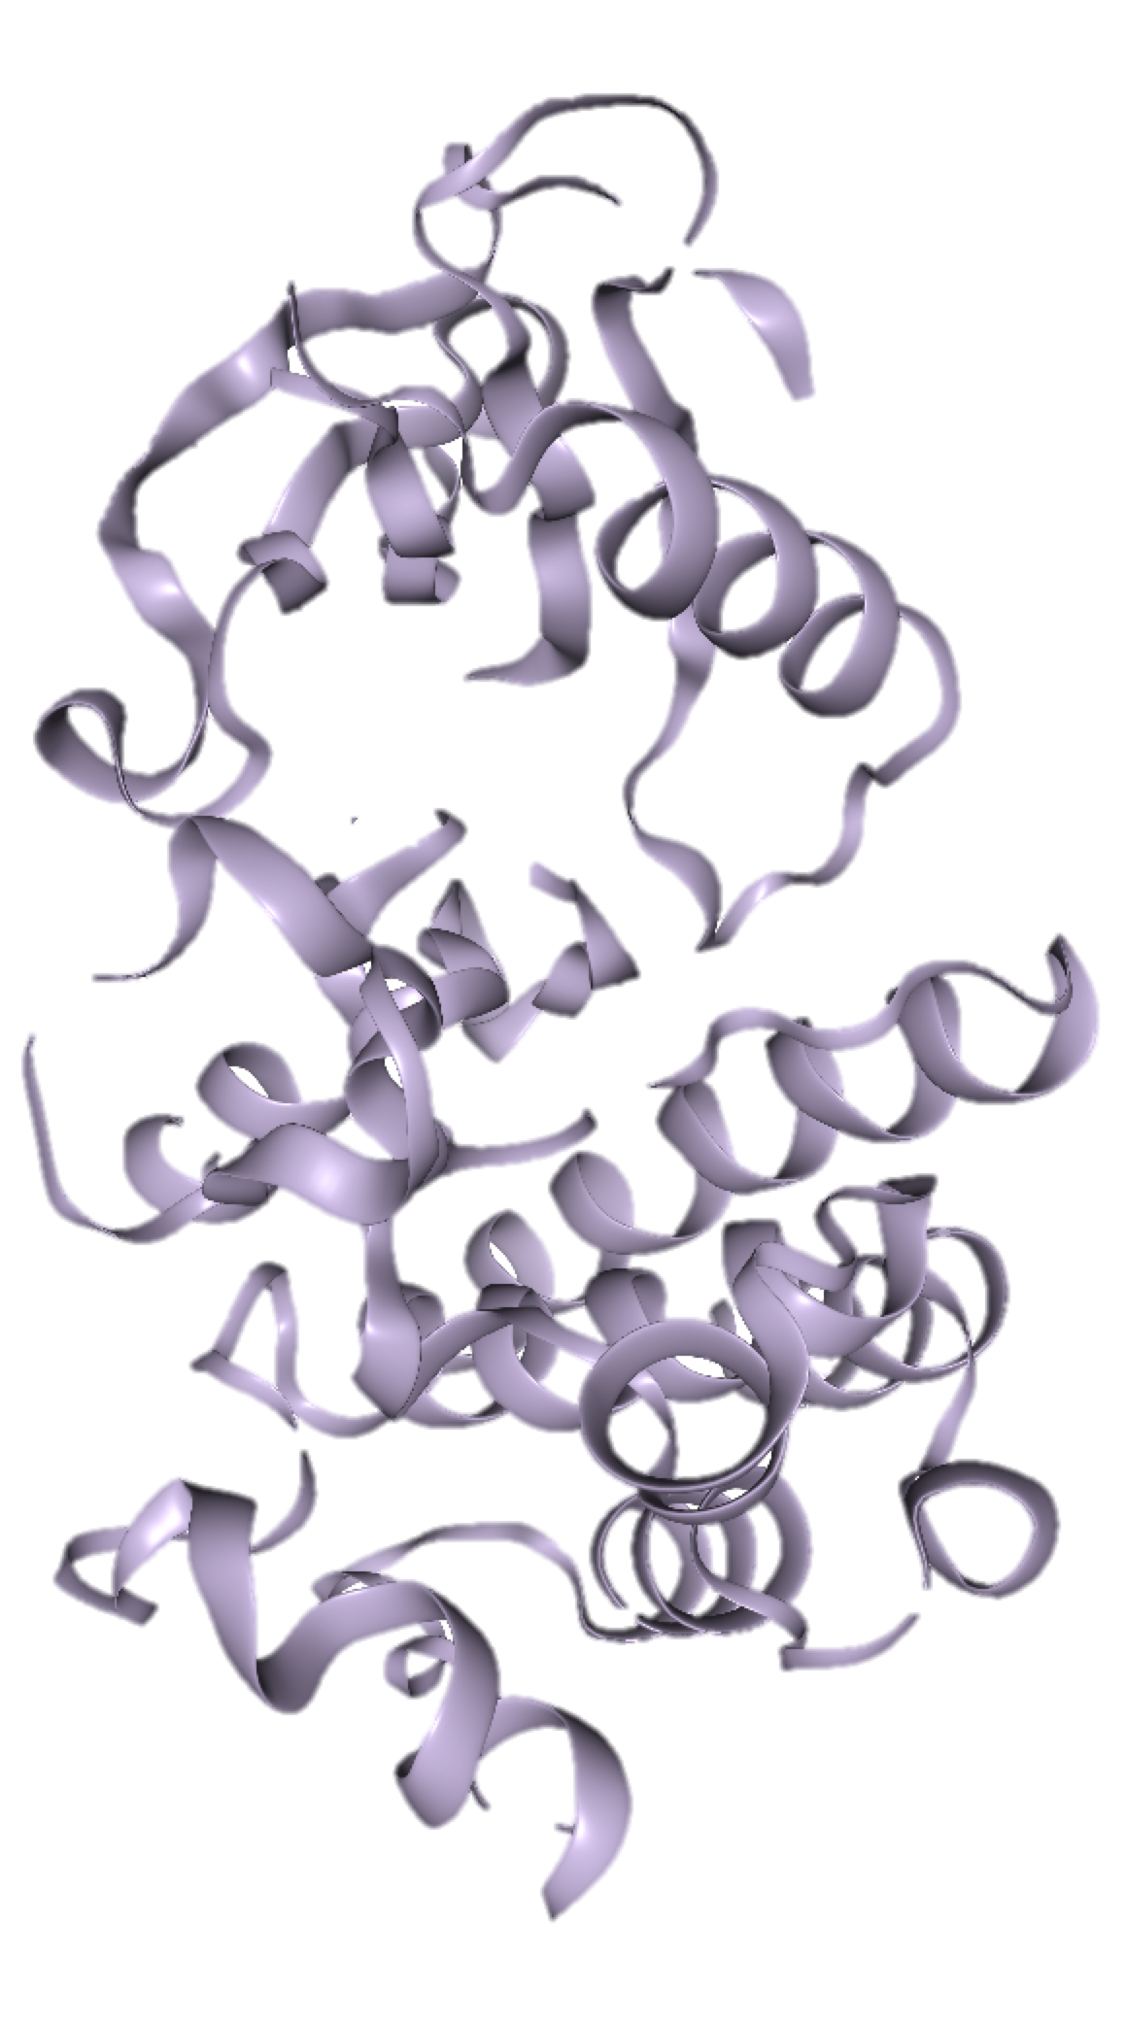
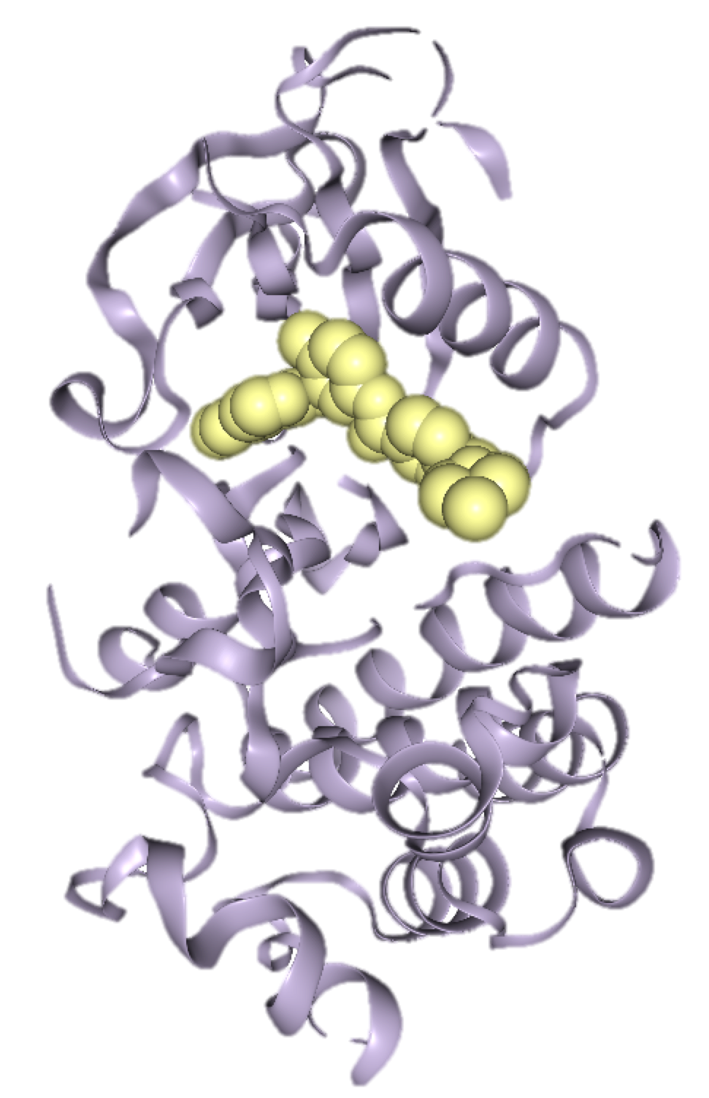
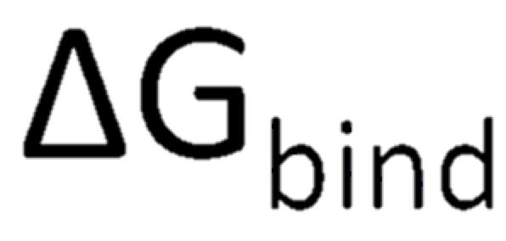
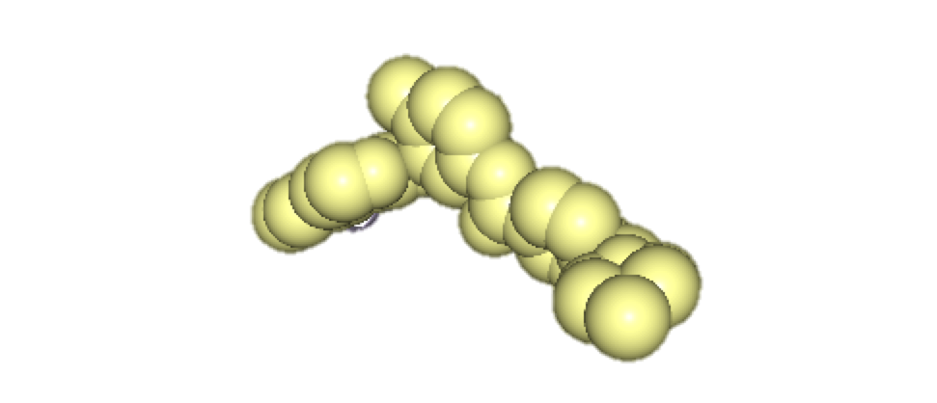
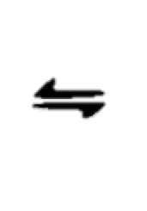
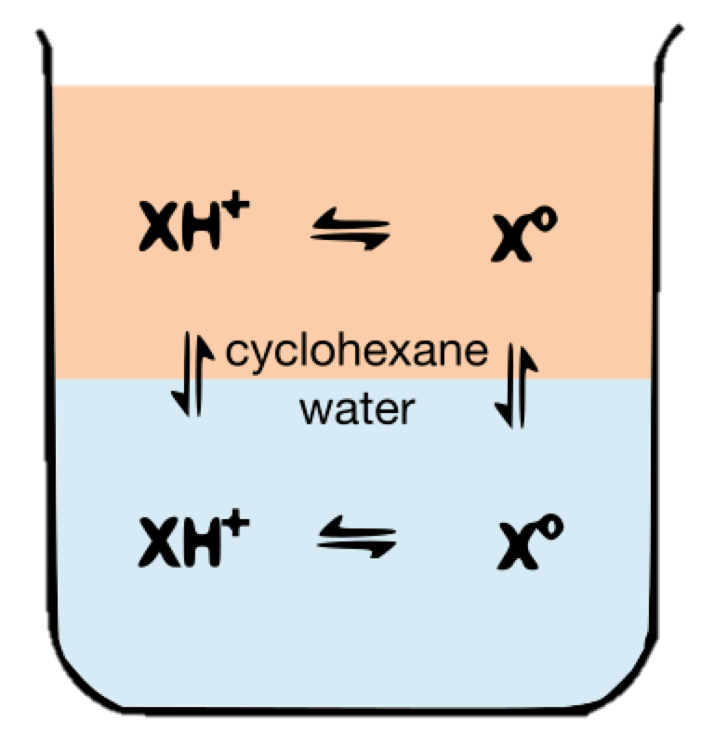
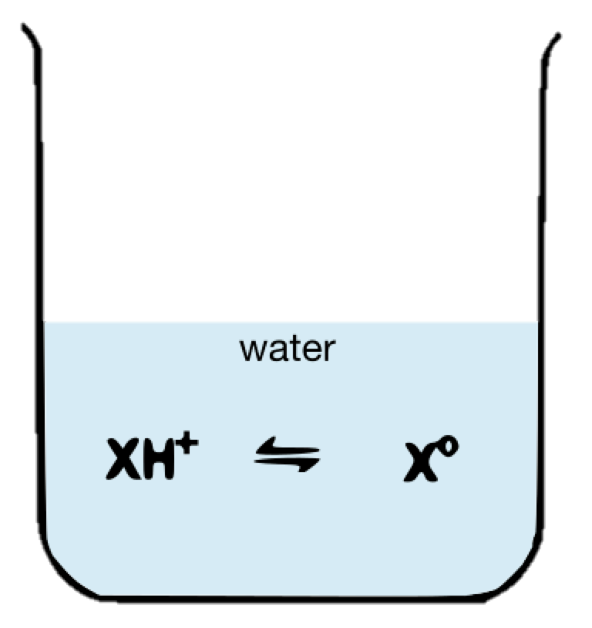

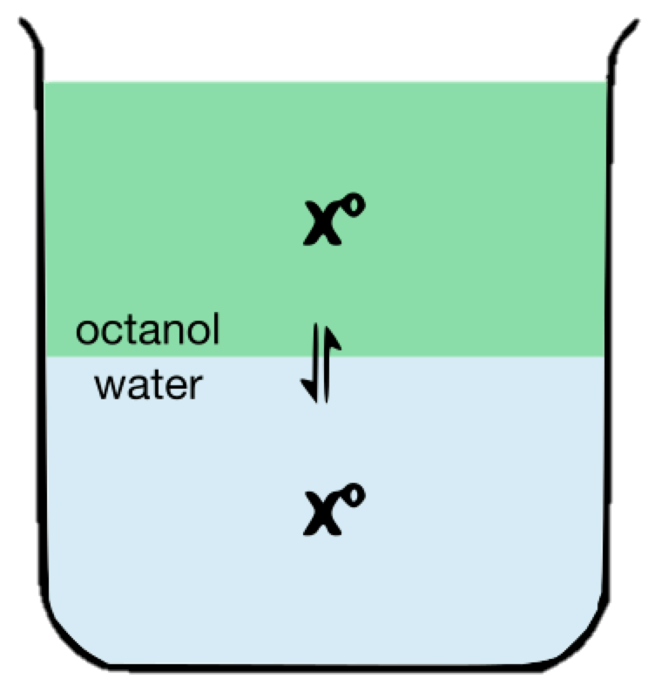
Learning from the physicochemical property prediction challenges
how to improve computational methods for drug discovery
Binding affinity prediction involves predicting the energetics of a ligand in aqueous phase vs. in complex.
  protein-ligand interactions
  protonation states
  solvation effects
SAMPL blind community challenges allow us to assess the performance of current computational methods and dissect sources of errors.
SAMPL5 log D challenge
SAMPL6 pK_{a} challenge
SAMPL6 log P challenge
Predicting small molecule protonation and tautomerization states is a part of affinity
prediction problem.
24 molecules  37 methods  11 research groups
LESSONS: Large range of pK_{a} errors, difficult to predict protonation sites, challenging moieties.
A simplified model solvation system to capture force field and modeling errors in transfer free energy predictions.
11 molecules  91 methods  27 research groups
LESSONS will be discussed today!
Notes:
Hello everyone. My thesis is about advancing computational modeling tools for rational drug design.
For this, I evaluate accuracy of current physical models and try to identify areas that need attention.
The goal of organizing SAMPL blind community challenges is to advance physical modeling of protein-ligand interactions.
We collect experimental data of physicochemical properties, don’t release it for 3 months and collect blind predictions computational chemistry groups to test different methods.
These focused challenges allow dissecting problems that LIMIT OUR ABILITY TO DO DRUG DISCOVERY.
When the structure of a protein target is known we want to be able to predict affinity of drug candidates.
Binding affinity prediction involves predicting the energetics of a ligand in aqueous phase vs. in complex.
It requires prediction of protonation states and capturing solvation effects.
Predicting logD distribution coefficients is a simpler test system to evaluate accuracy of affinity prediction methods.
A distribution coefficient is the equilibrium of all ionic states of a compound between two phases.
In SAMPL5 there was cyclohexane-water distribution coefficient, which turned out to be very difficult to predict.
Errors were all over the place.
logD prediction errors were convoluted with protonation state predictions.
Over the last 2 years, I organized separate challenges to isolate error contributions: pKa and partition coefficeints
pKa challenge results guide us about the problems with predicting protonation and tautomerization states
With large participation, we learned about
pKa errors can be very large
it is harder to predict the site of protonation than pKa value
and identified challenging chemical moieties
A partition coefficient is the equilibrium of neutral species between phases.
Predicting transfer free energies is analogous to predicting free energy of protein-ligand binding.
It is simplified model system without a protein to capture force field and modeling errors.
We had a huge amount of participation which allows comparative evaluation of current methods.
LogP errors were smaller compared to pKa prediction errors. QM and empirical methods were outperforming MD based methods.

Slide 4

Roadmap for SAMPL6 log P Challenge
Experimental data collection
Mehtap Isik
Dorothy Levorse (Merck, MRL)
Timothy Rhodes (Merck, MRL)
Brad Sherborne (Merck, MRL)
Challenge organizers
David Mobley
John Chodera
Mehtap Isik
Daniel Bergazin
1. Design of a blind prediction challenge that isolates problems
2. Experimental data collection. Data kept blind until the end of challenge.
3. Challenge announcement and publication of challenge instructions
4. 3-4 months allowed for blind predictions and collecting submissions
5. Public release of experimental data and performance evaluation of blind predictions
7. Organizing a workshop to discuss results
10. Publications gathered in special issue of a journal
JCAMD special issue deadline extended to October 15, 2019.

Slide 5

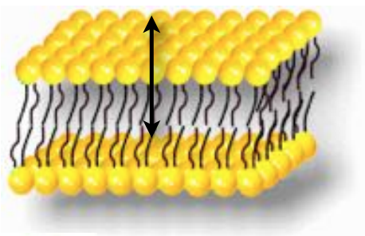
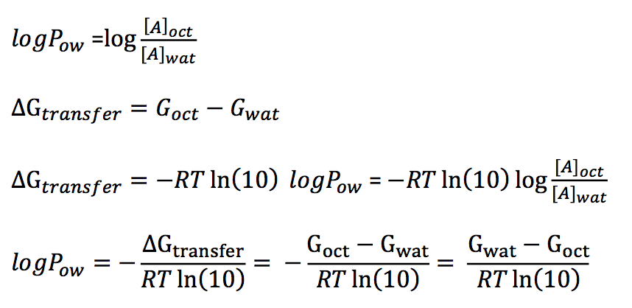
What is the motivation behind a blind octanol-water partition coefficient challenge?
Log P values are a proxy for predicting behavior of small molecules in biologically interesting environments such
as water-lipid membrane interfaces.
ΔG_{o/w transfer}
It provides a test system for evaluating force field errors in protein-ligand binding affinity prediction methods:
Octanol phase is a hydrophobic environment similar to protein environment.
Solvation free energies or transfer free energies between two environments can be calculated to predict partitioning.
Log P prediction allows separating force-field accuracy from errors related to conformational sampling of proteins and protonation state predictions.
solute
in octanol
solute
in water
Notes:
A test system for affinity prediction methods:
It embodies important elements of protein-ligand binding prediction such as solvation free energies and partitioning between two environments.
It allows separating force-field accuracy from errors related to conformational sampling of proteins and protonation state predictions of proteins and ligands.
SAMPL challenges are about assessing our capabilities for modeling proteins and ligands through blind challenges
and imporving our methods.
There are many factors making prediction of protein binding difficult. To take a step in that direction we would like to test our predictions
For physicohemical properties of the small molecules first. We want to make sure we are predicting pKa’s, logDs and solubilities properly.
These properties are also connected to each other as log P describes partition of uncharged species, pKa of the compound determines how much the
Charge will be dissociated. Distribution of charged and uncharged species overall is determined as logD.
Predicting logD of small molecules brings us one step closer to predicting how ligands will behave at water:lipid and water: protein interphases.
Why blind predictive challennges? Motivation?
Why pka is important for logD prediction?
Look at Bas’s slides
The distribution of all ionic species of a compound between two immiscible solvent layers, pH dependent

Slide 6
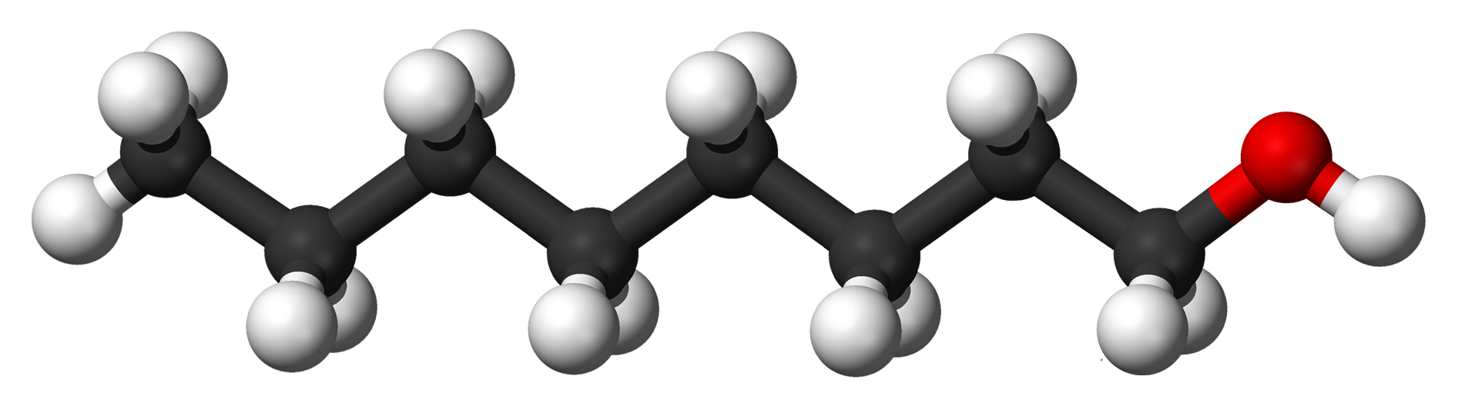
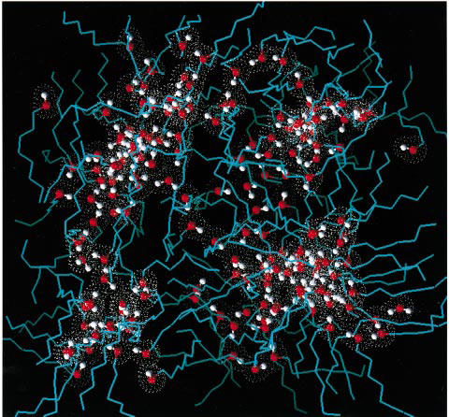
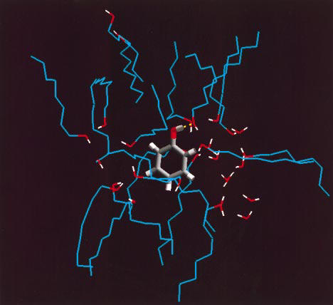
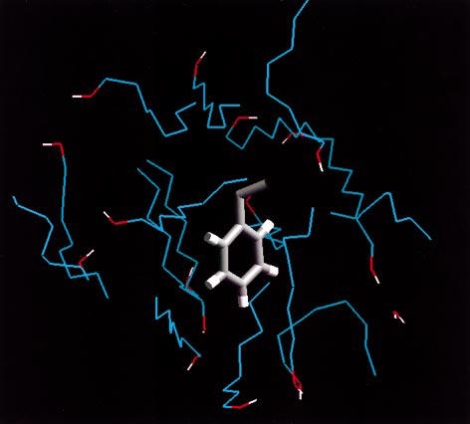
Properties of 1-octanol phase
1-octanol
Flexible molecule
Octanol phase is wet
  The mole fraction of water in octanol: 27.05% ^{[2]}
Heterogeneous environment that has hydrophobic and hydrophilic regions
Polar and hydrophobic regions of water saturated octanol._{[1]}
Phenol in polar region
Ethylbenzene in nonpolar region
[1] Best, Scott A., Kenneth M. Merz, and Charles H. Reynolds. “Free Energy Perturbation Study of Octanol/Water Partition Coefficients: Comparison with Continuum GB/SA Calculations.” The Journal of Physical Chemistry B 103, no. 4 (January 28, 1999): 714–26. https://doi.org/10.1021/jp984215v
[2] Lang, Brian E. “Solubility of Water in Octan-1-Ol from (275 to 369) K.” Journal of Chemical & Engineering Data 57, no. 8 (August 9, 2012): 2221–26. https://doi.org/10.1021/je3001427.

Slide 7
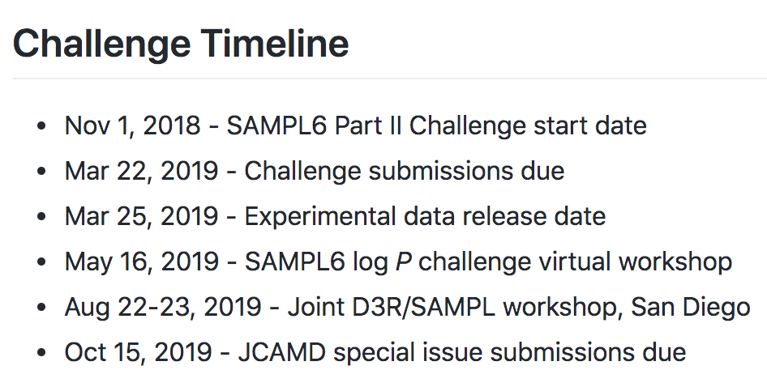
Structure of SAMPL6 log P Challenge
Predicted values to report:
  log P value
  log P SEM: Captures statistical uncertainty of the predicted method.
  model uncertainty: Predicted accuracy of a method, estimates of how well your predicted values are expected to agree with experimental values
Participants were asked to categorize their methods
  Physical
  Empirical
  Mixed
  Other
Detailed method description
For more information on log P prediction challenge
https://github.com/MobleyLab/SAMPL6
Notes:
SEM IF IT IS A STOCHASTIC METHOD
EXAMPLES FROM SUBMISSIONS FOR SEM AND MODEL UNCERTAINTY
e a specific
method can often yield free energy estimates which are
very precise given the particular parameters, yet their
expected discrepancy from experiment may be substantially larger than this level of precision. Our intent was that
the statistical uncertainty would represent the level of
uncertainty in the estimate given the particular model,
while the model uncertainty would represent the level of
uncertainty expected due to the details of the model

Slide 8
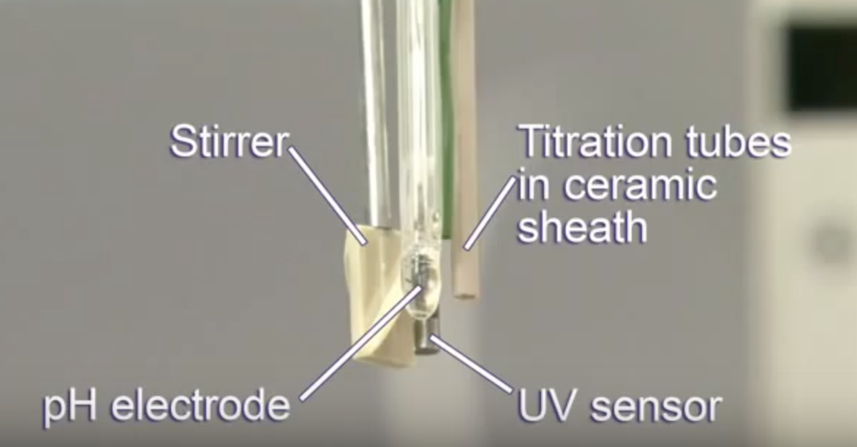
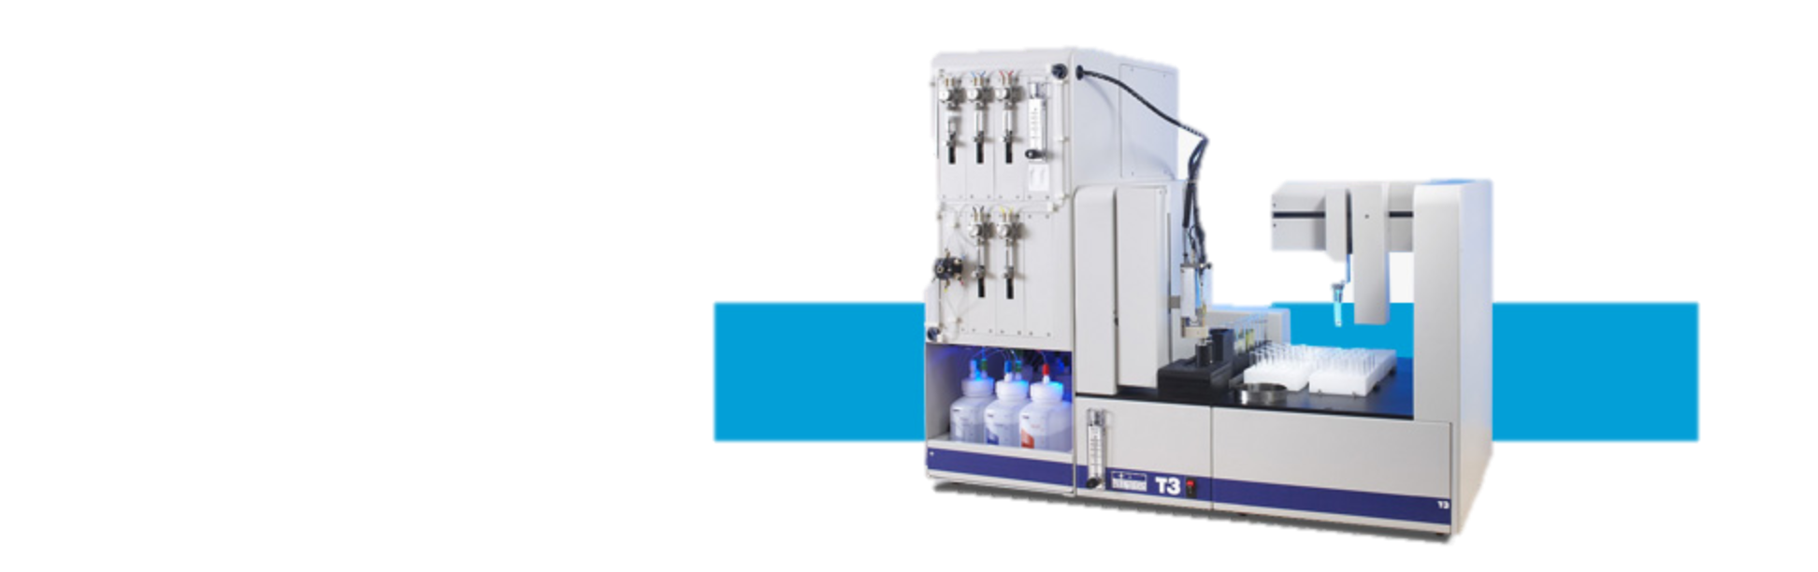
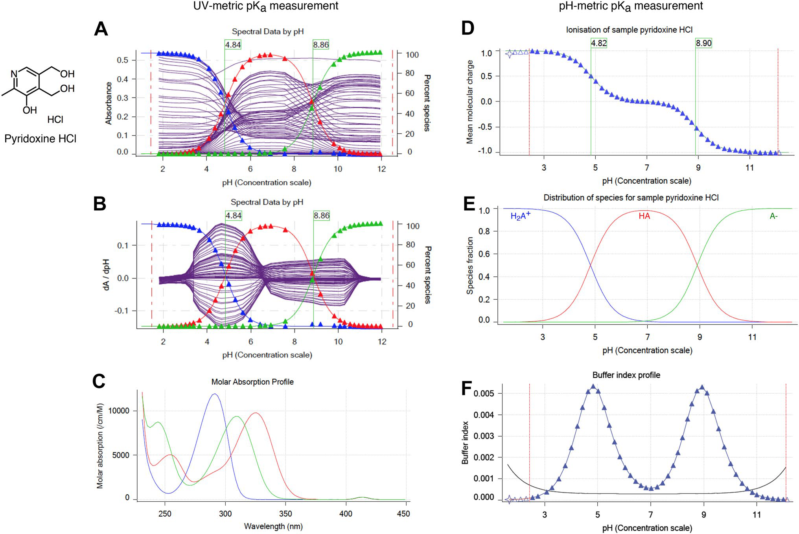
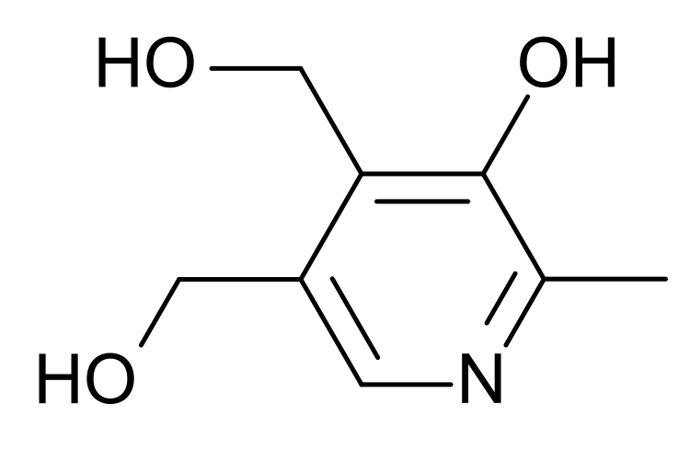
Potentiometric log P measurements were collected with Sirius T3
Collaborators from MRL
Dorothy Levorse
Timothy Rhodes
Potentiometric log P measurement relies on detecting
apparent pK_{a} shift in octanol-water biphasic system.
3 independent replicates
25 ± 0.5 °C
1-3 mg analyte
Ionic-strength adjusted water (0.15 M KCl)
Octanol saturated with ionic-strength adjusted water
Automated acid/base titrations
Pyridoxine HCl
Mehtap Işık, Dorothy Levorse, et al."pKa measurements for the SAMPL6 prediction challenge for a set of kinase inhibitor-like fragments" J Comput Aided Mol Des (2018) 32: 1117. https://doi.org/10.1007/s10822-018-0168-0
Notes:
The pH-metric log P measurement method of the Sirius T3 instrument [3-6] is based on determining a lipophilicity profile directly from acid-base titrations in a dual-phase water-partition solvent system. In this method, multiple potentiometric acid-base titrations are performed in the presence of different ratios of octanol and water to observe the ionization and partitioning behavior of the analyte. A s the relative volume ratio of octanol to water changes, a shift in apparent pKa (poKa) is observed due to partitioning to the octanol phase. Equations of partitioning and ionization are solved to determine the log P of the neutral and ionic species. To use this method, aqueous pKa value(s) must be known and analytes must be sufficiently water soluble.

Slide 9
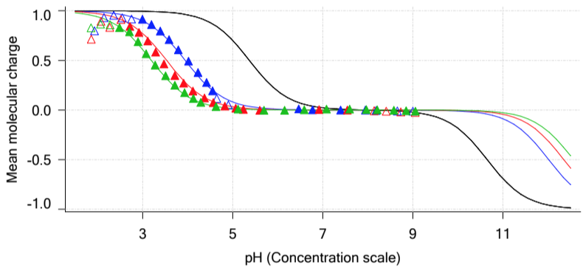
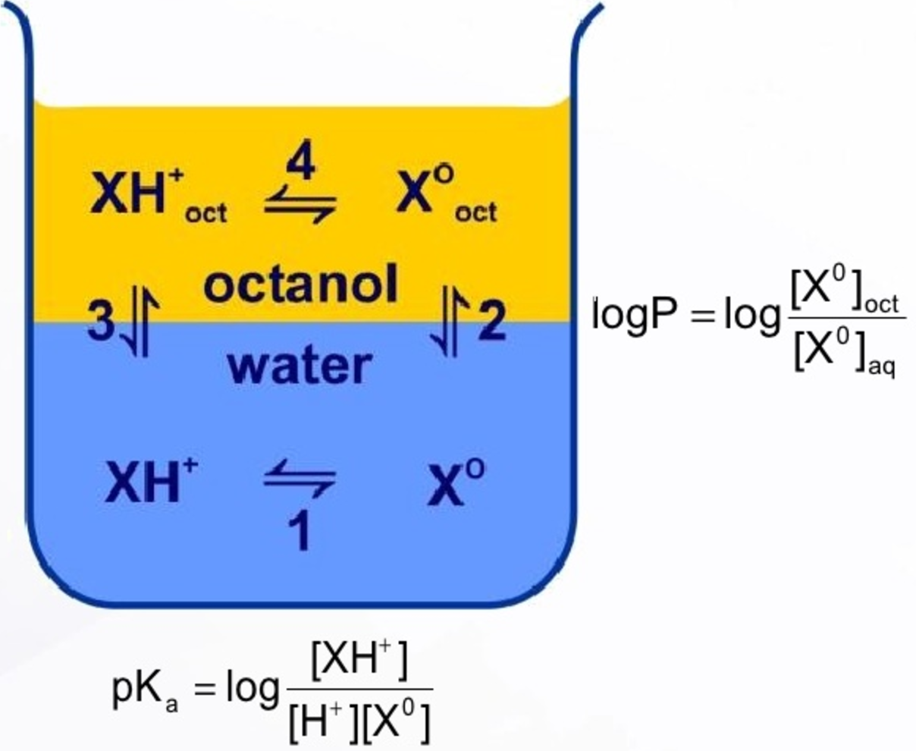

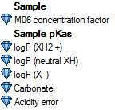
Potentiometric log P measurement relies on detecting apparent pK_{a} shift with respect to relative octanol volume in a biphasic system.
Collaborators from MRL
Dorothy Levorse
Timothy Rhodes
20 uL octanol 70 uL octanol 1070 uL octanol

Slide 10
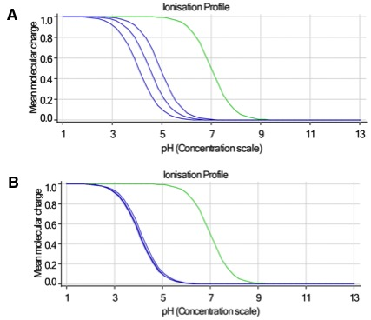
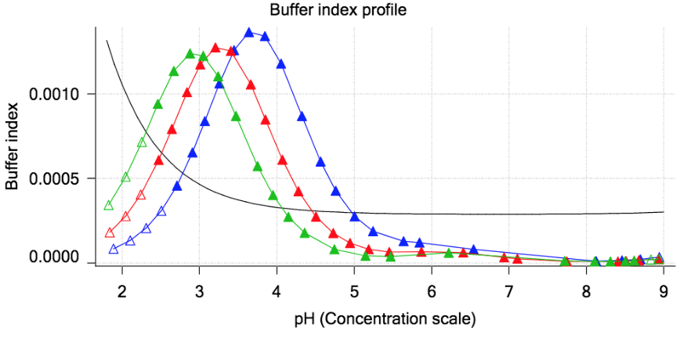
Limitations and challenges of potentiometric log P measurements
More octanol
How to optimize the correct octanol-water volume ratio?
  Significant pK_{a} shift desired
  Limited flask volume
Measureable pK_{a} range and pK_{a} shift
  At least one titratable group
  Must adjust protocol for significant apparent pK_{a} shift
  Can only measure pK_{a}s between 2-12
  Molecules with low basic pKas and high acidic pKas are not suitable for this measurement
How to optimize the analyte concentration?
  High enough buffering capacity required to measure pK_{a}
  Limited by thermodynamic and kinetic solubility
  pH titration requires visiting pH’s where analyte has low solubility.
Limited option of organic solvent
  Cyclohexane is too volatile for this measurement method
  Dodecane logP values of SAMPL6 compounds were beyond measurable range.

Slide 11
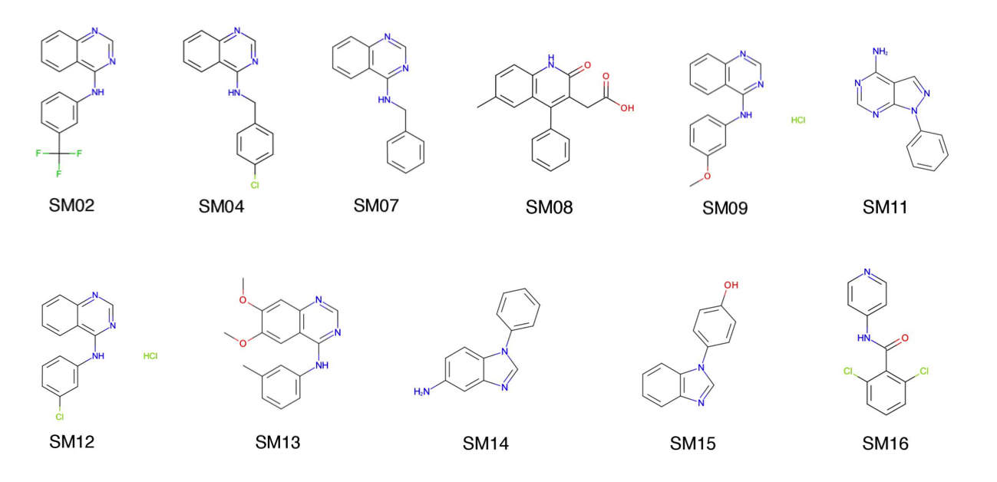
Octanol:water log P values for 11 compounds measured with potentiometric method of Sirius T3.
SAMPL6 log P challenge molecules are a subset of SAMPL6 pK_{a} challenge molecules which were dictated by the experimental limitations of potentiometric log P measurement method.
4-amino quinazoline group: 6 molecules
Benzimidazole group: 2 molecules
Narrow dynamic range of log P values:
1.95 - 4.09
Notes:
SUBSET OF PKA CHALLENGE sufficiently sollublle

Slide 12
We received a significant number of blind predictions covering a variety of methods.
We collected 91 blind submissions from 27 groups.
Reporting Predictions
Molecule ID, logP, logP SEM, logP model uncertainty
Method category
Empirical: 17
Physical: 48
Mixed: 17
Other: 9

Slide 13
How accurate were octanol-water log P predictions?
  Statistics calculated:
  Root mean square error (RMSE)
  Mean absolute error (MAE)
  Mean error (ME)
  Linear regression slope (m)
  R-squared (R²)
  Kendall’s Tau
  95% confidence intervals of each statistic were calculated by bootstrapping.
  Github SAMPL6 repository:
  Because of limited dynamic range RMSE and MAE more important statistics for evaluating model accuracy than correlation-based metrics.
Notes:
What R2 you expect by chance based on dynamic range.
David knows which paper.
Cite Scott Brown paper “healty skeptisizm”

Slide 14
Accuracy evaluation of methods that participated
SAMPL6 log P challenge
10 methods achieved RMSE ≤ 0.5 log P units
A significant portion of submissions achieved
RMSE ≤ 1.0 log P units
Error bars indicate 95% CI.
Notes:
Performance is generally better
Errors of best performing methods were better than SAMPL5

Slide 15
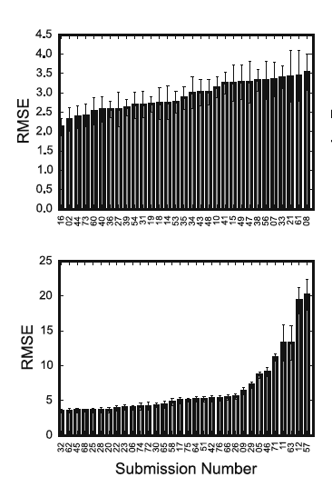
Accuracy evaluation of methods that participated
SAMPL6 log P challenge
SAMPL5 prediction challenge for
cyclohexane-water logD at pH 7.4
In SAMPL6 log P challenge:
Ionization state predictions do not contribute to prediction errors.
Neutral tautomeric states may effect log P predictions.
Chemical diversity in SAMPL6 dataset more is more limited.
1-octanol is a more familiar solvent for log P predictions.
Heterogeneity of wet octanol phase is a challenge for physical modeling methods.
Error bars indicate 95% CI.
Notes:
Performance is generally better
Errors of best performing methods were better than SAMPL5

Slide 16
Performance evaluation of methods that participated log P challenge
cosmotherm_FINE19: COSMOtherm QM calculations: BP//TZVP//COSM geo. opt., BP//TZVPD//FINE Single Point , wet octanol
Partitioning: BP_TZVPD_FINE_19
Global XGBoost-Based QSPR LogP Predictor: trained on EPI Kow dataset (EPA's OPERA toolkit)
cosmoquick_TZVP18+ML: COSMOfrag algorithm, COSMO-RS method, decision tree ensemble
(Stochastic Gradient Boosting via the XGBoost library5)
Local XGBoost-Based QSPR LogP Predictor
EC_RISM_wet_P1w+2o: Geo. gen. Maestro 2017-2/Macromodel with the OPLS3/Water force field
Geo. opt. B3LYP/6-311+G(d,p) using Gaussian 16revB01 with IEF-PCM
EC-RISM/MP2/6-311+G(d,p) using PSE2 and PSE1 closure for water and n-octanol
reparametrized with respect to the MNSol free energies of solvation
SM12-Solvation-Trained: SM12 solvation model as implemented in Q-Chem
Geo. Opt. M06-2X/cc-pVDZ,
Solvation: M06-2X/6-31G(d) with the SM12 solvation model
Multiple linear regression
RayLogP-II QSPR model
Notes:
3 different methods to evaluate SM13
Signed error

Slide 17
Prediction accuracy of methods from “empirical” category
Global XGBoost-Based QSPR LogP Predictor: trained on EPI Kow dataset (EPA's OPERA toolkit)
Local XGBoost-Based QSPR LogP Predictor
RayLogP-II QSPR model
rfs-logp: random forest model with recursive feature selection
S+logP: ADMET Predictor 9.5, Simulations Plus, Inc., 2018

Slide 18
Prediction accuracy of methods from “physical” category
cosmotherm_FINE19: COSMOtherm QM calculations: BP//TZVP//COSM geo. opt., BP//TZVPD//FINE Single Point , wet octanol
Partitioning: BP_TZVPD_FINE_19
EC_RISM_wet_P1w+2o: Geo. gen. Maestro 2017-2/Macromodel with the OPLS3/Water FF
Geo. opt. B3LYP/6-311+G(d,p) using Gaussian 16revB01 with IEF-PCM
EC-RISM/MP2/6-311+G(d,p) using PSE2 and PSE1 closure for water and n-octanol
reparametrized with respect to the MNSol free energies of solvation
LogP_SMD_Solvation_DFT: Gas phase geom.: M06L functional with the D3zero dispersion correction
Solvation: continuum solvation model based on density (SMD) and M06-2X functional with
D3zero dispersion correction, Def2-SVP basis set
SM8-Solvation:
SM8 solvation model as implemented in Q-Chem
Geo. Opt. M06-2X/cc-pVDZ l
Solvation: M06-2X/6-31G(d) level of theory/basis set
EC_RISM_dry_P1w+2o
SM12-Solvation
Notes:
Is there a second force field based physical model here?

Slide 19
Prediction accuracy of methods from “physical” category
Notes:
Is there a second force field based physical model here?

Slide 20
Prediction accuracy of methods from “physical” category
Molecular-Dynamics-Expanded-Ensembles: Amber/OPLS FF
MM-based
Alchemical-CGenFF
Alchemical-CGenFF
QM-based
FS-GM (Fast switching Growth Method): CGenFF/OPC3
FS-AGM (Fast switching Annihilation/Growth Method): CGenFF/OPC3
Alchemical-CGenFF
FS-AGM (Fast switching Annihilation/Growth Method): OPLS-AA/OPC3
InterX_GAFF_WET_OCTANOL
FS-GM (Fast switching Growth Method): OPLS-AA/OPC
MD/S-MBIS-GAFF-TIP3P/MBAR/
MD-AMBER-dryoct: GAFF/TIP3P
Notes:
Is there a second force field based physical model here?

Slide 21
Prediction accuracy of methods from “mixed” category
cosmoquick_TZVP18+ML: COSMOfrag algorithm, COSMO-RS method, decision tree ensemble
(Stochastic Gradient Boosting via the XGBoost library5)
SM12-Solvation-Trained: SM12 solvation model as implemented in Q-Chem
Geo. Opt. M06-2X/cc-pVDZ, Solvation: M06-2X/6-31G(d) with the SM12 solvation model
Multiple linear regression
SMD-Solvation-Trained
ML Prediction using MD Feature Vector Trained on logP_octanol_water,
with Additional Meta-learner
ML Prediction using MD Feature Vector Trained on logP_octanol_water
SM8-Solvation-Trained
ZINC15 versus PM3: logP calculation using PM3 and linear fit to experimental data

Slide 22
Prediction accuracy of methods from “other” category
Compscience-3: Junction Tree Neural Network predictor
DLPNO-CCSD(T)/cc-pVTZ//B3LYP-D3/cc-pVTZ
DLPNO-Solv-ccCA
BLYP/cc-pVTZ//B3LYP-D3/cc-pVTZ

Slide 23
Performance comparison based on Kendall rank correlation coefficient
EC_RISM_wet_P1w+2o: Geom. gen. Maestro 2017-2/Macromodel with the OPLS3/Water force field.
Geom. opt. B3LYP/6-311+G(d,p) using Gaussian 16revB01 with IEF-PCM
EC-RISM/MP2/6-311+G(d,p) using PSE2 and PSE1 closure for water and n-octanol.
Reparametrized with respect to the MNSol free energies of solvation
EC_RISM_dry_P1w+2o
LogP-prediction-SMD-HuangLab
EC_RISM_wet_P1w+1o
Solvation-M062X
5 methods with lowest RMSE

Slide 24
Analysis of average prediction accuracy of each molecule
There wasn’t any molecule that was significantly harder to predict than others.
To see the distribution of accuracy across models for each molecule more detail please see the violin plots found in SAMPL6 repository:
Notes:
Violin plot/ridge plot for sample statistics.

Slide 25
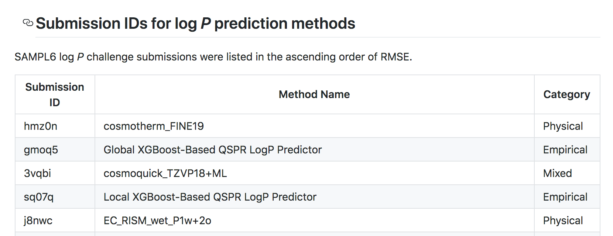
Suggested directions for analysis of method performance
1. Due to limited dynamic range of experimental data, prefer RMSE and MAE over correlation statistics to judge model performance.
2. Is your method able to capture log P rank order of 4-amino quinazoline series? Is it capable of capturing substituent effects to log P?
3. Are there any molecules with lower prediction accuracy than others?
4. Does tautomer prediction impact log P predictions?
5. How does your method perform compared to similar methods in SAMPL6 challenge?
Refer to submissions table to find similar methods:
Notes:
Follow up for more methods details.

Slide 26
Acknowledgments
SAMPL6 organizers and advisors
David Mobley
John Chodera
Daniel Bergazin
Caitlin Bannan
Andrea Rizzi
Bas Rustenburg
D3R
Michael Gilson
Rommie Amaro
Michael Chiu
Merck Preformulation Group
Timothy Rhodes
Dorothy Levorse
Heather Wang
Brad Sherborne
NIH R01 GM124270
Tri-Institutional PhD Program in Chemical Biology
Doris J. Hutchison Fellowship
Participants of SAMPL6 log P challenge
Alexei Nikitin
Andreas Kraemer
Andrew Paluch
Bogdan Iorga
Boris Sattarov
Chris Loschen
Chung Kee-Choo
Davy Guan
Diogo Santos Martins
Esteban Vohringer-Martinez
Evrim Arslan
Floriane Montanari
Ganesh Kamath
Hwangseo Park
Jae Hong Shin
Jing Huang
Jose Jimenez Luna
Michael Jones
Mohammed Ali
Piero Procacci
Prajay Patel
Raymond Lui
Robert Fraczkiewicz
Samarjeet Prasad
Shuzhe Wang
Stefan Kast
William Zamora

Slide 27
Participants who will be presenting today at the virtual workshop
and their submissions
Christoph Loschen (Cosmologic)
Stefan Kast (TU Dortmund )
Prajay Patel (Michigan State University)
William Zamora (Universitat de Barcelona)

Slide 29
Is there a reason to suspect experimental error for SM13 logP value?
Absolute errors plots for calculated for each molecule for methods with lowest RMSE don’t suggest a possibility of experimental error with SM13.
With additional NMR and MS measurements we confirmed that SM13 has the correct structure.
Dorothy Levorse

Slide 30
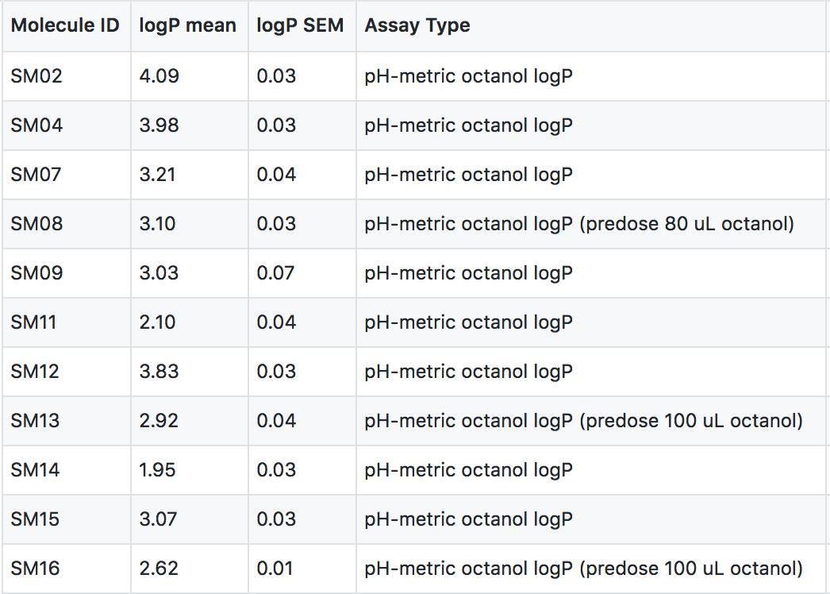

SAMPL6 log P challenge experimental data has been released after challenge deadline.
3-4 independent replicates were performed for each molecule.
Narrow dynamic range of log P values:
1.95 - 4.09
Notes:
kinetic solubility issues of the analytes, solid samples were predosed manually with 80-100 uL octanol

Slide 31
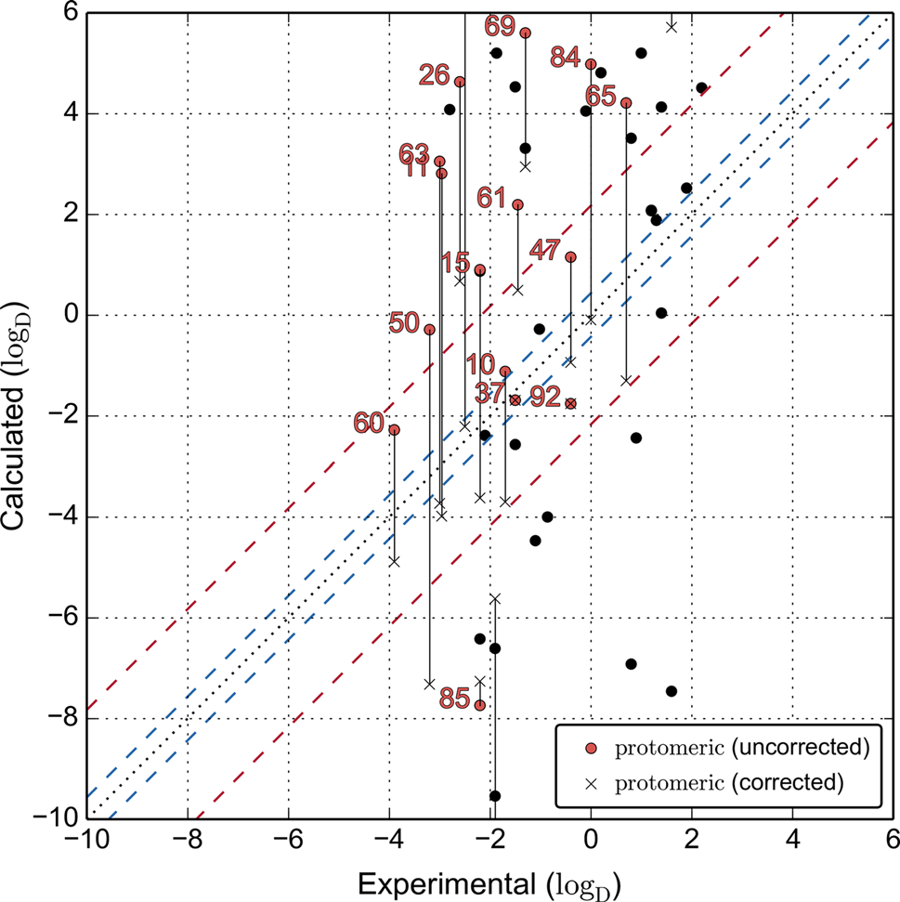
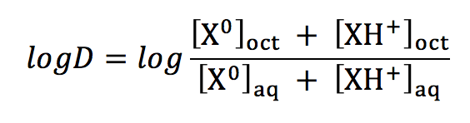
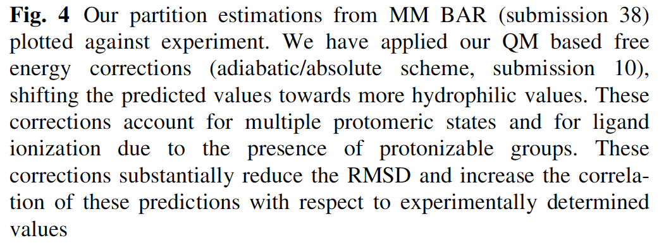
Why did we decide to organize a separate pK_{a} and logP prediction challenges in SAMPL6?
SAMPL5 logD challenge showed that the failure to account for ionization state (pKa) effects impact prediction accuracy of logD.
cyclohexane
Pickard, F. C. et al. Blind prediction of distribution in the SAMPL5 challenge with QM based protomer and pKa corrections. Journal of Computer-Aided Molecular Design 30, 1087–1100 (2016).
Notes:
Failure to account for pKa effects can have a large impact on prediction accuracy.
SAMPL5 logD challenge indicated the impact of prediction of the ionization state distribution on the accuracy of logD predictions.
In SAMPL6 we organized separate challenges for pKa and partician coefficients, with the goal of deconvoluting these effects from one another.

Slide 32
How accurate were model uncertainty predictions?
  To evaluate if model uncertainty is overestimated or underestimated we calculated error slope (ES):
  The slope calculated from linear least squares fit to Q-Q Plot.
ES ≈ 1
good estimate of model uncertainty
ES > 1
overestimated
ES < 1
underestimated
  Q-Q Plots for each method can be found in SAMPL6 GitHub repository:
  For comparison of error slope values please refer to:
Mobley, David L., et al. “Blind Prediction of Solvation Free Energies from the SAMPL4 Challenge.” Journal of Computer-Aided Molecular Design 28, no. 3 (March 2014): 135–50. https://doi.org/10.1007/s10822-014-9718-2.
Notes:
Explanation of QQ Plot Error Slope
X = Quantiles of a normal distribion
y:= Fraction of prediction errors that are less than model uncertainty

Slide 33
Which methods were very good at estimating their model uncertainty?
EC_RISM_dry_P1w+1o
ML Prediction using MD Feature Vector Trained on logP_octanol_water, with Additional Meta-learner
EC_RISM_wet_P1w+1o
ARROW_2017
cosmoquick_TZVP18+ML
LogP-prediction-method-IEFPCM/MST

Slide 34
SAMPL6 logP challenge participants are encouraged to submit publications to JCAMD special issue.
In coordination with Terry Stouch, we are planning a special issue of
J. Comp. Aided Mol. Design (JCAMD) focused on the SAMPL6 logP challenge.
All participants are welcome to submit manuscripts evaluating their methods.
The submission deadline for this is
Overall performance analysis paper
Paper that describes experimental data collection
Individual method papers by participants
?

Slide 35
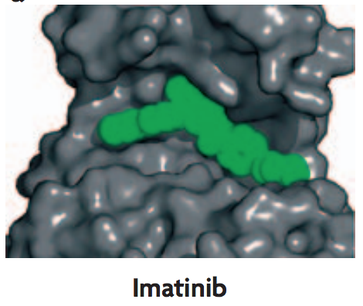
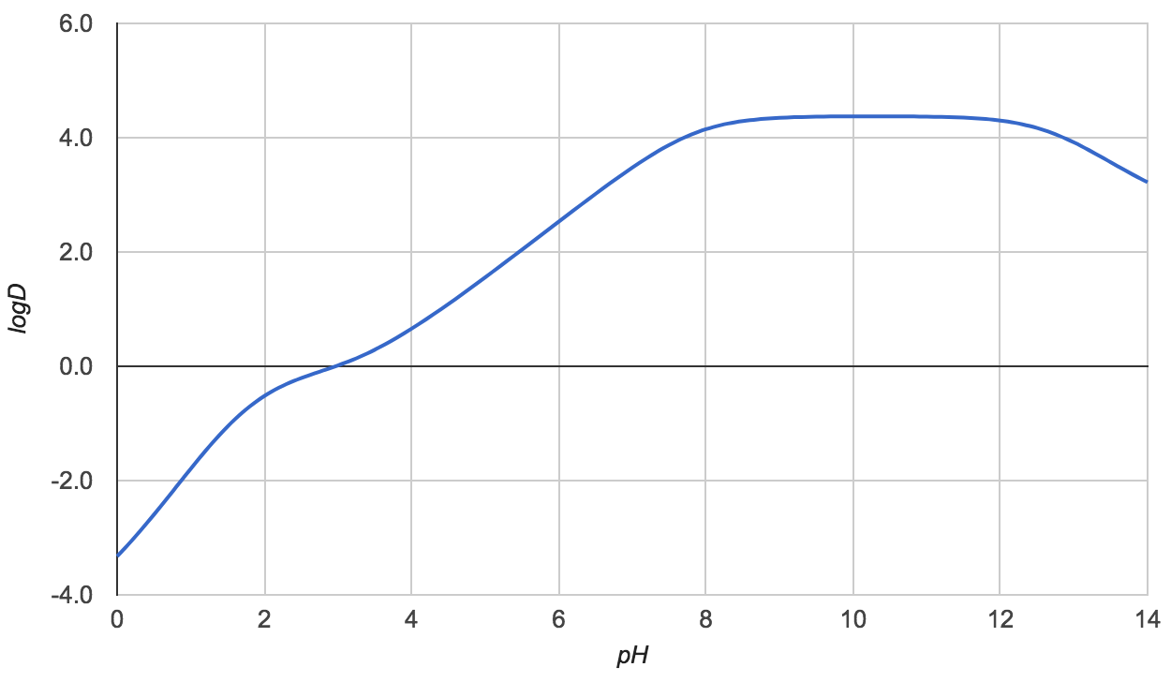
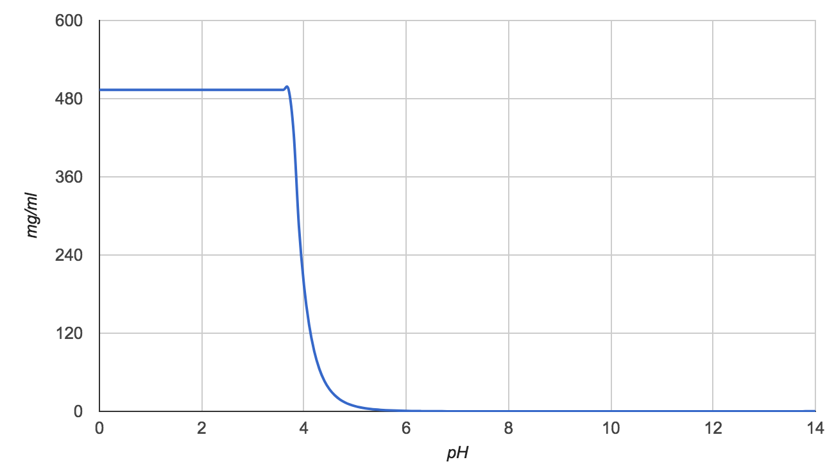
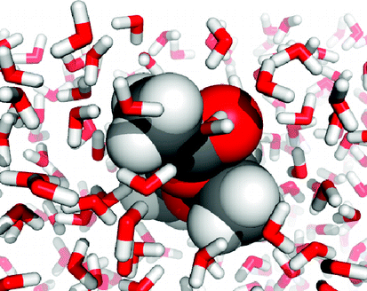
pKas affect physicochemical and pharmaceutical properties
Protein binding
Potential hydrogen bonds
Dipole moment of the molecule
Free energy penalty of protonation
(1.36 kcal/mol for 1 pKa unit)
Imatinib:ABL
Lipophilicity
Distribution coefficient (logD)
to organic phase
Membrane permeability
Blood-brain barrier partitioning
logD vs pH
Solubility
pH dependent
Charged species are more soluble
logS vs pH
Nature Reviews Cancer volume 7, pages 345–356 (2007)
www.chemicalize.com

Slide 36
Experimental pKa values for SAMPL6 were measured with Sirius T3
Collaboration with Merck, MRL
Dorothy Levorse
Timothy Rhodes
Method: UV-absorbance spectra based pKa measurement
Measurement range: 2-12
24 small kinase inhibitor fragment-like molecules
Temperature: 25°C
Ionic strength: 150 mM KCl solution
3 independent replicates (from the same DMSO stock)

Slide 37
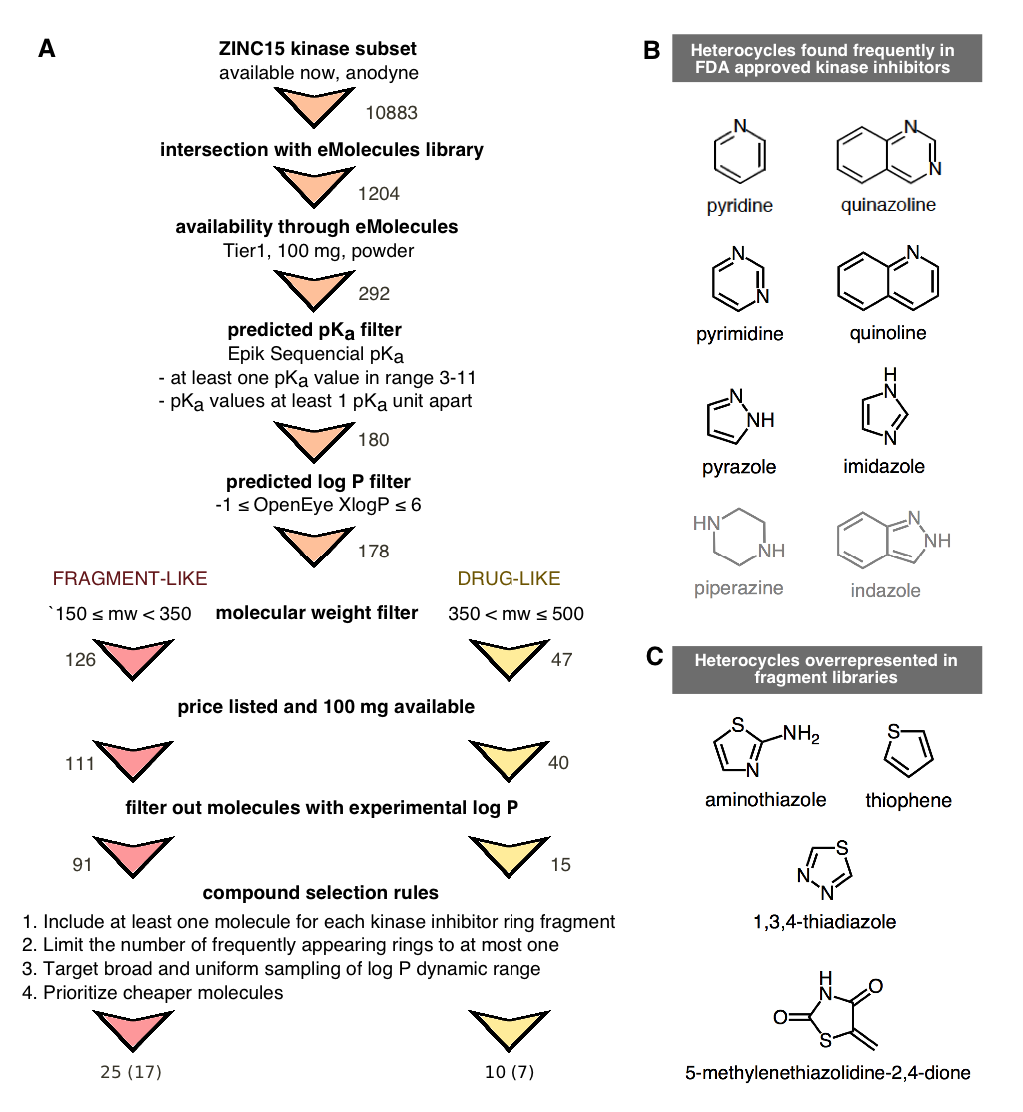
Selection of small molecules for the first pKa prediction challenge of SAMPL series

Slide 38
The first pK_{a} challenge of SAMPL series was organized to evaluate the current state of pK_{a} prediction methods.
Selected compounds with kinase inhibitor-like properties
Collected experimental pK_{a} values
3 months allowed for blind predictions
12 research groups participated, testing 41 different methods
Frequent heterocycles found in FDA-approved kinase inhibitors

Slide 39
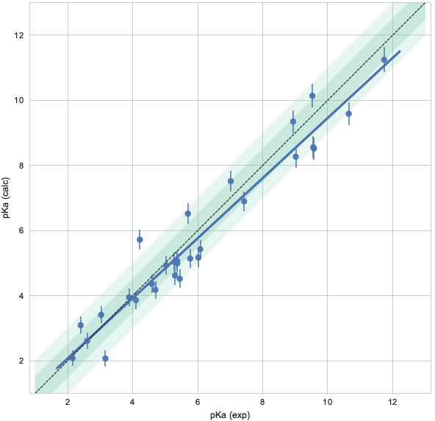
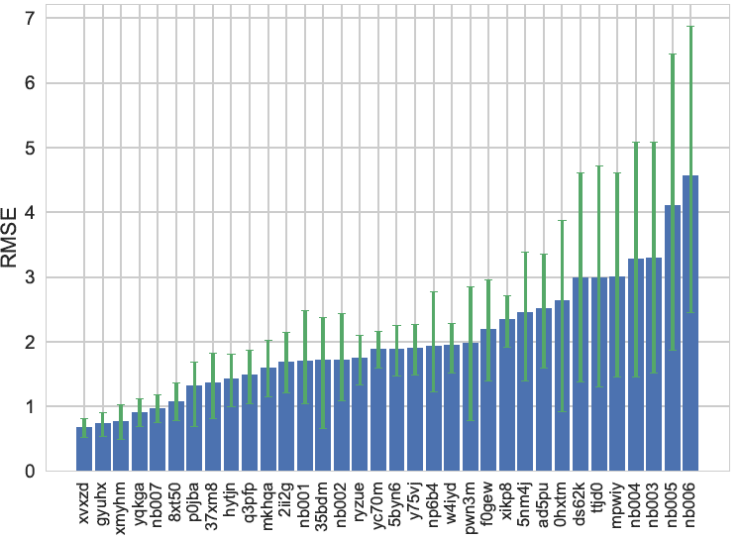
Overall performance of macroscopic pKa predictions
RMSE values span the range of 0.7-5 pKa units.
Submission ID

Slide 40

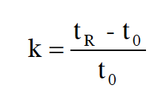
Possibility of including reverse phase chromatography retention time based logD values
Dorothy Levorse
Timothy Rhodes
Standard curve for HT logD measurements
HTS logD Protocol of Adopted by Preformulaton Group
UPLC runs with reverse phase C₁₈ columns and acetonitrile gradient
logD_{ow} = a + b RT
Measureable range: 0.5 – 5
Analytical : +- 0.1
Reproducibility: +- 0.5 (Interlab comparison to shake- flask method)
Concerning deviations from established OECD method
1.
2. Acetonitrile gradient elution instead of isocratic method with methanol
3. Presence of acetonitrile as cosolvent causes shifts in pKa values.
4. pKa values close enough to measurement pH that ionization is possible. LogP values can’t be approximated by logD measurements.
k: capacity factor
t₀: dead time
t_{R}: retention time
Standards | Literature log D (pH 7) | RT [min] | HT logD (pH 7)
Benzophenone | 3.18 | 0.77
Warfarin | 0.85 | 0.43
Ketoconazole | 3.48 | 0.71
Diphenyl Ether | 4.21 | 0.88
Biphenyl | 4.01 | 0.89
Hydrocortisone | 1.52 | 0.50
Carbamazepine | 1.65 | 0.54
Imipramine | 2.31 | 0.71
Terfenadine | 4.05 | 0.94
Propranolol | 1.30 | 0.48 | 1.31, 1.32, 1.32, 1.33
OECD Guideline for testing chemicals: Partition Coefficient, High Performance Liquid Chromatography Method. (Guideline 117, 2001)

Slide 41
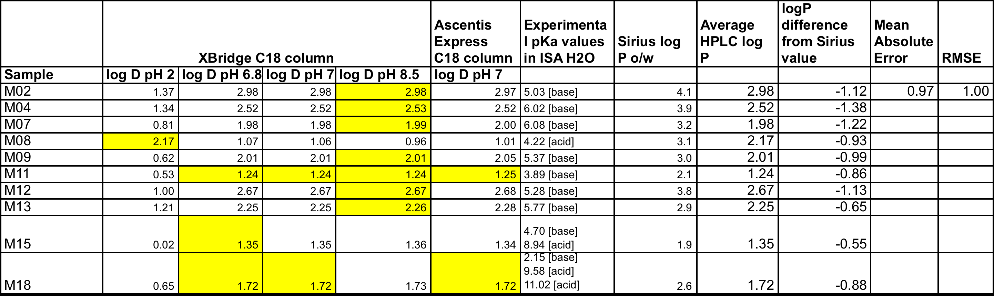
Attempting to adjust HTS method to measure logP didn’t resulted in consistent values with Sirius pH-metric logP measurements
Dorothy Levorse
Timothy Rhodes
Results from two measurements methods were not similar.
RMSE 1 log unit.
Relying on this dataset would require extensive validation work.
Therefore, we decided to construct the logP challenge only on the 11 logP measurements performed with Sirius T3.

