Slide 1
Pose and affinity prediction by ICM in D3R GC4
Max Totrov
Molsoft

Slide 2
Overview
Cathepsin S
Affinity
APF 3D QSAR
APF
GC4
Affinity
‘4D’ grid ens. docking
LigBEnD
ICM
BACE
Pose: cross
ICM dock
GRC ring flex macrocycle
Pose: cognate
rec.

Slide 3
Atomic Property Fields (APF)
Totrov M. Atomic Property Fields: generalized 3D pharmacophoric potential for automated ligand superposition, pharmacophore elucidation and 3D QSAR. Chem Biol Drug Des. 2008 ;71(1):15-27.

Slide 4
APF - 3D pharmacophoric potential
3D pharmacophore: arrangement of molecular properties in space that confers activity. Generalization of point pharmacophore concept:
Discrete pharmacophoric points → Continuous distributions
Moieties represented as Ph4 types → Vectors of atomic properties
φ^{j}_{i} - vector of properties i for atom j
Atomic similarity measure - dot product of property vectors: ∑ φ^{j}_{i} φ^{k}_{i}
Atomic Property Field (APF) - continuous 3D potential:
P_{i}(r) =∑ φ^{j}_{i} exp((r-r^{j})²/λ²_{APF});
Pseudo-energy (score) of a compound in APF:
E_{APF}=-∑φ^{j}_{i} P_{i}(r^{j});
Implementation - on a 3D (multi)grid
continuous derivatives (spline)
fast potential for molecular mechanics/optimization in combination with force-field energy
Notes:
What is the genesis of APF
The APF gives, at every point in space, a vector of values that reflect properties preferred at that point.
Sum of dot products of vectors of properties for each atom and APF vector at the corresponding point in space.

Slide 5
APF 3D QSAR
Docking (or alignment) to generate poses
3D QSAR:
ΔG_{bind} ≈ ∑ ∑ φ^{m}_{i} P_{i}^{APF-QSAR} (r^{m});
P_{i}^{APF-QSAR} (r) =∑ ∑ω^{k}_{i}φ^{j}_{i} exp(-(r-r^{j})²/λ²);
7·N_{train} weights ω^{k}_{i} for the contributions of each molecule k in the training set into each APF component i
ΔG^{l}_{bind} ≈ ∑ ∑ ω^{k}_{i} E_{APF}^{kl}_{i}; E_{APF}^{kl}_{i} = ∑ ∑ φ^{m}_{i} φ^{j}_{i} exp(-(r^{m}-r^{j})²/λ²);
Partial Least Squares (PLS) to determine weights ω^{k}_{i}
Totrov M. Atomic Property Fields: generalized 3D pharmacophoric potential for automated ligand superposition, pharmacophore elucidation and 3D QSAR. Chem Biol Drug Des. 2008 ;71(1):15-27.

Slide 6
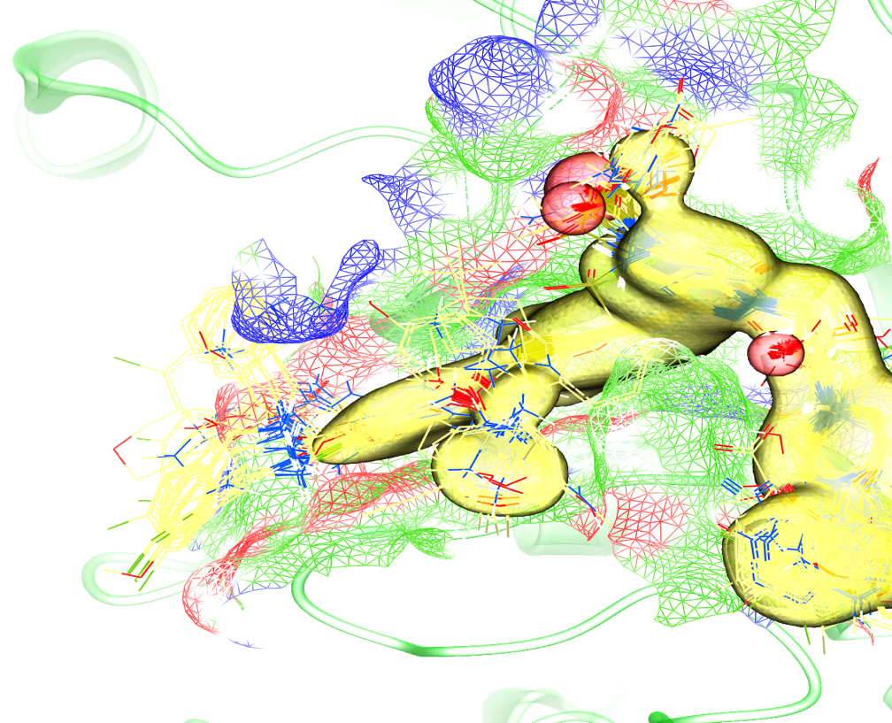
Training APF 3D QSAR: Cathepsin S
430 compounds (related to challenge compounds) docked
3D poses used to build APF 3D-QSAR model
Visualization of APF fields of pKd model for Cathepsin S

Slide 7
Iterative “pose selection-consistent” 3D QSAR model building
Ideally, ‘good’ 3D QSAR model should also rank near-native poses above decoys
CatS: Lowest Score Conf != Lowest pred pKd Conf for ~1/3 of the training set
“Pose selection-consistent” (PSC) 3D QSAR: docked poses for prediction are selected according to the model itself
PRC model is built iteratively
Cross-validation (3-fold cluster) on Cathepsin S training set suggested PRC model is better
Training set docked poses 10/lig.
Lowest
Score
poses
Lowest
pred. pKd
poses
Train 3D QSAR
 | RMSE_{cross} | R_{cross} | 𝛕_{cross}
Lowest score | 0.69 | 0.5 | 0.38
PSC | 0.65 | 0.6 | 0.45
No
Yes
Changed?
Done

Slide 8
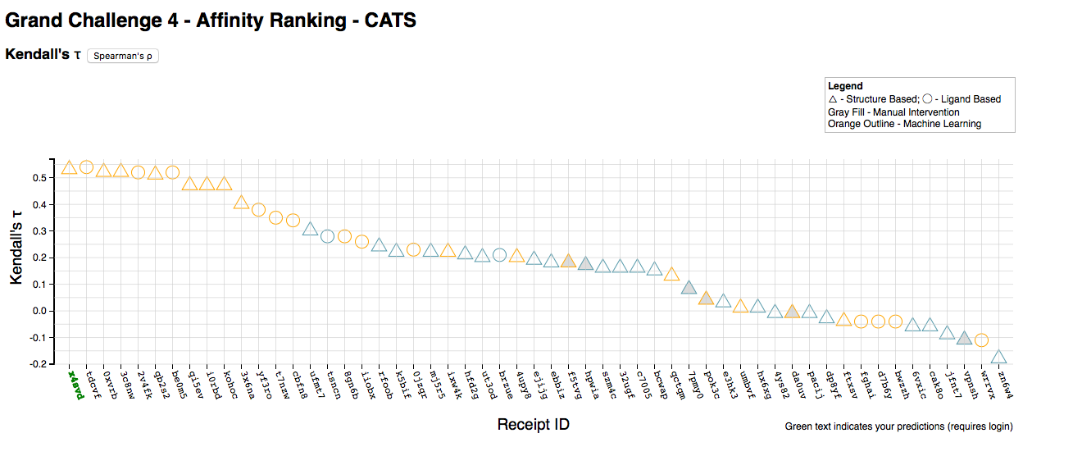
Cathespin S activity GC4 prediction results
𝛕 = 0.54

Slide 9
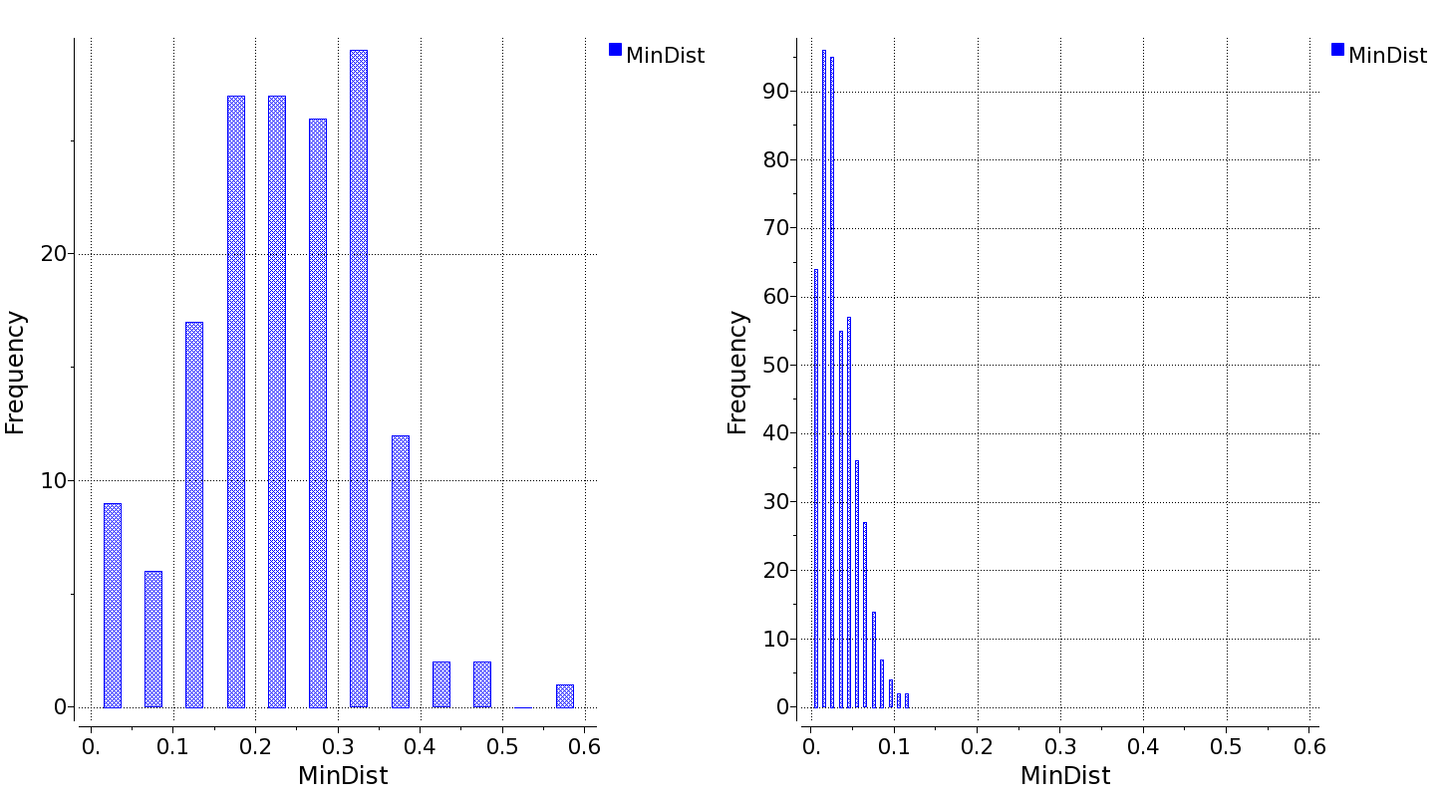
BACE activity prediction
Closest training set compound distance distribution
Submitted 3D QSAR gave poor correlation (𝛕=0.21)
Chemical distance from the available training set likely the culprit. Model works within ~0.17 Tanimoto
On full set simple baseline predictors perform better, comparable to best submissions
BACE
Cathepsin S
Tanimoto
BACE expt./QSAR correlation
Applicability
domain
 |  | Kendall’s 𝛕, pKd versus property:
Compound Set | Number of cmpds. | Molecular Weight | Molecular Surface Area | Molecular Volume | Hydrophobic Interaction Term
Related ChEMBL | 103 | 0.15 | 0.11 | 0.19 | -0.30
Macro ChEMBL | 149 | 0.14 | 0.04 | 0.13 | -0.22
All ChEMBL | 7124 | -0.03 | -0.04 | -0.03 | N/A
D3R Challenge | 154 | 0.31 | 0.35 | 0.38 | -0.32
% of the challenge set included

Slide 10
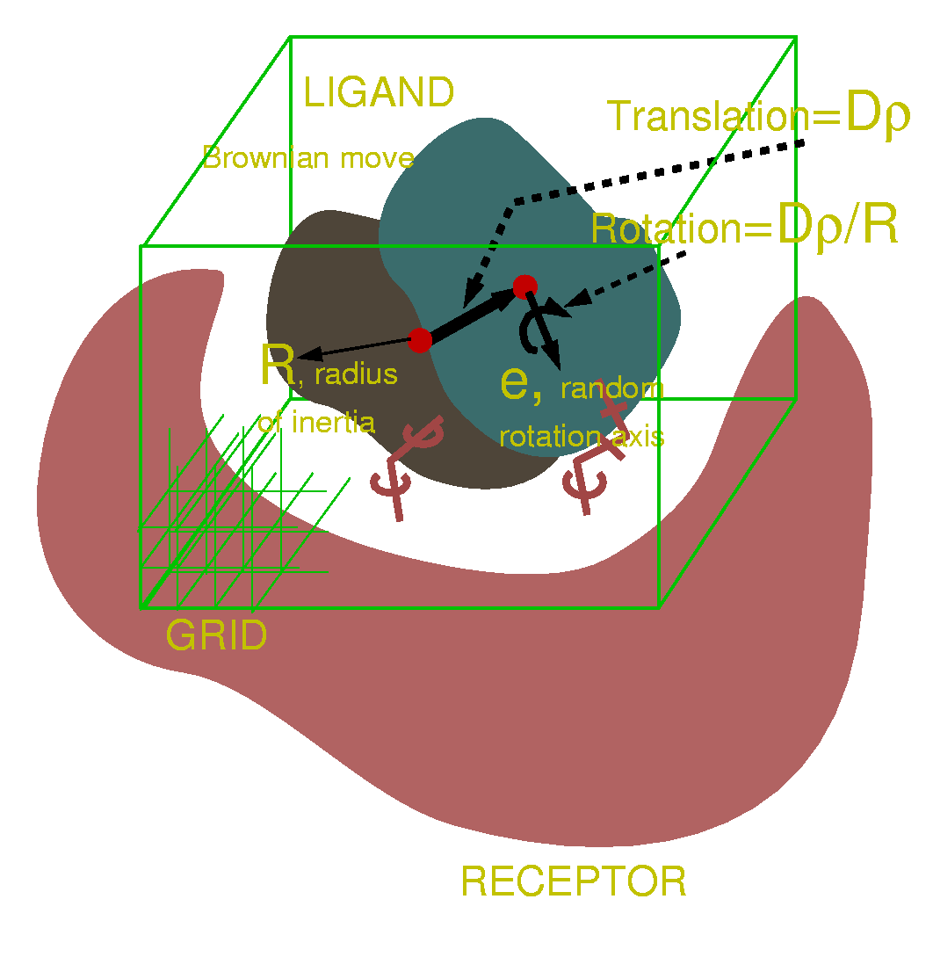
Pose prediction method: ICM-dock
ICM-dock:
pre-sampling of ligand conformers
multiple trajectory Monte-Carlo with gradient minimization in internal coordinates
receptor represented by grid potentials
multiple receptor conformations used when needed to address flexibility
pose re-ranking with ICM VLS score (enhanced GB/SA class scoring function)

Slide 11
Macrocycle sampling in internal coordinates
GC4: BACE ligands macrocyclic
ICM: internal coordinate (torsion space) representation of the molecule during Monte-Carlo sampling/gradient minimization
In acyclic structures all bonds are edges of the internal coordinate tree and idealized covalent geometry is preserved automatically
Ring structures: certain bonds are off-the-tree ‘extra’ bonds
Gradient Ring Closure: covalent geometry of ‘extra’ bonds enforced by explicit stretching and bending terms during gradient minimizations.
𝚽₄
𝛗₅
b₄
b₅
5
b₃
3
𝛂₅
2
𝛂₃
𝛂₄
4
𝚽₇
𝚽₆
𝛂₆
b₆
Z
𝚽₃
b₂
𝛂₂
1
𝛂₇
6
-1
𝚽₂
𝛗₈
b₇
𝚽₁
𝛂₈
𝚽₉
b₈
𝛂₉
𝛂₁
b₁
7
𝚽₁₀
-2
Y
8
b₉
0
9
𝛂₁₀
𝚽₁₁
X
Ring
‘extra’ bond
13
𝛂₁₁
b₁₀
b₁₃
𝛂₁₃
𝛂₁₂
10
𝚽₁₂
12
11
b₁₁
b₁₂
𝚽₁₃

Slide 12
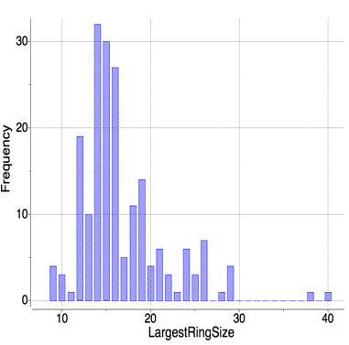
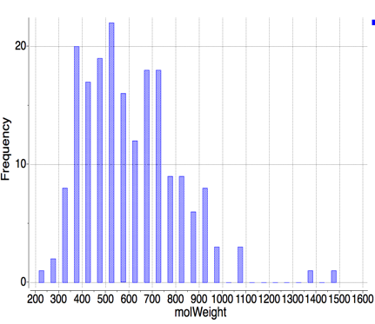
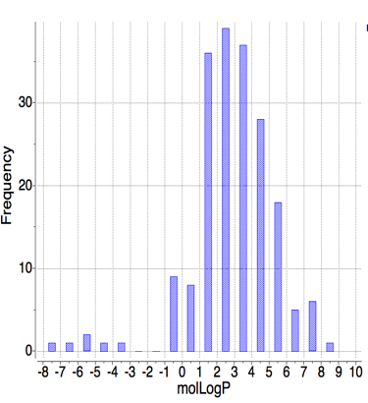
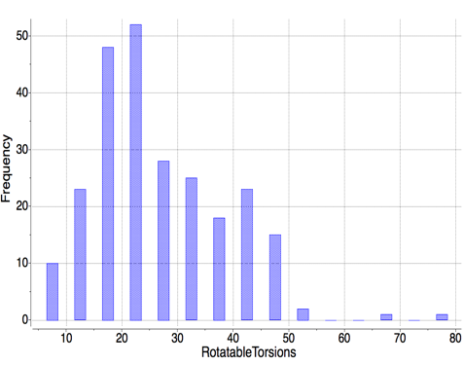
Preliminary tests: macrocycle benchmark
500Da
246 complexes from PDB, 198 unique ligands, 126 unique proteins:
9-member or larger rings
resolution <2.5A
checked for common quality problems
suspicious structures reviewed against electron density, chemistry cross-checked against literature, etc.
Most ligands in bRo5 space
Macro ring size
MW
0.
5.
Typical
drugs
LogP
Torsion count with flexible rings
Property distributions of ligands in the benchmark

Slide 13
Benchmarking results
Top ranking pose RMSD < 2A: 62%; within top 5 poses: 75%
Upper size range most challenging
For half of the benchmark covering smaller molecules (≤42 heavy atoms or ≲600Da): top pose 76%; top 5 poses 86% success rates
GC4 ligands <MW>=535Da
Top pose
Best in top 5
Best freeconf.

Slide 14
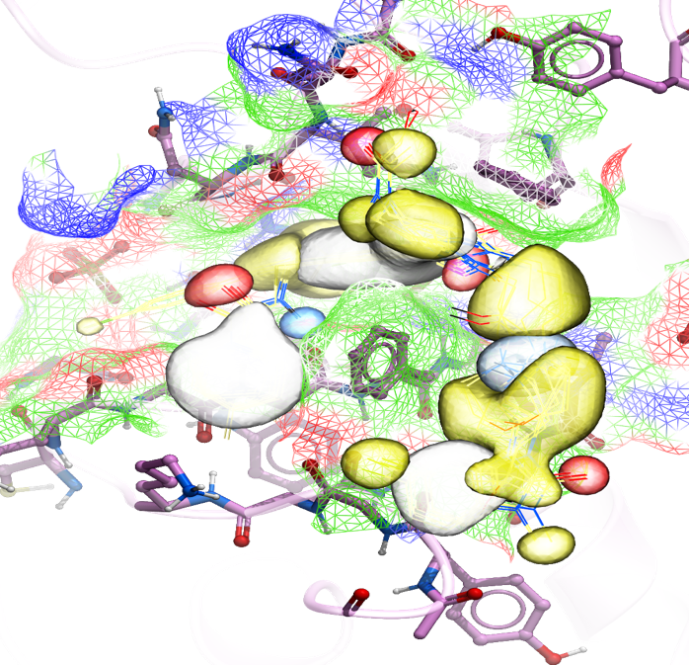
Ligand-Biased docking with APF
Bias towards X-ray ligand -like poses
MC docking simulations: APF potentials in addition to physical interaction term grids
Pose re-ranking: composite score combining physics-based ICM VLS score and APF pseudo-energy
Visualization of APF used for ligand bias in Cathepsin S docking
Lam PC, Abagyan R, Totrov M. Ligand-biased ensemble receptor docking (LigBEnD): a hybrid ligand/receptor structure-based approach. J Comput Aided Mol Des. 2018; 32(1):187-198.

Slide 15
Multiple receptor conformation ensemble ‘4D’ docking
Receptor input: conformational ensemble
Interaction potentials pre-calculated for each conformation as ‘4D’ grids: extra dimension – receptor conformation index.
Sampling on the fly in MC by a special grid switching random step
Also useful for other alternative states (e.g. protonation)
PDB BACE structures
Similarity to GC4 ligands: 14 structures
Non-redundant set : 7 conformations
Alternative D93/D289 protonation: 14 states/conf.
Template ligands for APF bias
Bottegoni et al J Med Chem 2009 Four-dimensional docking: a fast and accurate account of discrete receptor flexibility in ligand docking
‘4D’ grids

Slide 16
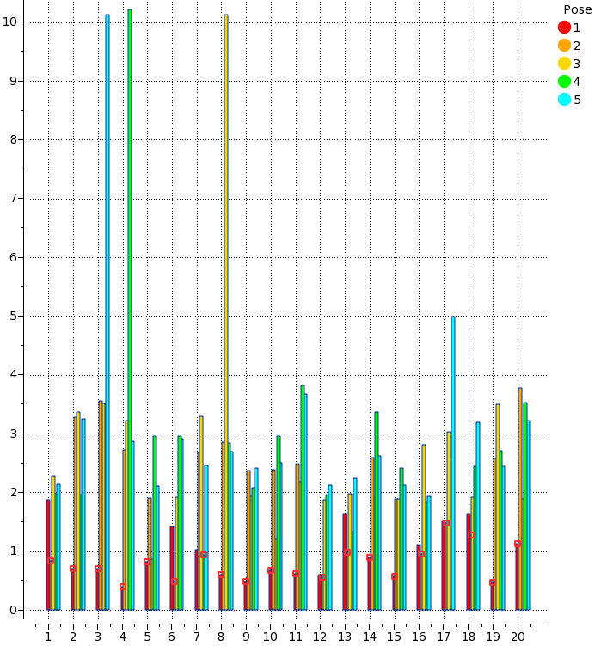
GC4 Stage 1A: BACE ligand pose prediction
Pose
Top poses for all ligands under 2A RMSD
Top pose has lowest RMSD in most cases
Mean/median RMSD 0.93A/0.74A
Ligand RMSD
Ligand #

Slide 17
Optimization of receptor conformational selection
‘4D’ grid MRC docking not only optimizes ligand, but also selects preferred receptor conformation in the ensemble
Ideally – closest to the native
Practically – not always: receptor conformational energy is not accounted for; errors from artifacts of scoring function and effects of ligand templates (APF).
Correction: per-conformation energy offsets
Offsets optimized for best recognition of cognate receptor/ligand pairs of the X-rays in MRC ensemble
Ligands
Rec. Confs
Ligands
Rec. Confs
1
+E_{o}
2
+E_{o}
3
+E_{o}
4
+E_{o}
5
+E_{o}
6
+E_{o}
7
+E_{o}
No offsets
Optimized offsets
Receptor conformational selection in 4D grid re-docking of ligands from PDB structures

Slide 18
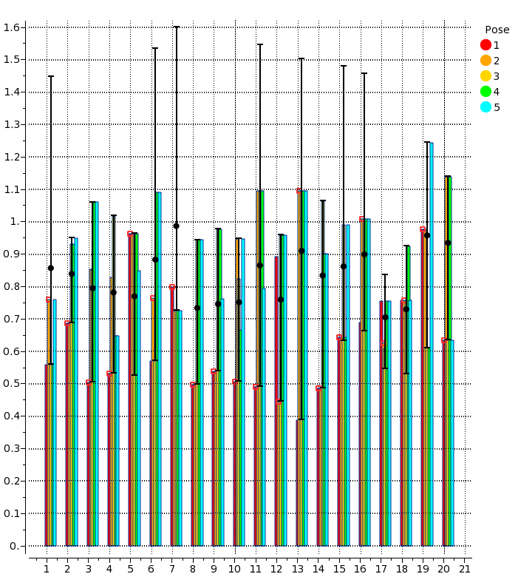
BACE receptor conformational selection results
RMSD Max/Mean/Min
of MRC ensemble vs. cognate
Best available receptor conformation (out of 7) is selected for 10 ligands, and selection is better than average for 15 (in pose #1).
Receptor RMSD
Complex #

Slide 19
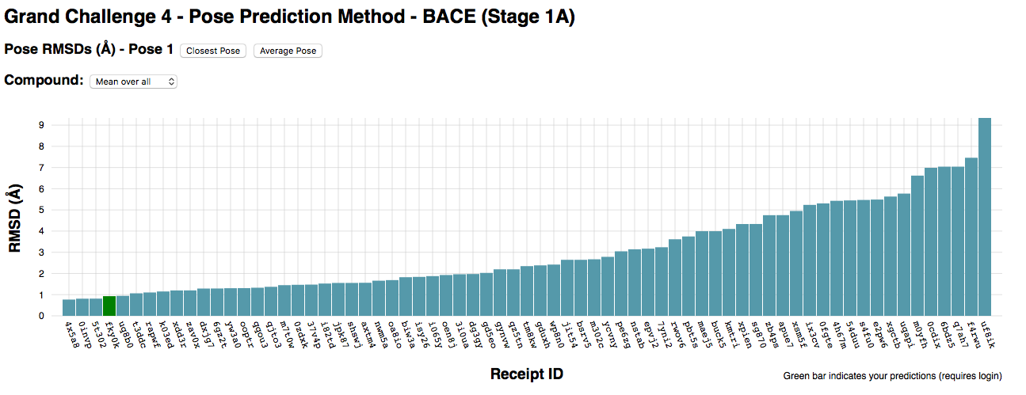
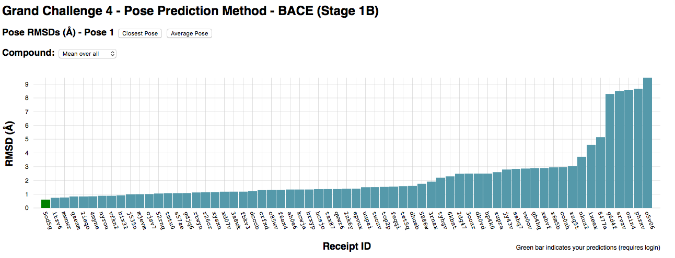
BACE pose prediction
0.93Å
No ligand data (bias) used!
0.61Å

Slide 20
Summary
Atomic Property Field-based 3D QSAR activity models perform well (when used within the applicability domain)
Gradient Ring Closure (GRC) in internal coordinates allows successful macrocycle conformational sampling and docking
‘4D’ ensemble docking with conformation energy offsets effectively selects near-cognate receptor conformations

Slide 21
Acknoledgments
Polo Lam
Eugene Rausch
Ruben Abagyan
D3R organizers

