Slide 1
Protein – small molecule docking in HADDOCK
Panagiotis Koukos
Bijvoet Center for Biomolecular Research
Faculty of Science, Department of Chemistry, Utrecht University
2019/08/22

Slide 2
Docking – HADDOCK

Slide 3
Docking – HADDOCK

Slide 4
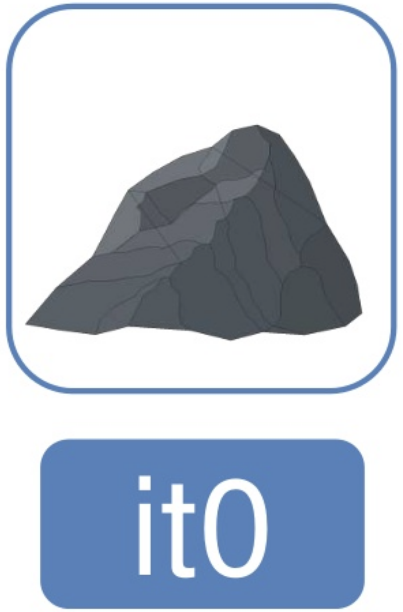
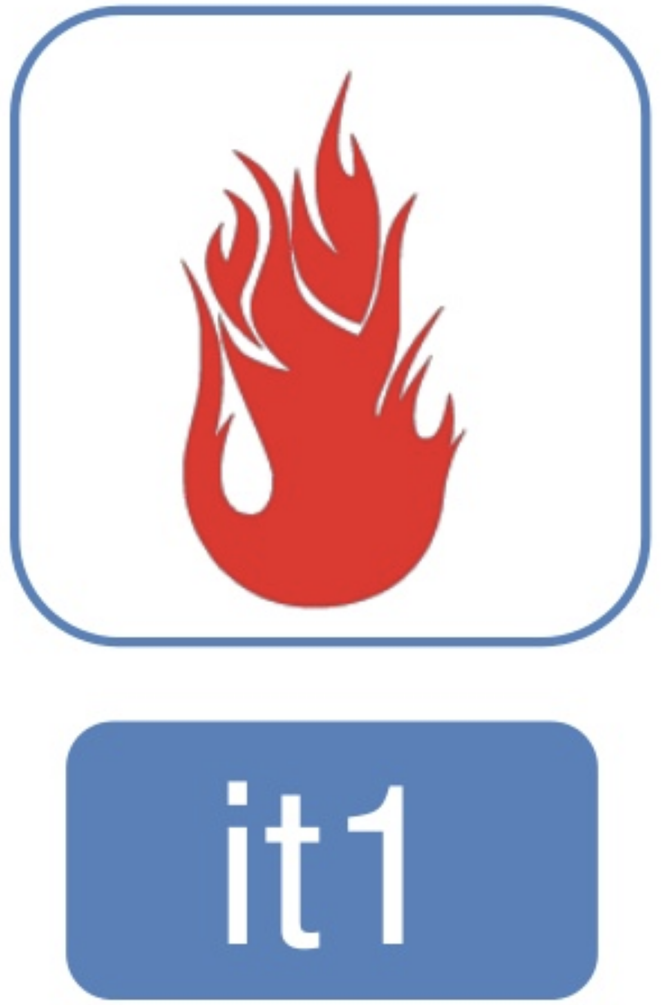
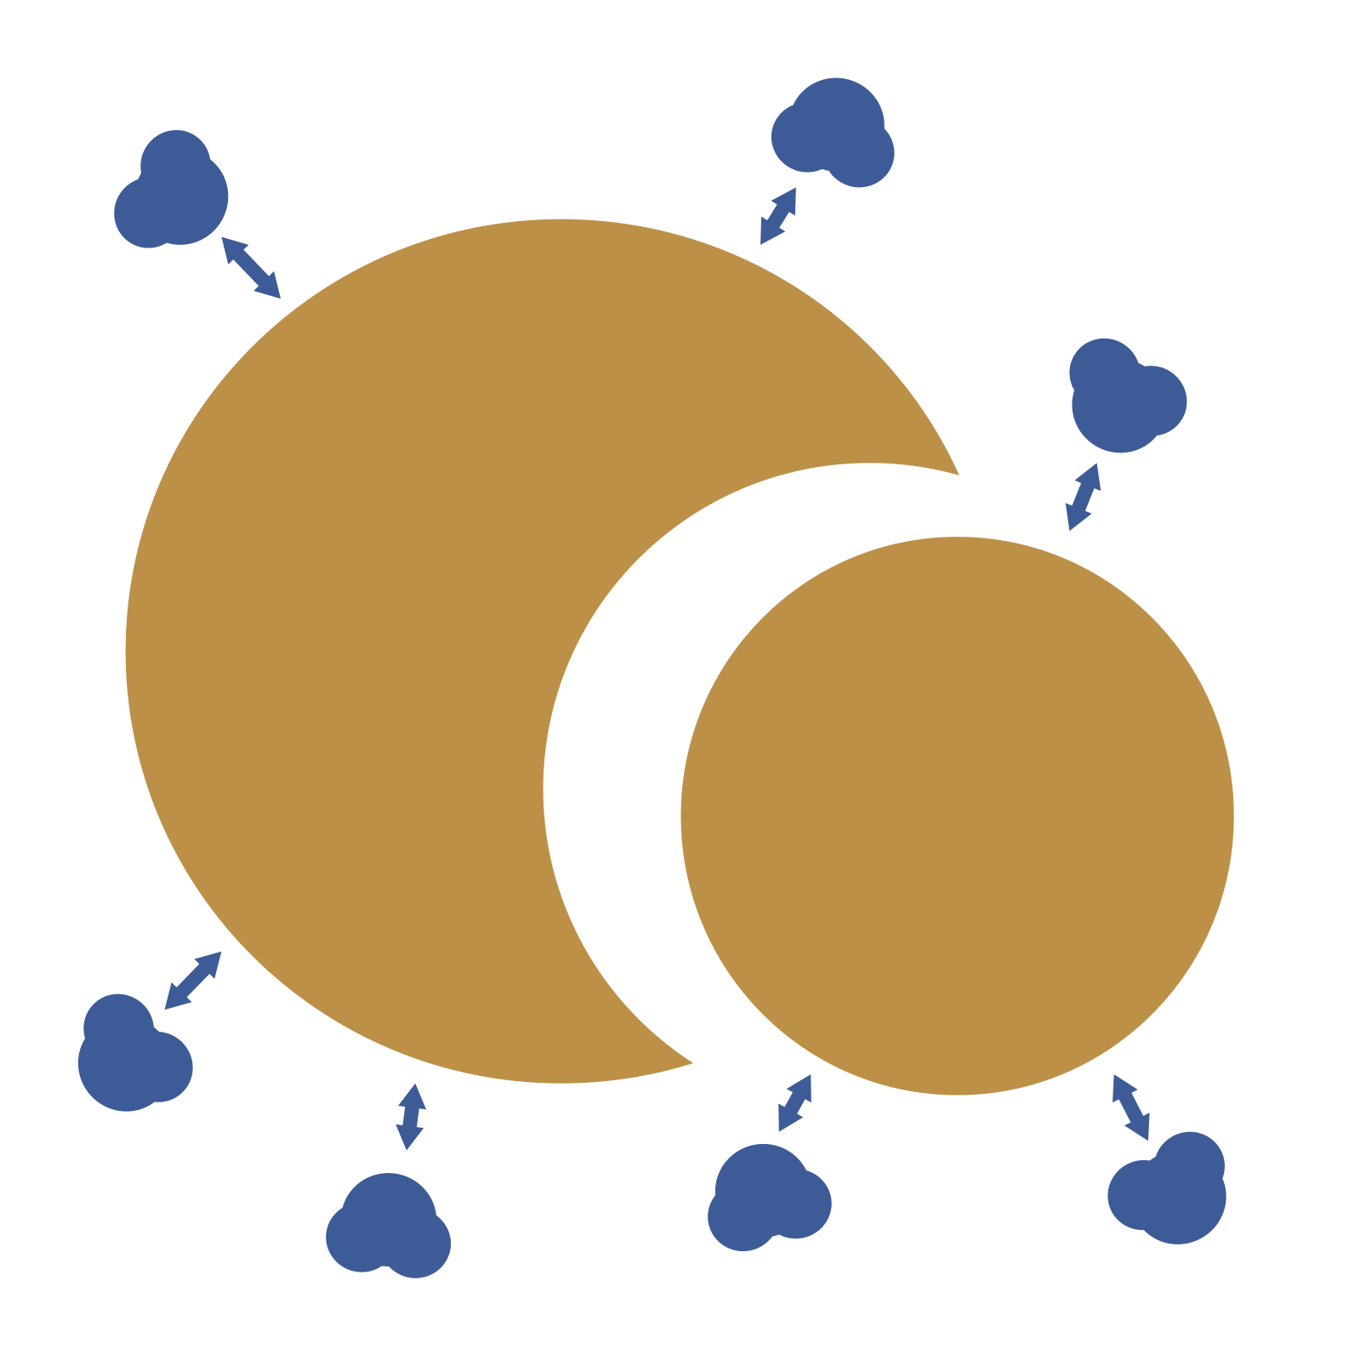
Docking – HADDOCK
Rigid body energy minimisation
$$HS={1.0 E}_{elec}+ {0.01 E}_{vdw}+{1.0 E}_{desolv}+0.01 E_{AIR}−0.01 BSA$$
Simulated annealing in torsional space
$$HS={1.0 E}_{elec}+ {1.0 E}_{vdw}+{1.0 E}_{desolv}+ 0.1{ E}_{AIR}−0.01 BSA$$
Refinement in explicit solvent and cartesian space
$$HS={0.2 E}_{elec}+ {1.0 E}_{vdw}+{1.0 E}_{desolv}+ 0.1{ E}_{AIR}$$

Slide 5
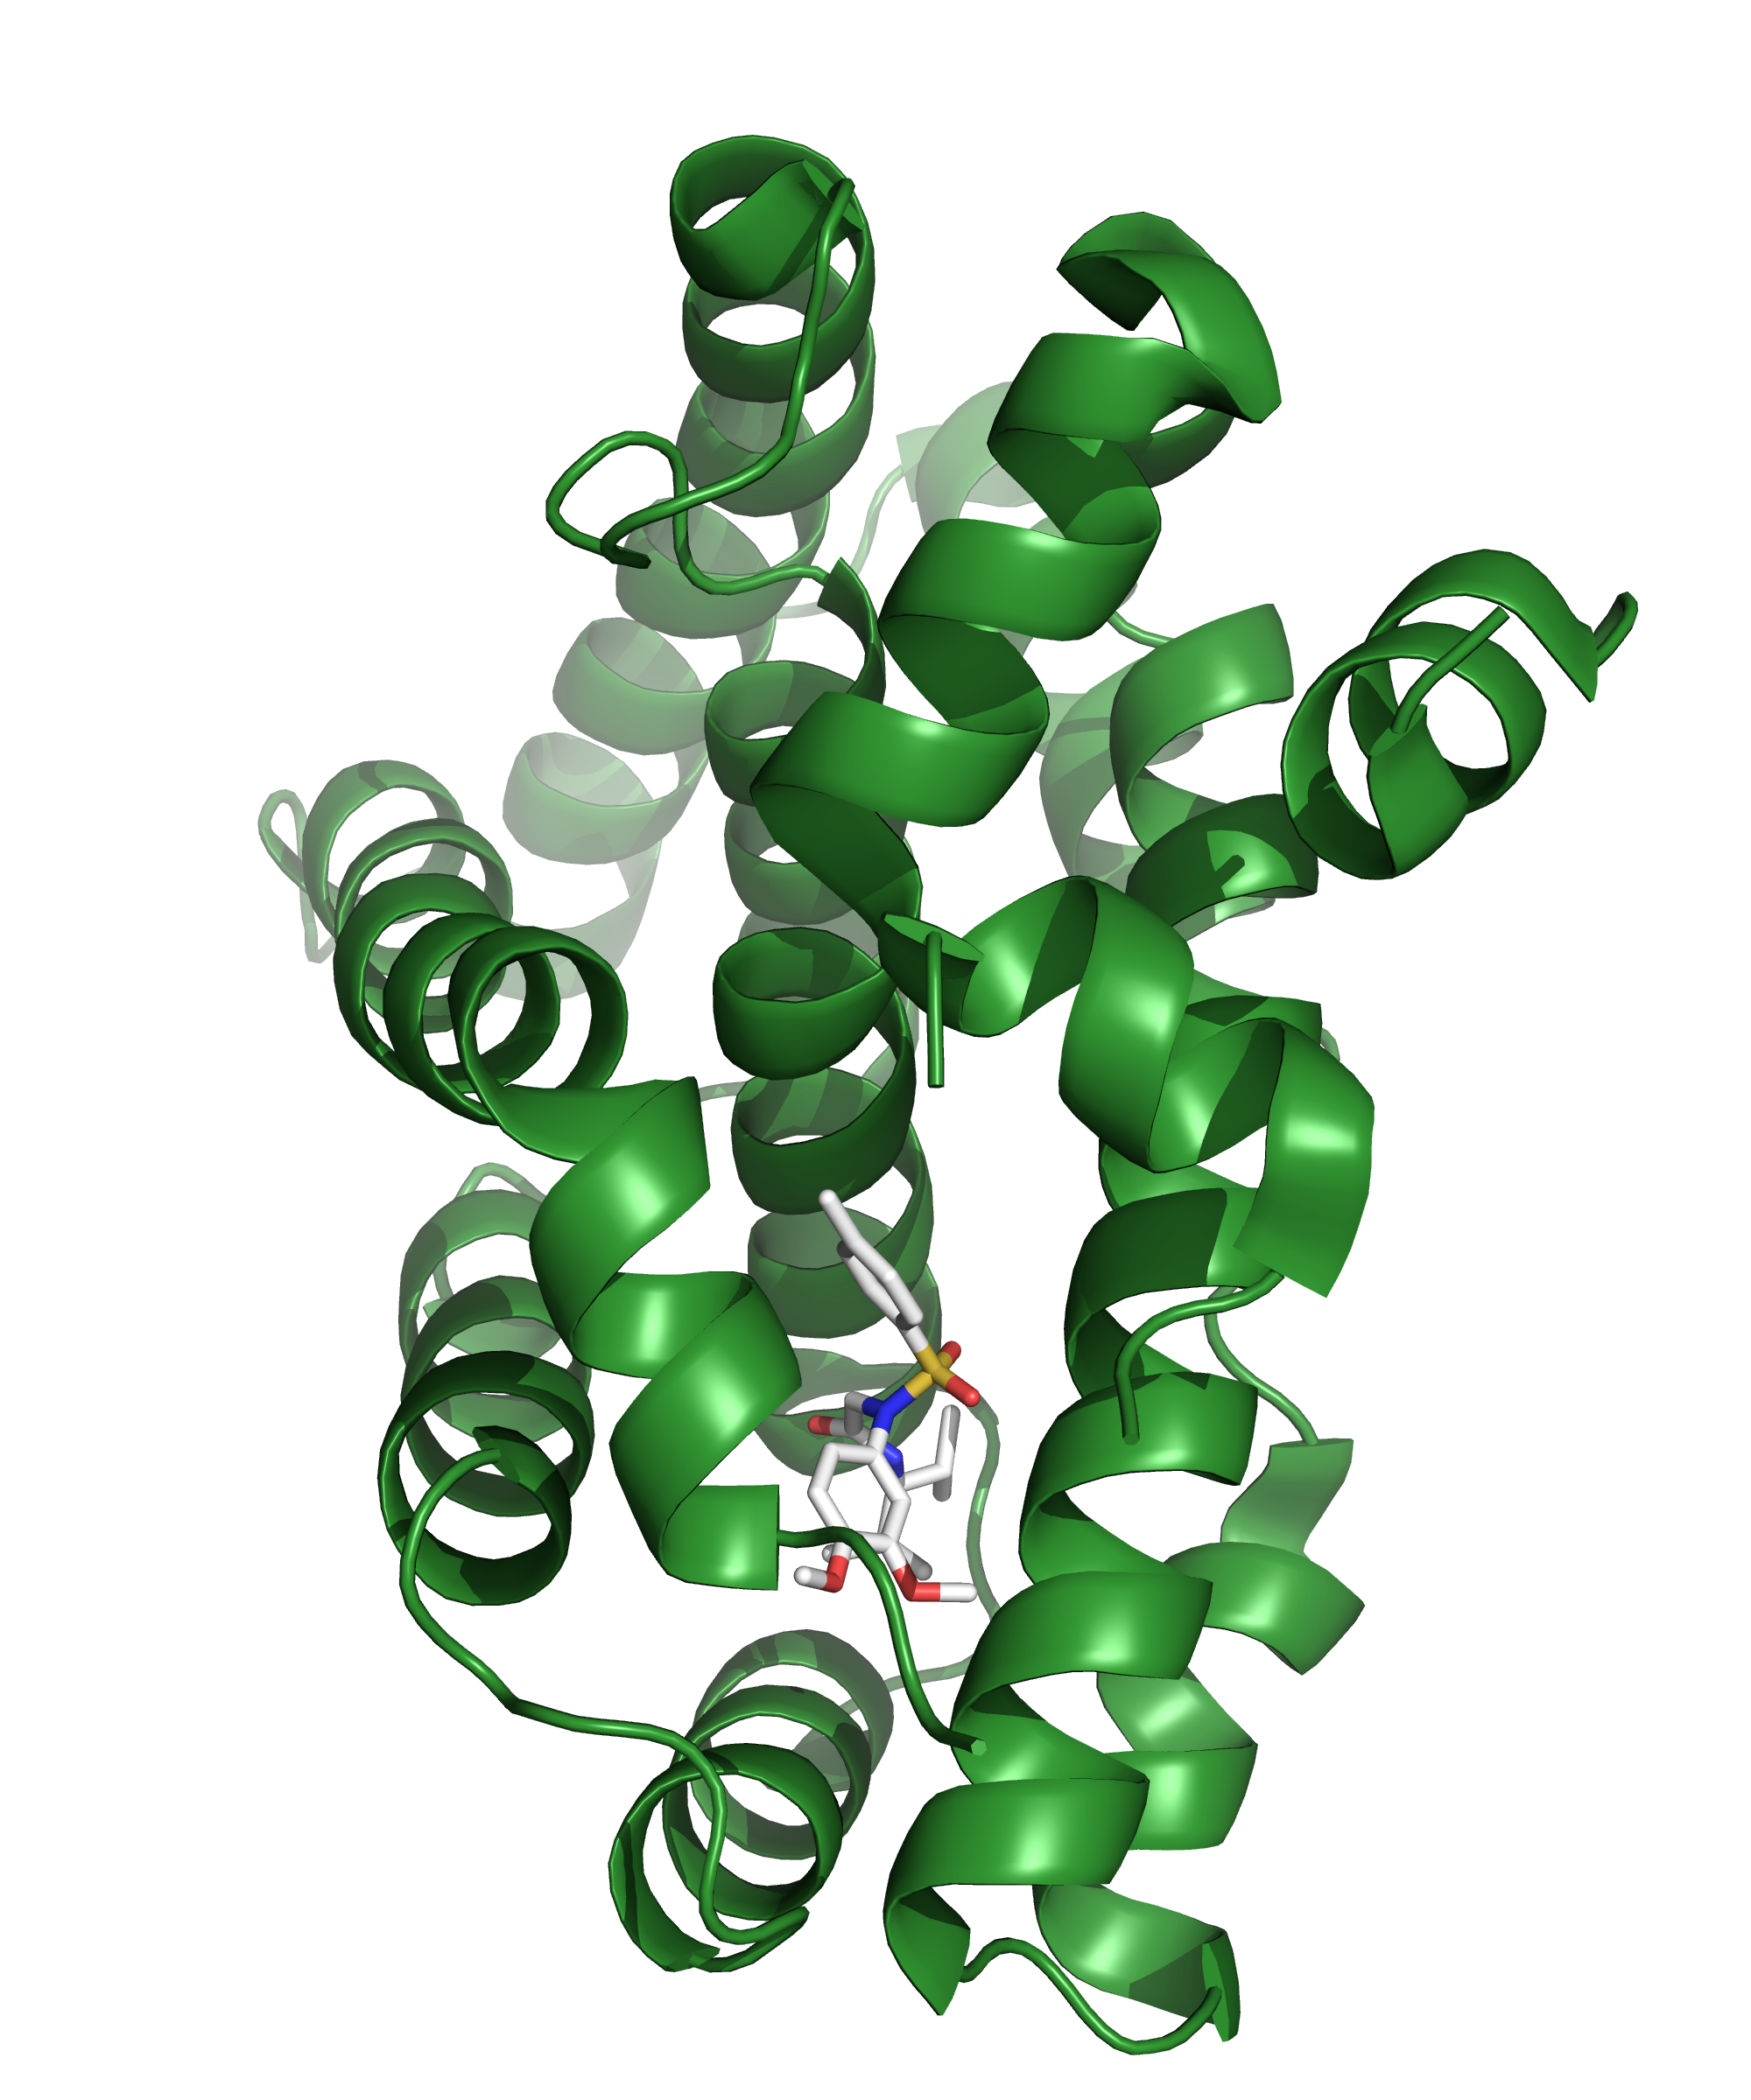
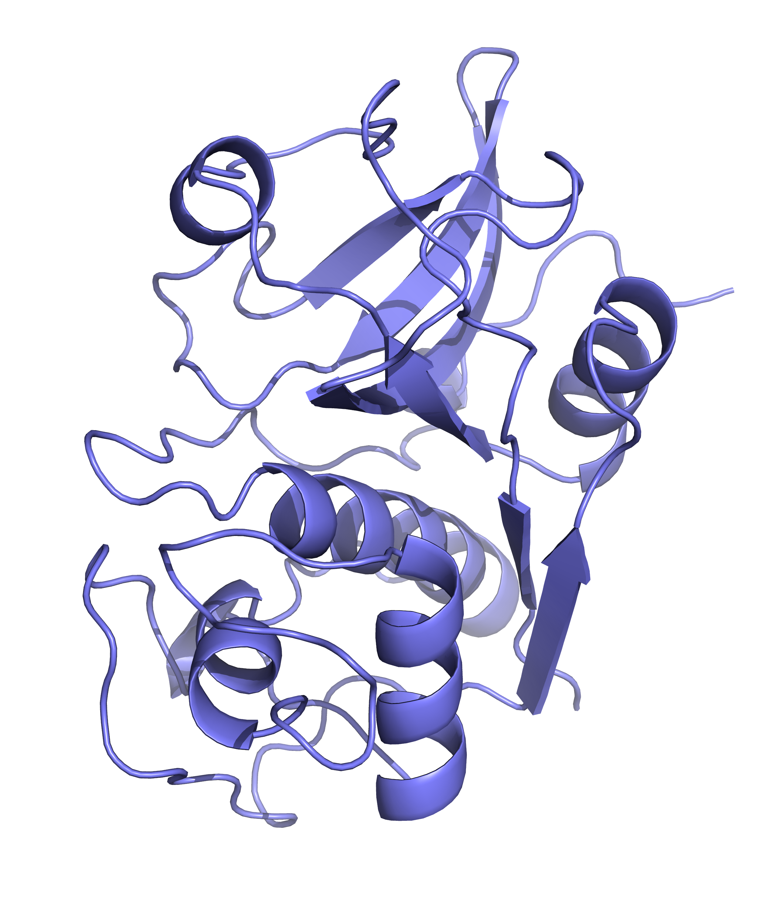
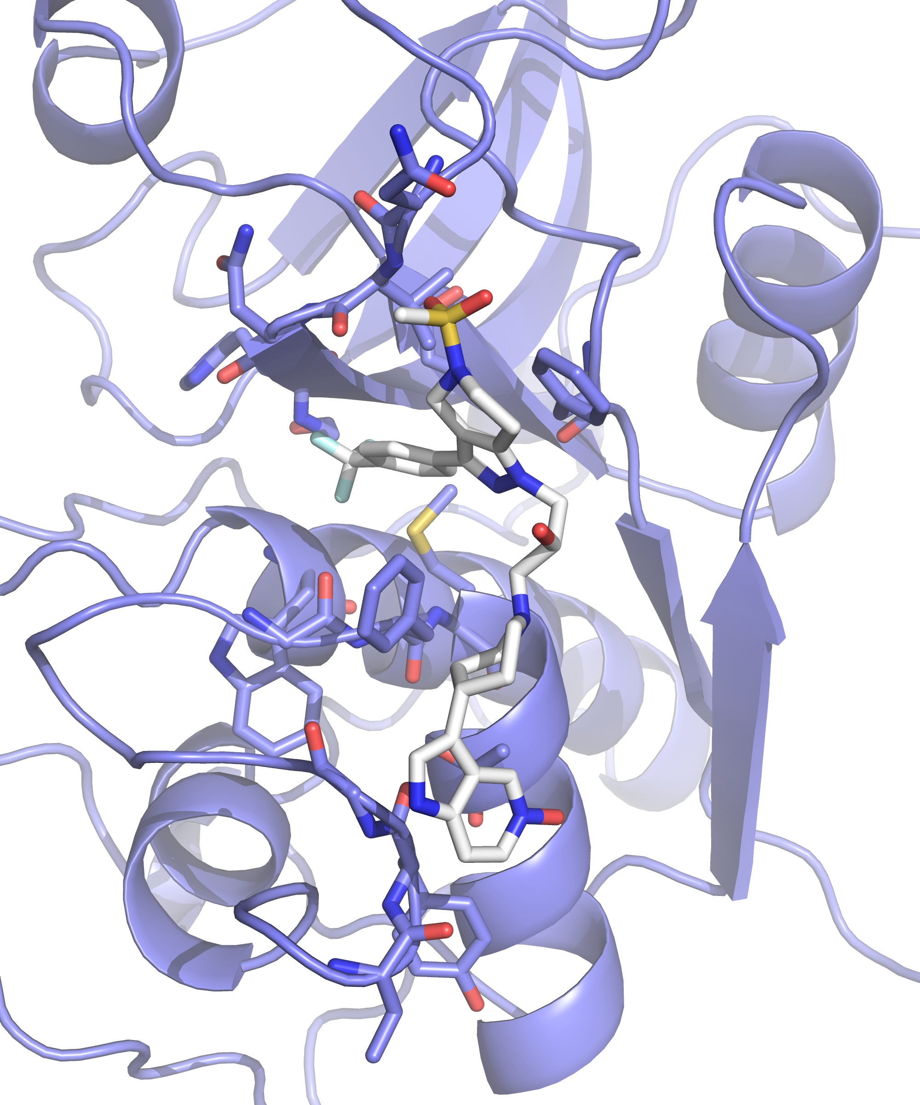
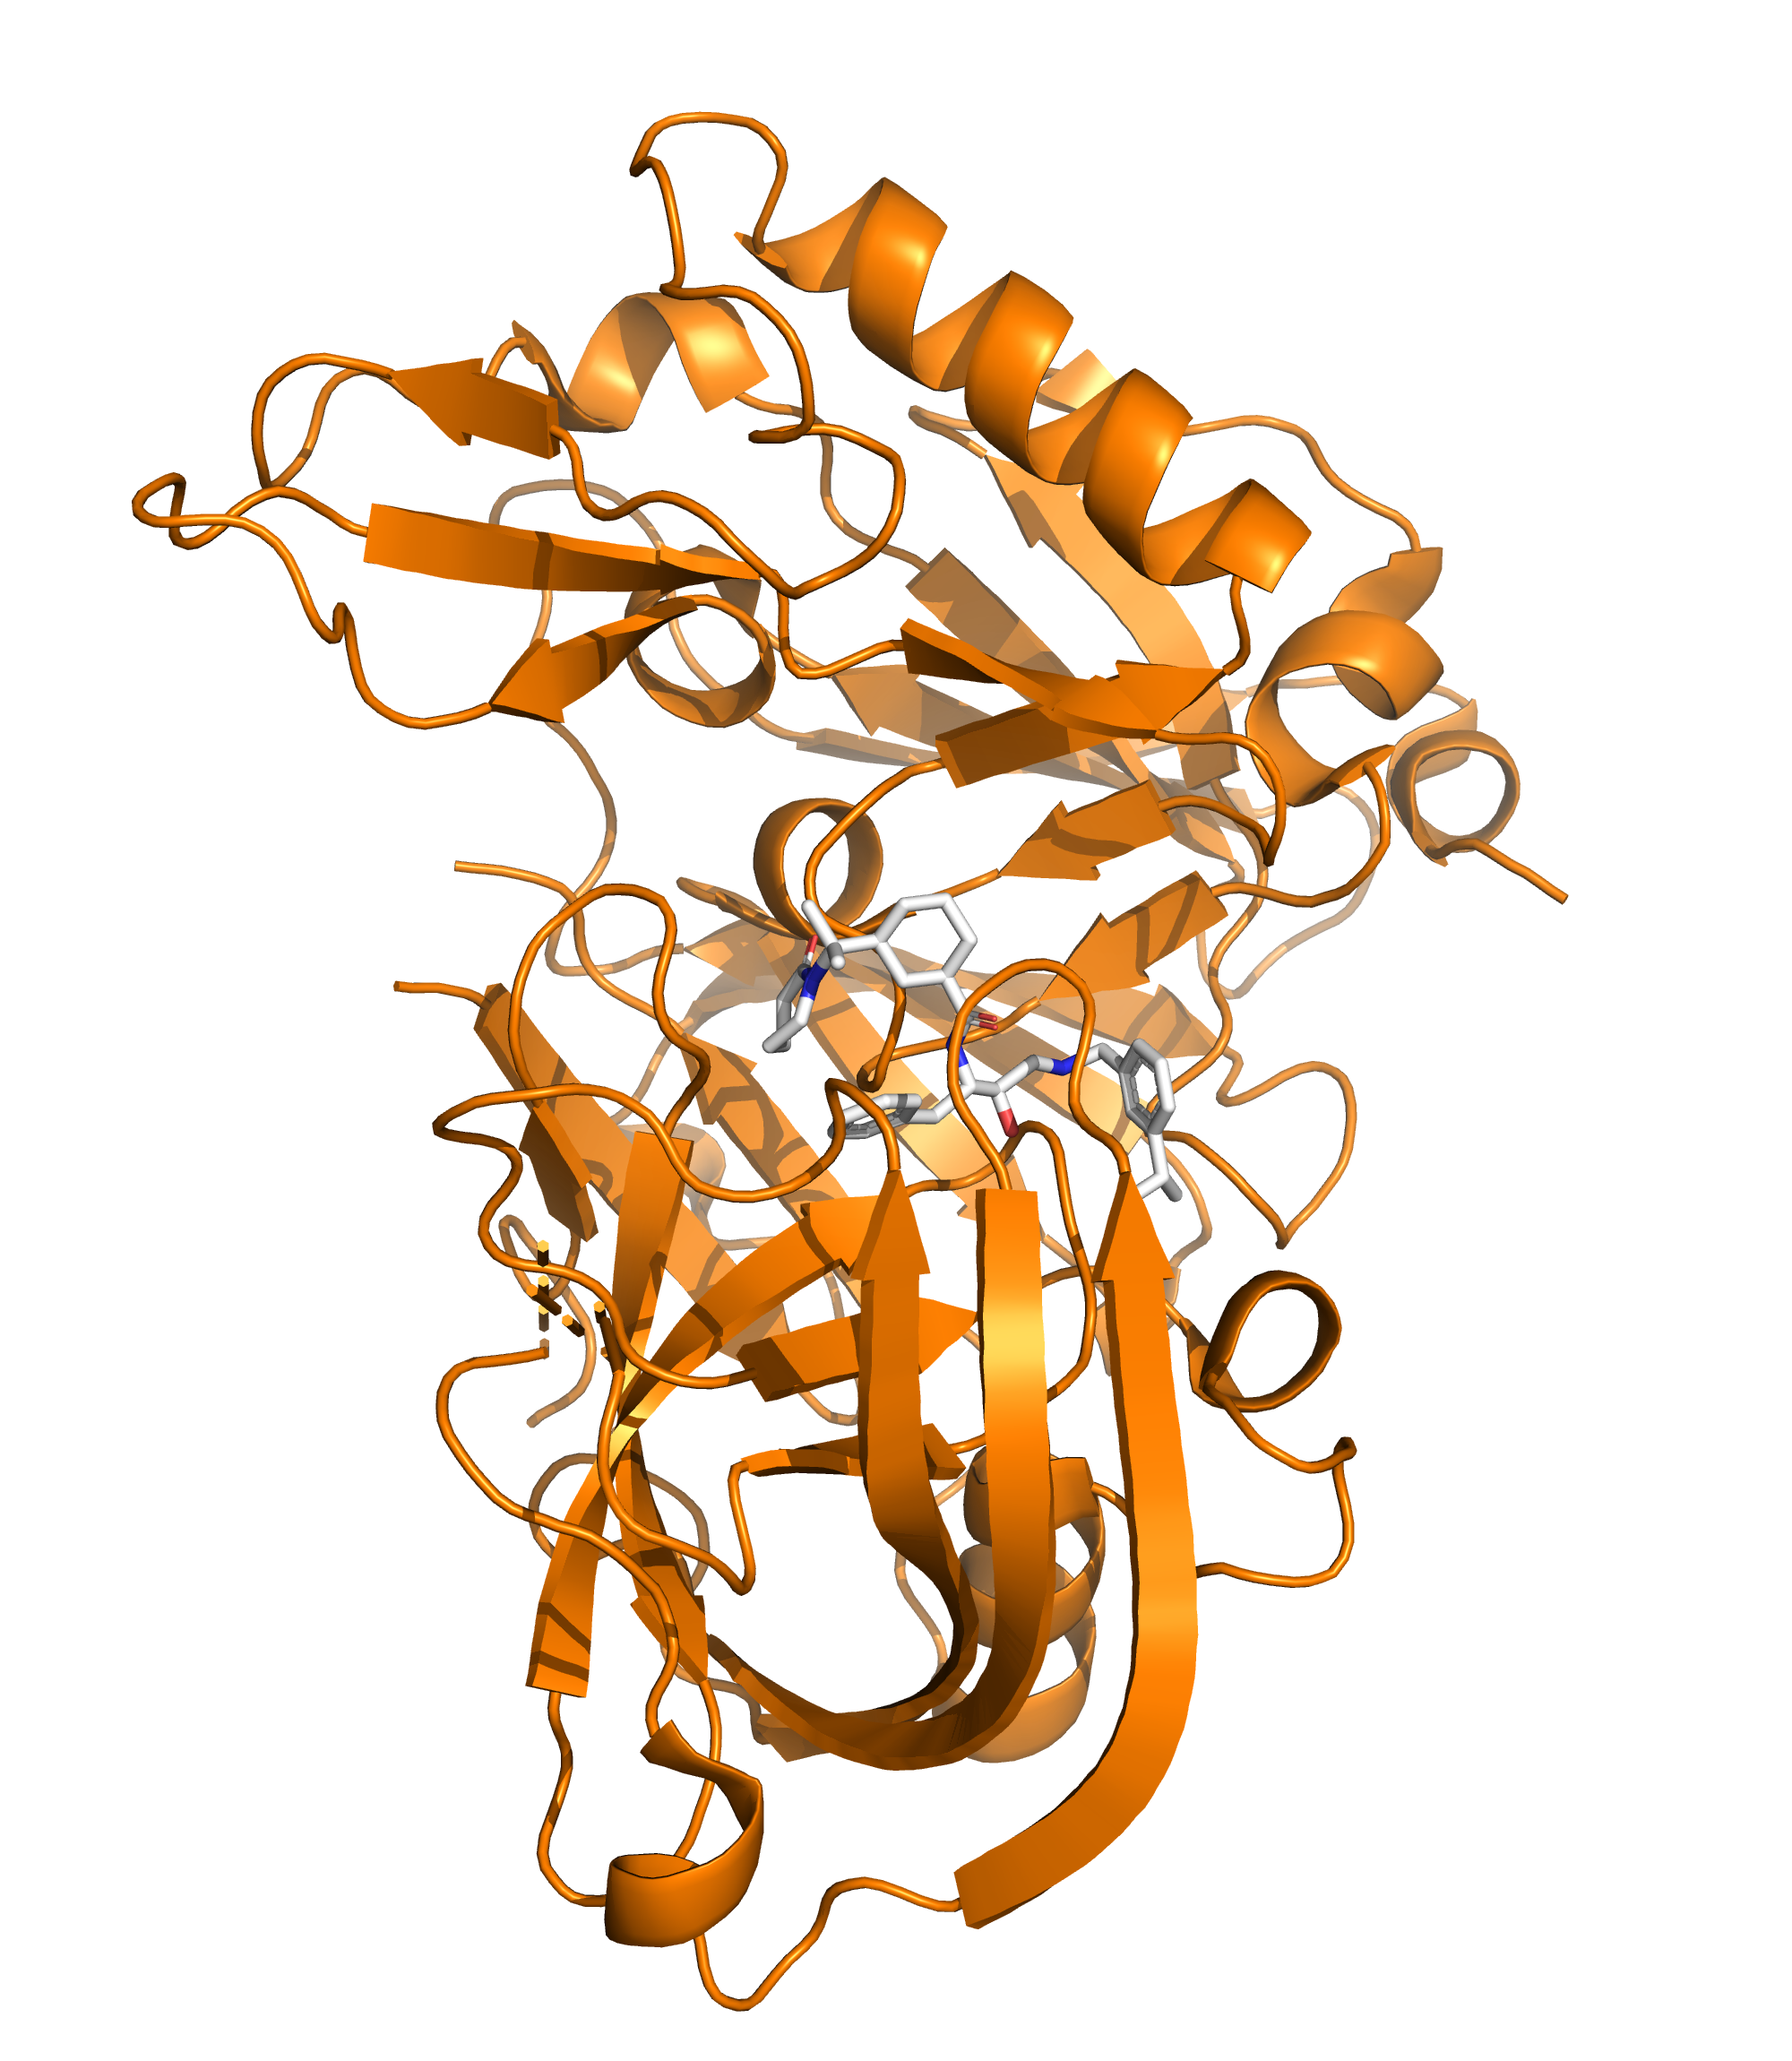
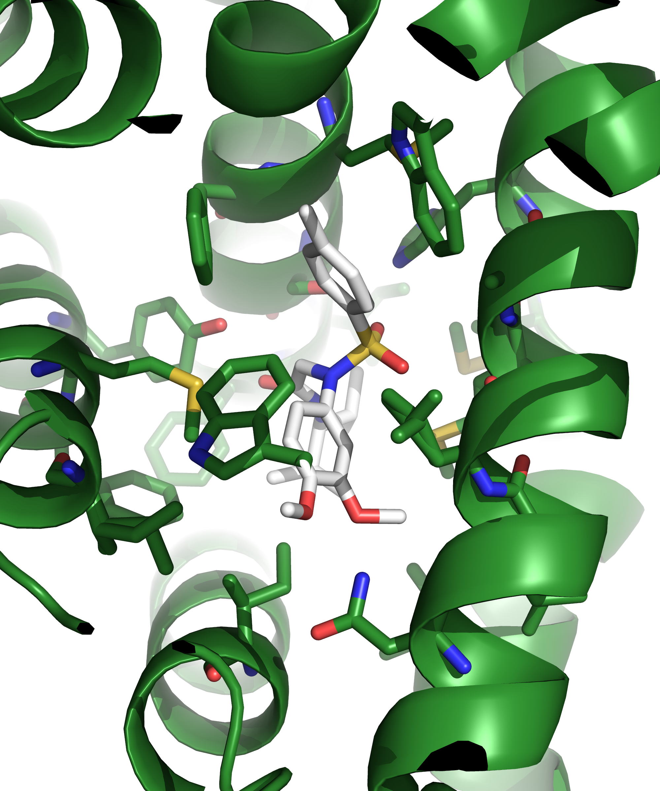
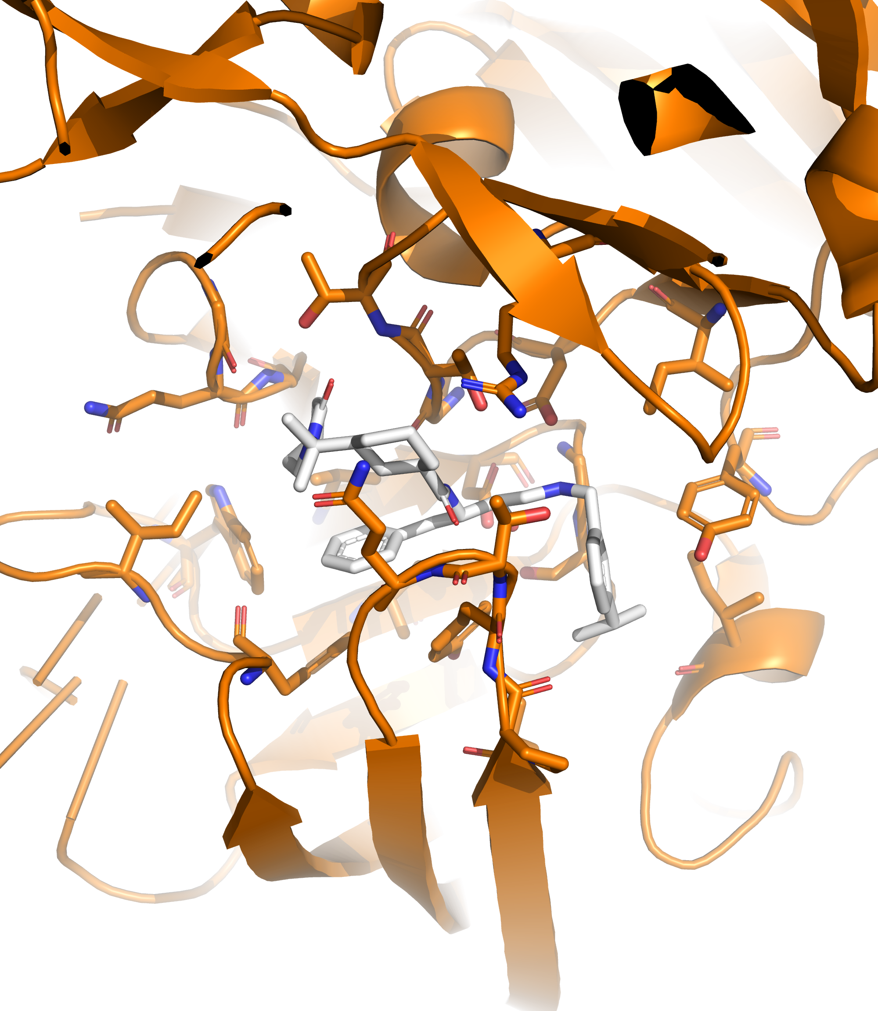
D3R Grand Challenge
D3R 2016 Grand Challenge
1 protein target against 35 small molecules
D3R 2017 Grand Challenge
1 protein target against 24 small molecules
D3R 2018 Grand Challenge
1 protein target against 20 small molecules

Slide 6
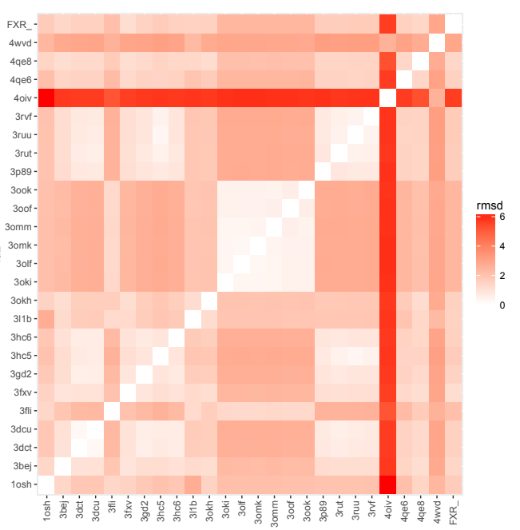
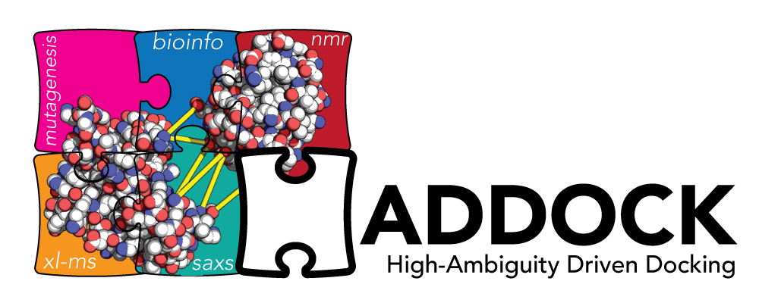
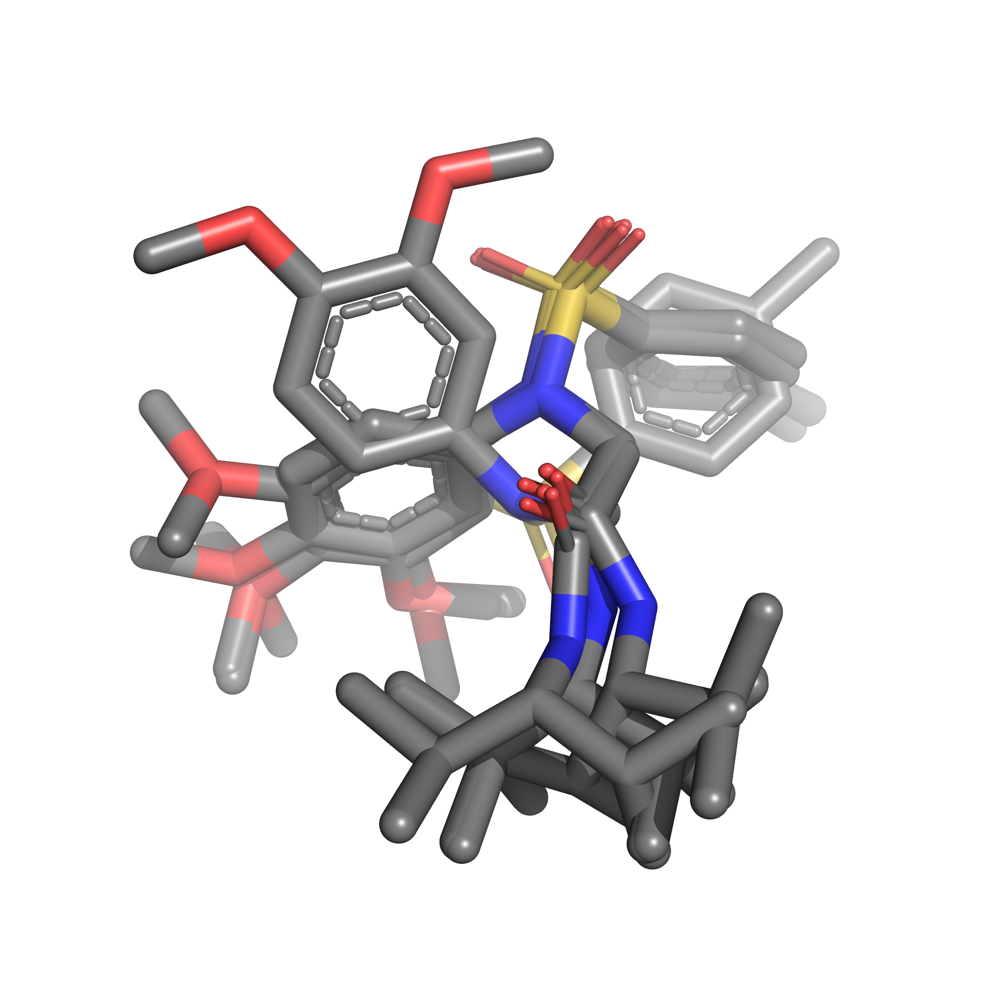
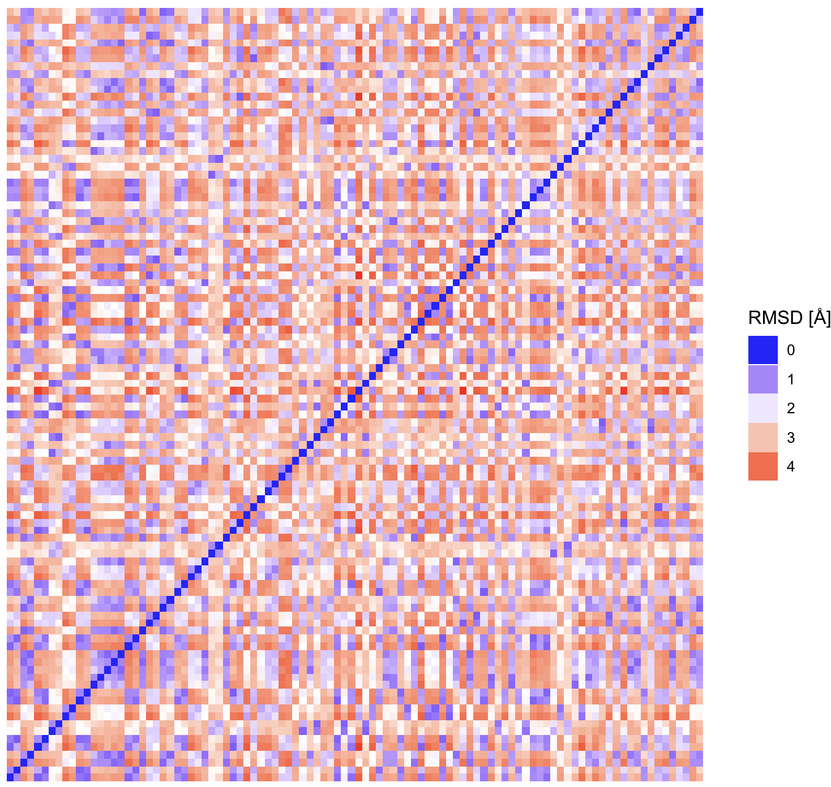
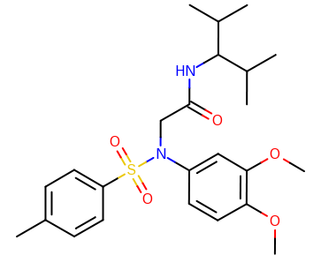
GC2 Protocol
Protein
Docking
Ligand
Hawkins, P.C.D. et al. Conformer Generation with OMEGA: Algorithm and Validation Using High Quality Structures from the Protein Databank and the Cambridge Structural Database J. Chem. Inf. Model. 2010, 50, 572-584

Slide 7
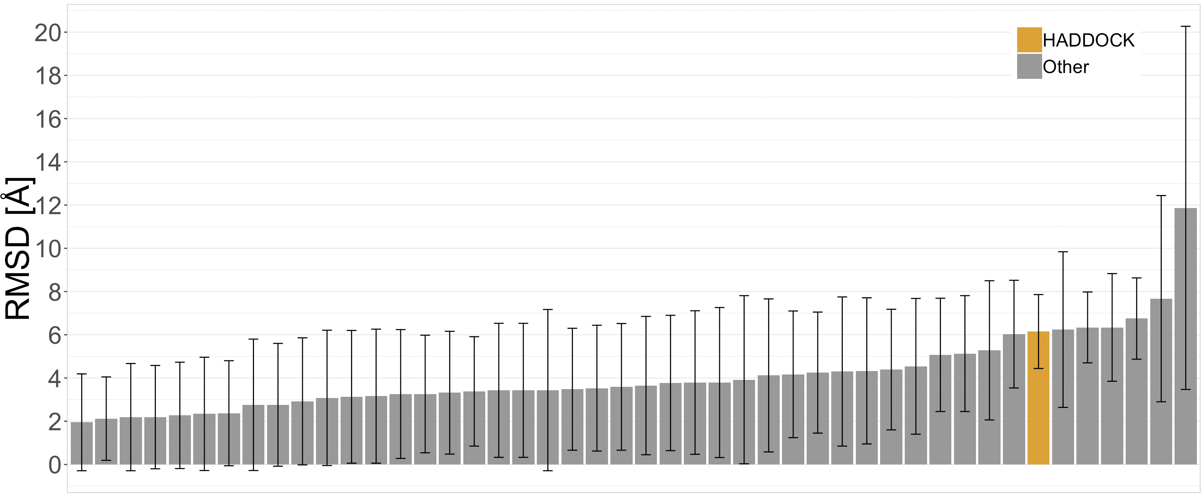
GC2 Results
RMSD of the top pose averaged over all compounds

Slide 8
GC2 Updated Protocol
Protein
Docking
Ligand

Slide 9
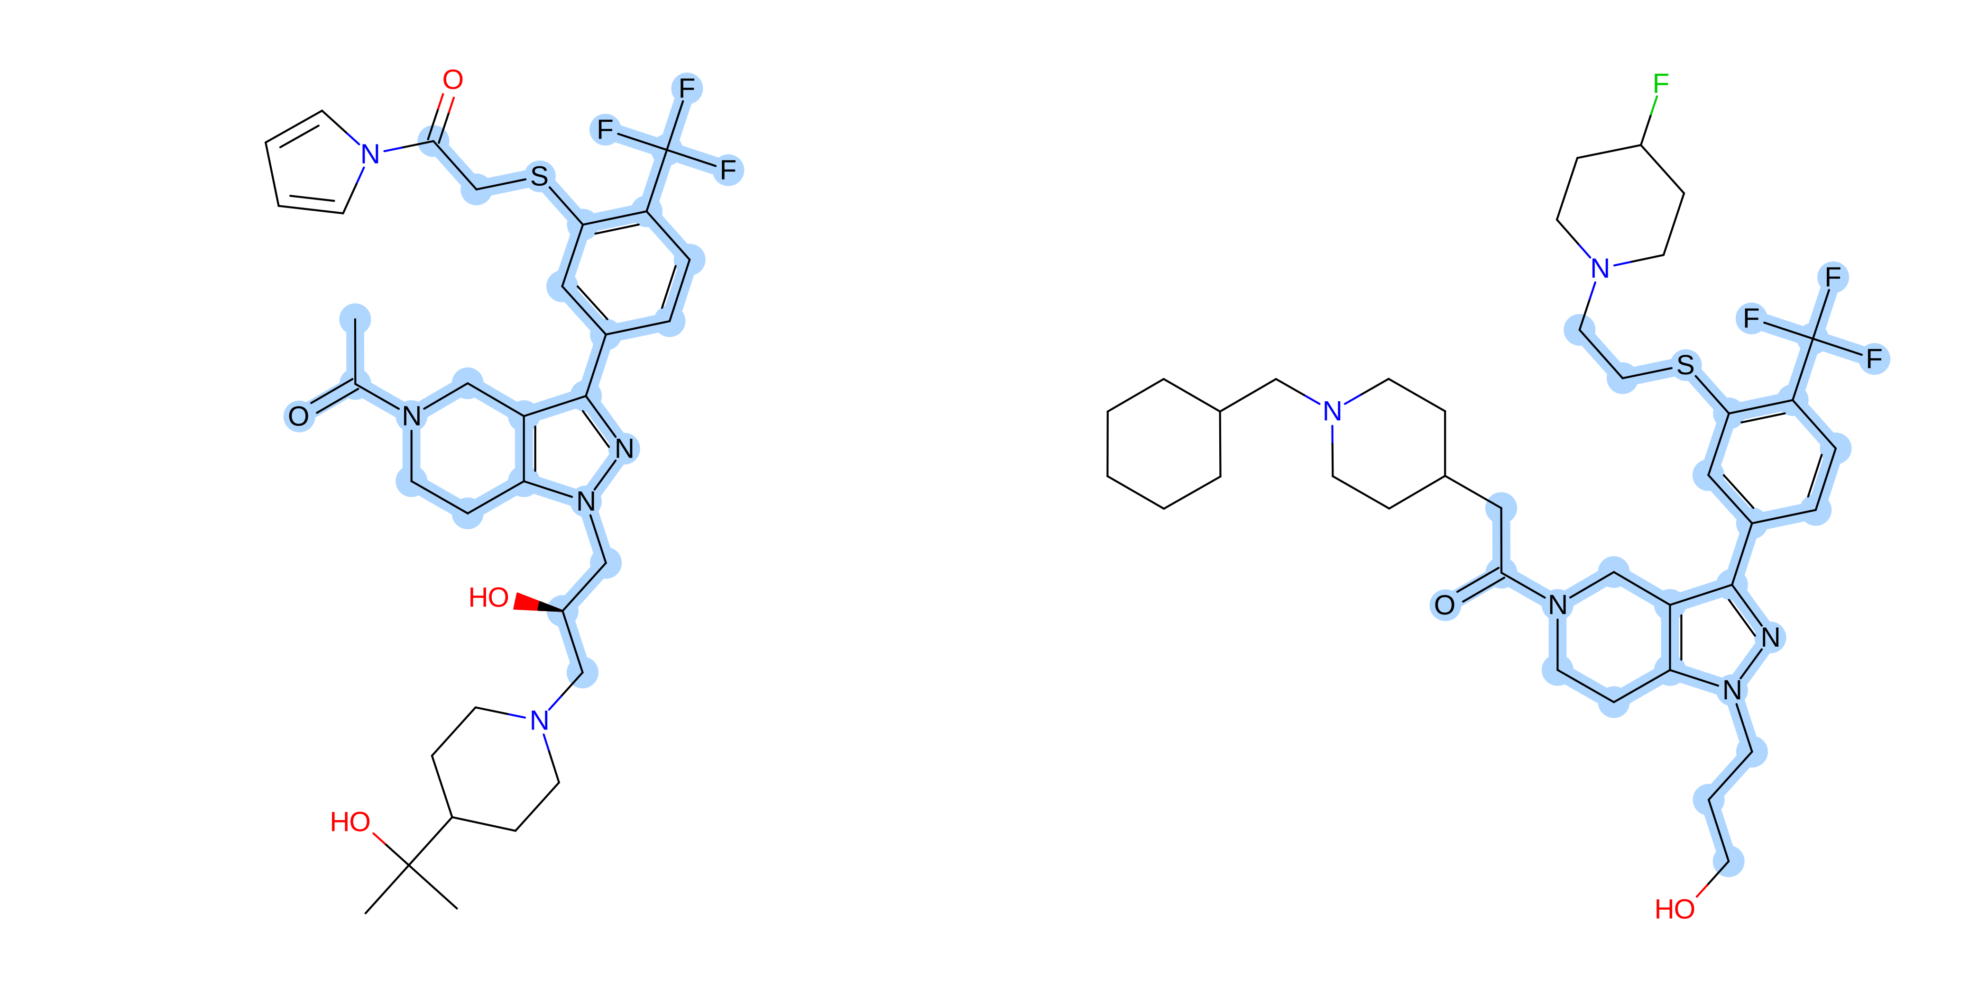
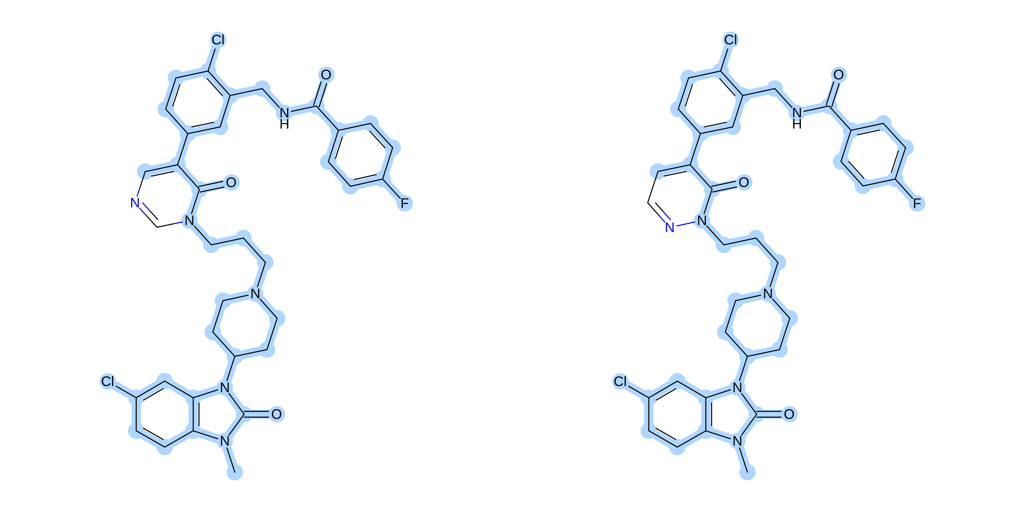
GC2 Updated Protocol
Compare compounds with Tanimoto similarity values after identifying the Maximum Common Substructure (MCS)

Slide 10
GC2 Results
RMSD of the top pose averaged over all compounds

Slide 11
GC2 Updated Results
RMSD of the top pose averaged over all compounds

Slide 12
Lessons
Select the receptor template smartly

Slide 13
Small molecule docking
D3R 2016 Grand Challenge
1 protein target against 35 small molecules
D3R 2017 Grand Challenge
1 protein target against 24 small molecules
D3R 2018 Grand Challenge
1 protein target against 20 small molecules

Slide 14
GC2 Updated Protocol
Protein
Docking
Ligand

Slide 15
GC3 Protocol
Select conformers based on 3D shape similarity
https://docs.eyesopen.com/rocs/_images/overlay_theory.png
Hawkins, P.C.D. et al, Comparison of Shape-Matching and Docking as Virtual Screening Tools, Journal of Medicinal Chemistry, Vol. 50, pp. 74-82, 2007

Slide 16
GC3 Protocol
Select conformers based on chemical similarity
Hawkins, P.C.D. et al, Comparison of Shape-Matching and Docking as Virtual Screening Tools, Journal of Medicinal Chemistry, Vol. 50, pp. 74-82, 2007

Slide 17
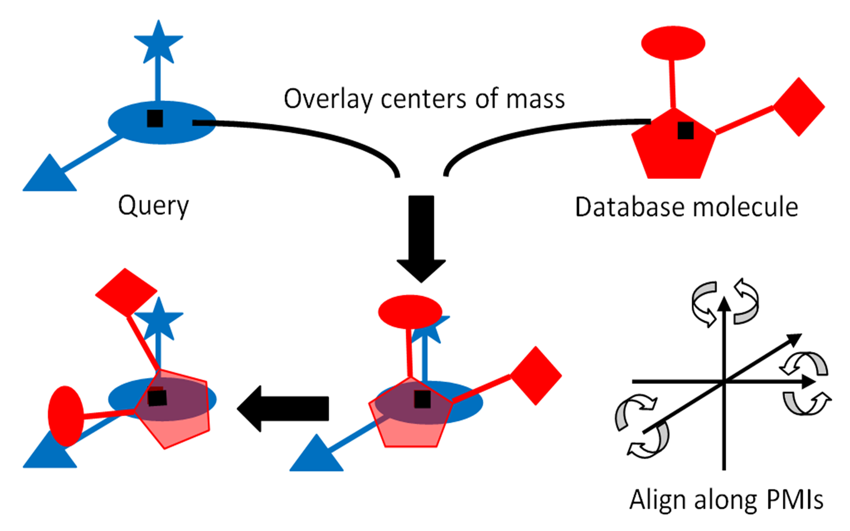
GC3 Protocol
Protein
Refinement
Ligand

Slide 18
GC3 Results
RMSD averaged over all five poses per target

Slide 19
GC3 Results – Cross docking
RMSD of the top pose averaged over all compounds

Slide 20
GC3 Results – Self docking
RMSD of the top pose averaged over all compounds

Slide 21
GC4 Results
RMSD averaged over all five poses per target

Slide 22
GC4 Results – Cross docking
RMSD of the top pose averaged over all compounds

Slide 23
GC4 Results – Self docking
RMSD of the top pose averaged over all compounds

Slide 24
Lessons
Select the receptor template smartly
Select the ligand ensemble based on shape similarity
Position the ligands using shape similarity

Slide 25
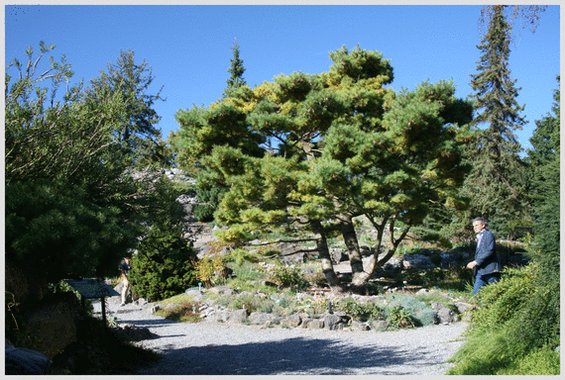
Acknowledgments: the CSB group @ UU
Funding €€

Slide 26
Thank you for your attention!
HADDOCK online:
http://haddock.science.uu.nl
http://bonvinlab.org/software
http://ask.bioexcel.eu

