Slide 1
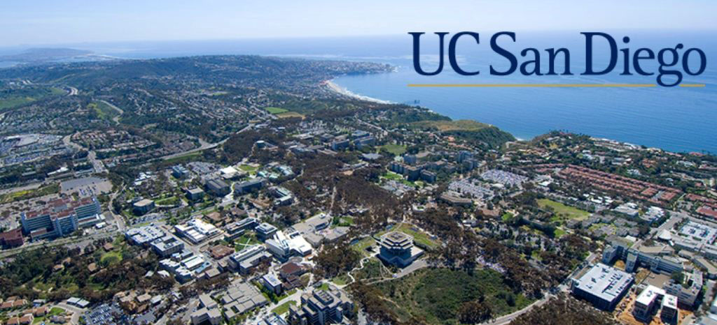
Welcome to the 2019 D3R workshop!

Slide 2
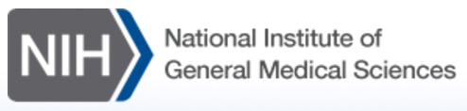
Workshop on Challenges in Docking and Screening
US National Institutes of Health, 2005
Participants from pharma, academia, US government
  Academic: Mike Gilson, Art Olson, Brian Shoichet
  Government: Chris Austin, Anne Chaka, Jayne Kapur, Janna Wehrle
  Pharma: Jeff Blaney, Wendy Cornell, Debbie Loughney, Cathy Peishoff, Emanuele Perola
Conclusions
  Computational predictions of poses and affinities need to improve
  Datasets from pharma could help
NIH-funded initiative
  CSAR 2010-2014 (Carlson, U. Michigan)
  D3R 2014-present (Amaro & Gilson, UC San Diego)
Workshop report: http://bit.ly/2pLpy8C

Slide 3

Drug Design Data Resource (D3R)
NIH-U01, Unique Purpose
Central Goal: Utilize previously unpublished datasets as benchmarks for developers of protein-ligand modeling technologies
Synergy with Public Databases: Public release of more industrial crystal structures and affinity data
Broader Goals: Utilize blinded datasets to drive improvement of all CADD technologies and to foster education and dissemination of methods
More predictive CADD methods benefit everyone!

Slide 4




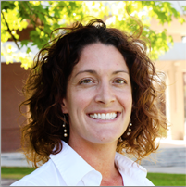
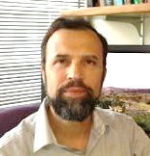
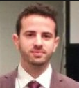
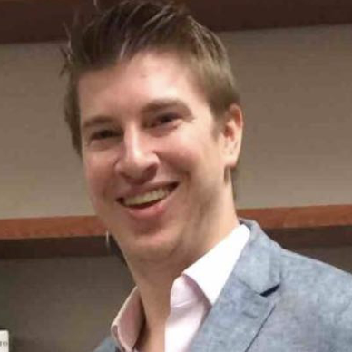
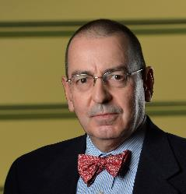
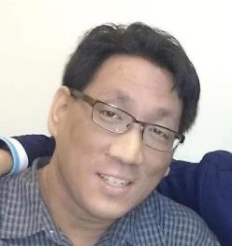
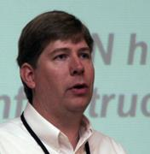
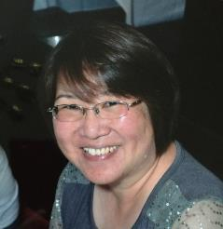
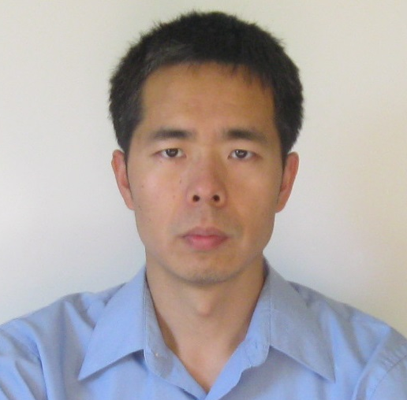
D3R Project Team
Crystallography Group
Rommie Amaro
Mike Gilson
Zied Gaieb
Conor Parks
Stephen Burley
Mike Chiu
Dan Crawl
Jeff Grethe
Jasmine Young
Chenghua Shao

Slide 5

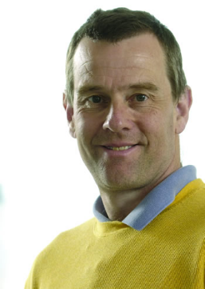

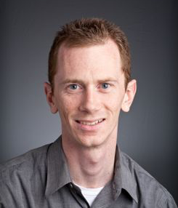
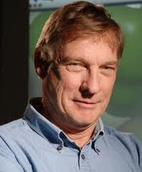
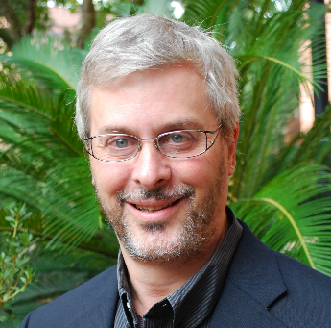
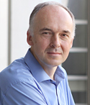
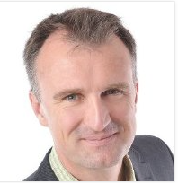
D3R Scientific Advisory Board
Aled Edwards
SGC
Charles Grimshaw
Takeda
David Mobley
UC Irvine
John Moult
U Maryland
Adrian Roitberg
U Florida
Torsten Schwede
Biozentrum
Martin Stahl
Roche

Slide 6
Unique Hub for CADD Community
  Coherent CADD datasets
  Blinded challenges: Protein-ligand, model systems
  Evaluation metrics
  Capturing and disseminating workflows
  Workshops and networking

Slide 7
Challenge Types
Grand Challenges: ligand-protein poses and affinities
SAMPL: affinities, physical properties of simpler systems
with David Mobley, John Chodera, & Michael Shirts
CELPP: automated, weekly pose prediction challenge

Slide 8
Grand Challenges
Stage 1: Predict poses and affinities of multiple ligands for a protein
Stage 1b: Release co-crystal structures without ligands to enable self-docking (Isolates evaluation of docking algorithm)
*Co-crystal structures released*
Stage 2: Predict affinities again
All data released, deposited to PDB, BindingDB
Notes:
Stage 1b is a new feature of the GCs that we added in GC3

Slide 9
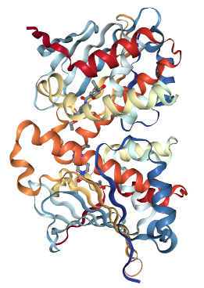
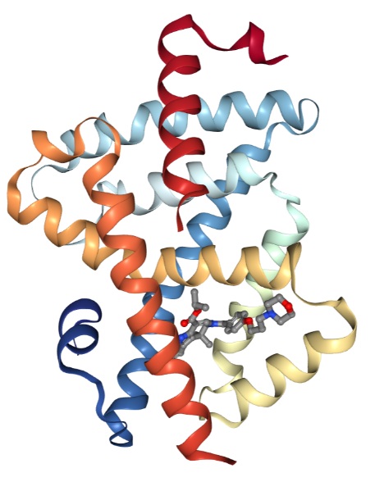
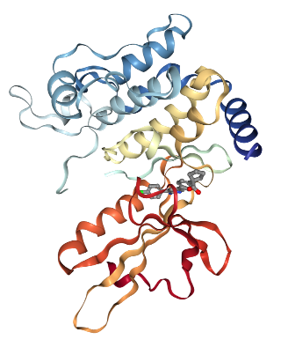
Grand Challenge 2015
35 participants, 355 submissions
Grand Challenge 2
49 participants, 262 submissions
HSP 90: focus on potency predictions
Data from Abbvie and Carlson’s CSAR project
8 cocrystal structures (.6-2.0 Å resolution)
180 IC50s (5 nM-20 µM)
Three series: benzimidazolones, aminopyrimidines, benzophenone-like
Varied water-mediated interactions; open/closed conformations
MAP4K4: focus on pose predictions
Data from Genentech
30 cocrystal structures (1.6 – 2.5 Å resolution)
18 IC50 data (3.1 nM - 10 µM)
Diverse chemotypes binding in ATP site
Open/closed P-loop structures
Farnesoid X Receptor (FXR): poses and potencies
Data from Roche
36 cocrystal structures (resolutions <2.6Å)
102 IC50s (0.3 nM-260 µM)
Three series + misc: sulfonamides, benzimidazoles, spiros
Helix shifts and varied water-bridges

Slide 10
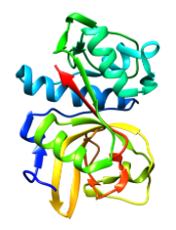
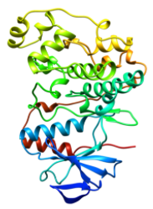
Grand Challenge 3
Kinase K_{d}s
SGC-UNC/DiscoverX
Cathepsin S poses & IC50s
Janssen Pharmaceuticals
24 cocrystal structures, 3.0 Å
136 IC50s, 3 – 8500 nM
Selectivity
VEGFR2
85 (0.62 to >10⁴ nM)
JAK2
89 (0.66 to >10⁴ nM)
p38-⍺
72 (0.28 to >10⁴ nM)
Activity Cliffs
JAK2
17 (53 to >10⁴ nM)
Activity Cliffs
TIE2
18 (3.4 to >10⁴ nM)
Mutations
ABL1
12 (49 to >10⁴ nM)
27 participants
303 submissions
11 participants
94 submissions
6 participants
25 submissions
6 participants
32 submissions
6 participants
11 submissions

Slide 11
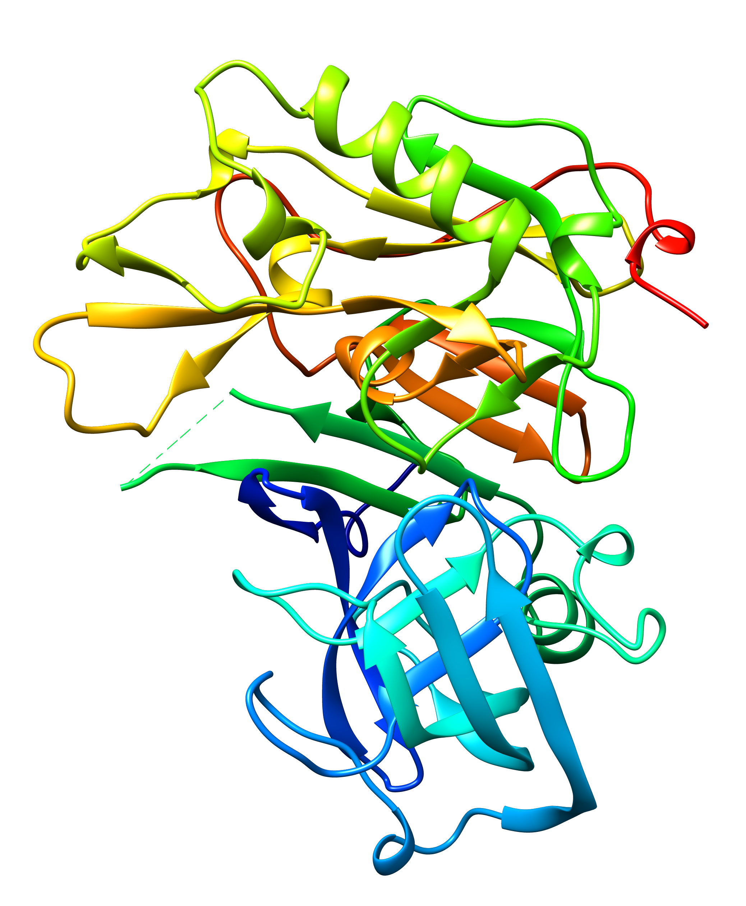
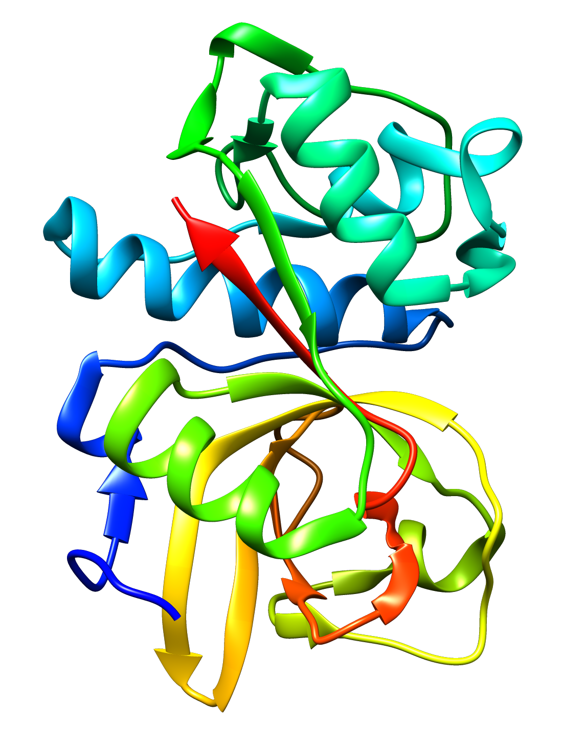
Grand Challenge 4
BACE1 poses & IC50s
Novartis
CatS IC50s
Janssen Pharmaceuticals
20 cocrystal structures, 3.0 Å
154 IC50s, 0.5 nM – 61 µM
459 IC50s,
6.5 nM – 10 µM
45 participants
311 submissions
49 participants
93 submissions
Notes:
51 unique participants!

Slide 12
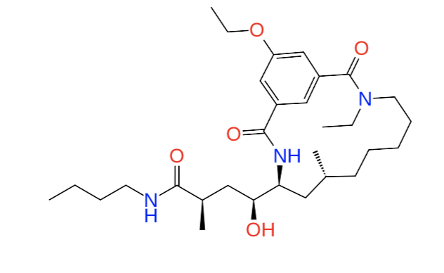
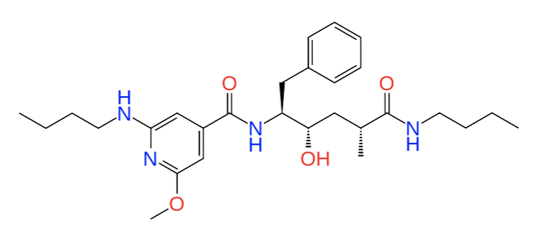
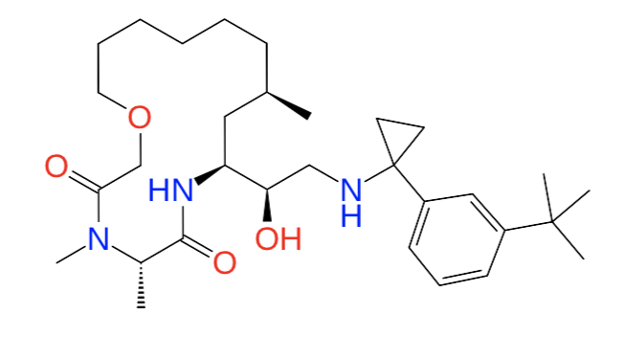
GC4: Pose Prediction Challenge for BACE1
Hypothesis: Complicated ligands, difficult docking challenge. Were anticipating a right skewed RMSD probability distribution
Notes:
In the 90’s – biomedical research funding rose from $48 B to $94 B. Curve of submissions of new drugs shows opposite trend. Approximately half of phase III molecules pass, where as historical norm was 85%. Trends are not not sustainable over the long term

Slide 13
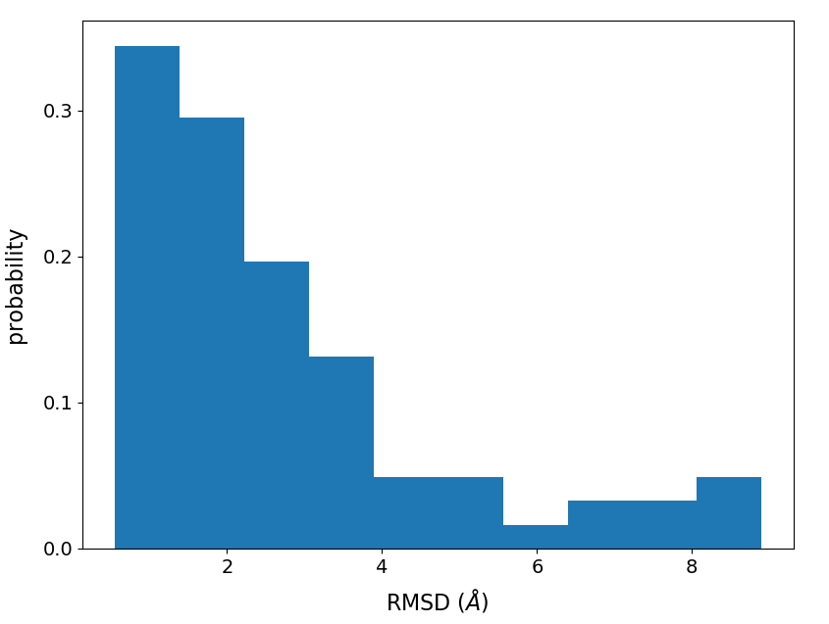
GC4: Pose Prediction Challenge for BACE1
Hypothesis: Complicated ligands, difficult docking challenge. Were anticipating a right skewed RMSD probability distribution
RESULTS:
LEFT skewed RMSD distribution
Median pose 1 RMSD stats:
< 2.0 across ALL participants
8/10 top submissions < 1.0 !
Notes:
In the 90’s – biomedical research funding rose from $48 B to $94 B. Curve of submissions of new drugs shows opposite trend. Approximately half of phase III molecules pass, where as historical norm was 85%. Trends are not not sustainable over the long term

Slide 14
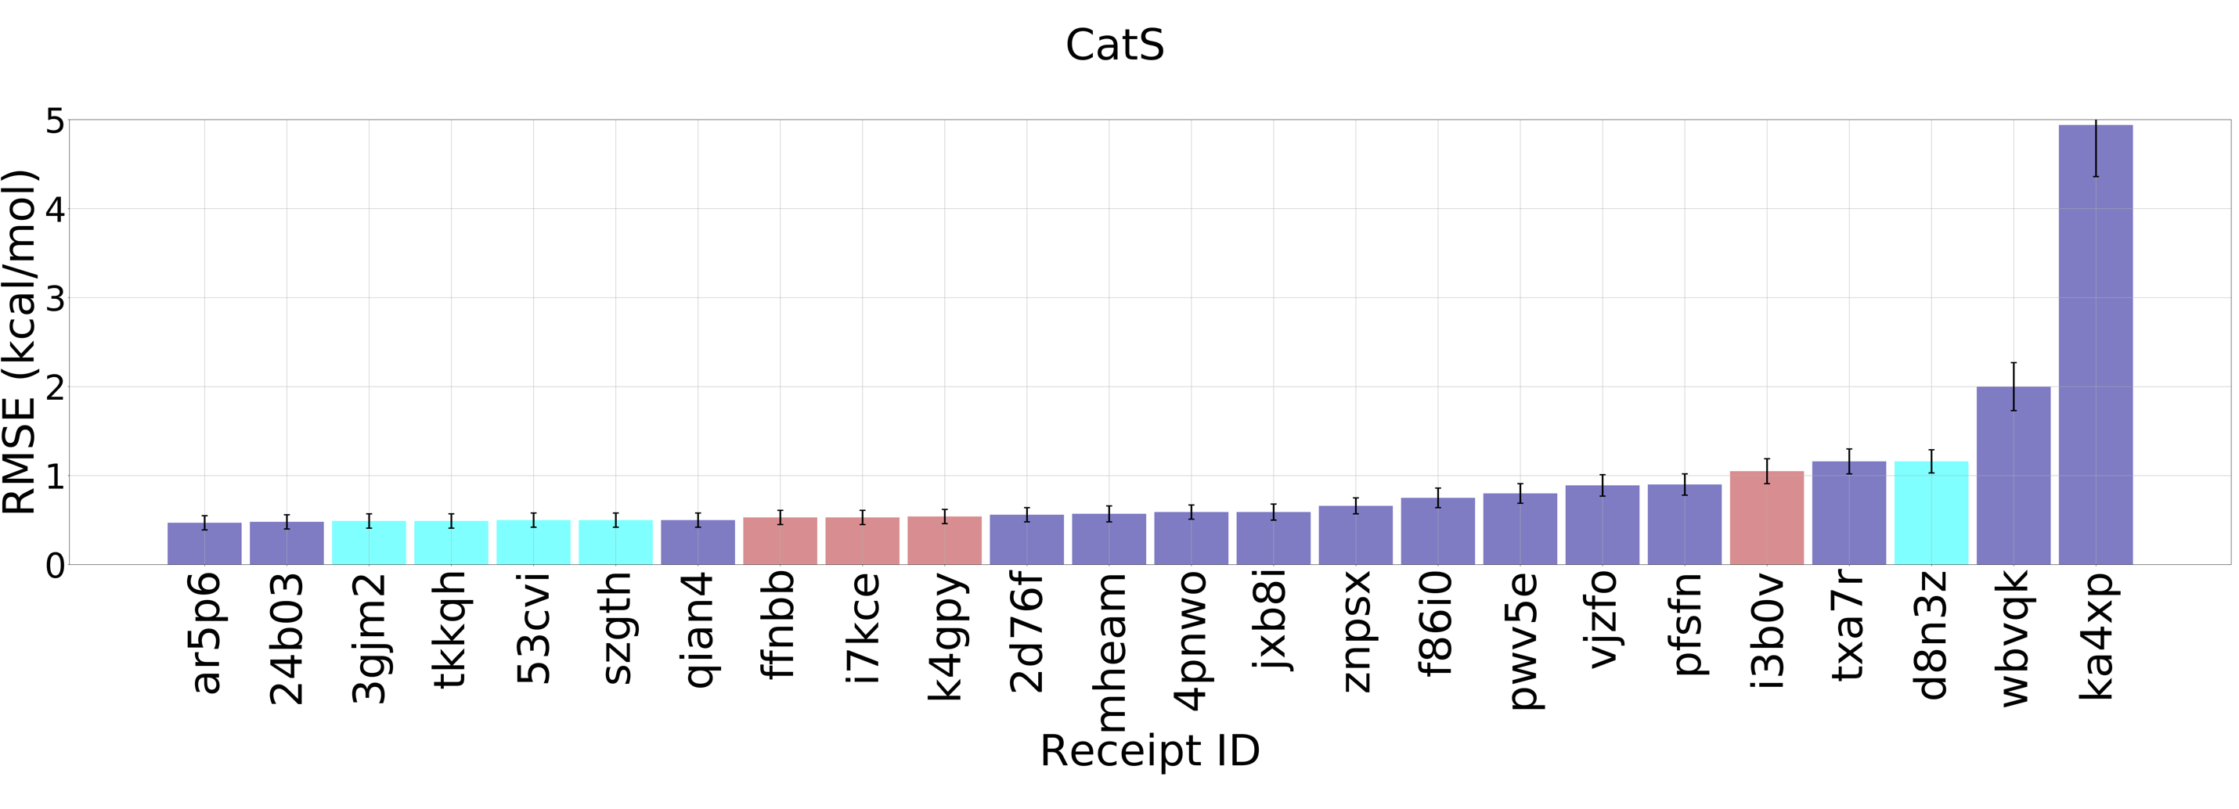
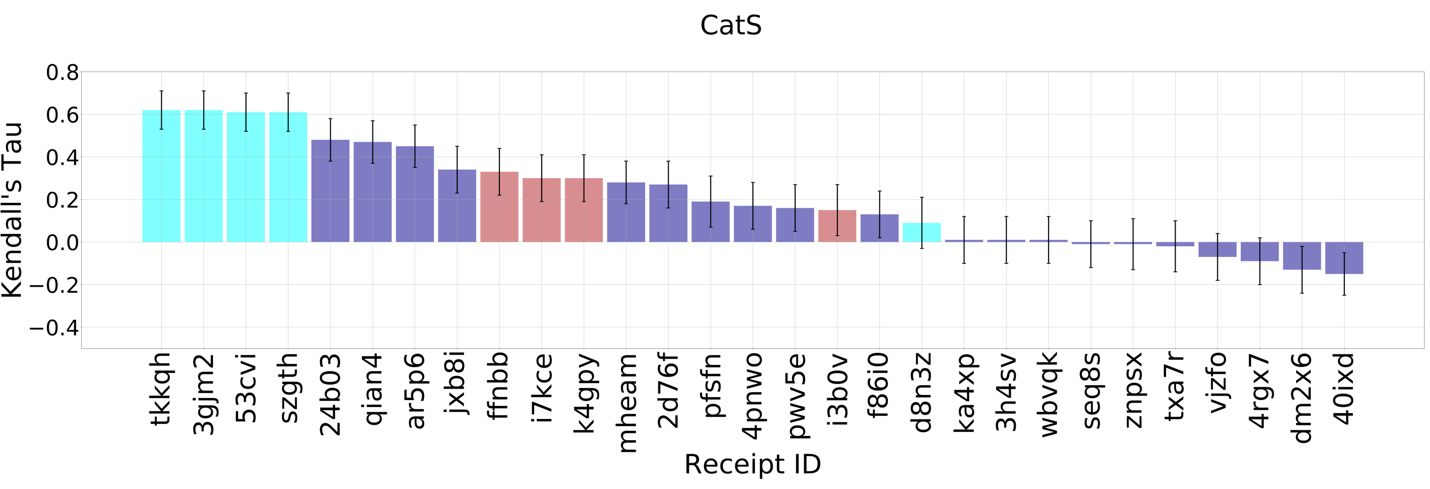
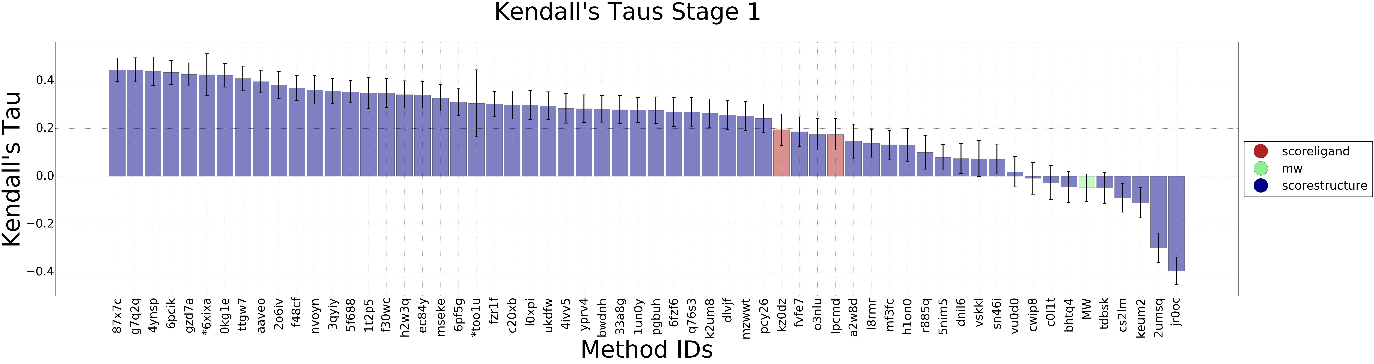
GC4: CatS Binding Free Energy Prediction Evaluation
Explicit solvent free energy methods produced greater ranking accuracy than faster, less detailed scoring methods.
Ligand-based scoring
Structure-based scoring
Free energy

Slide 15
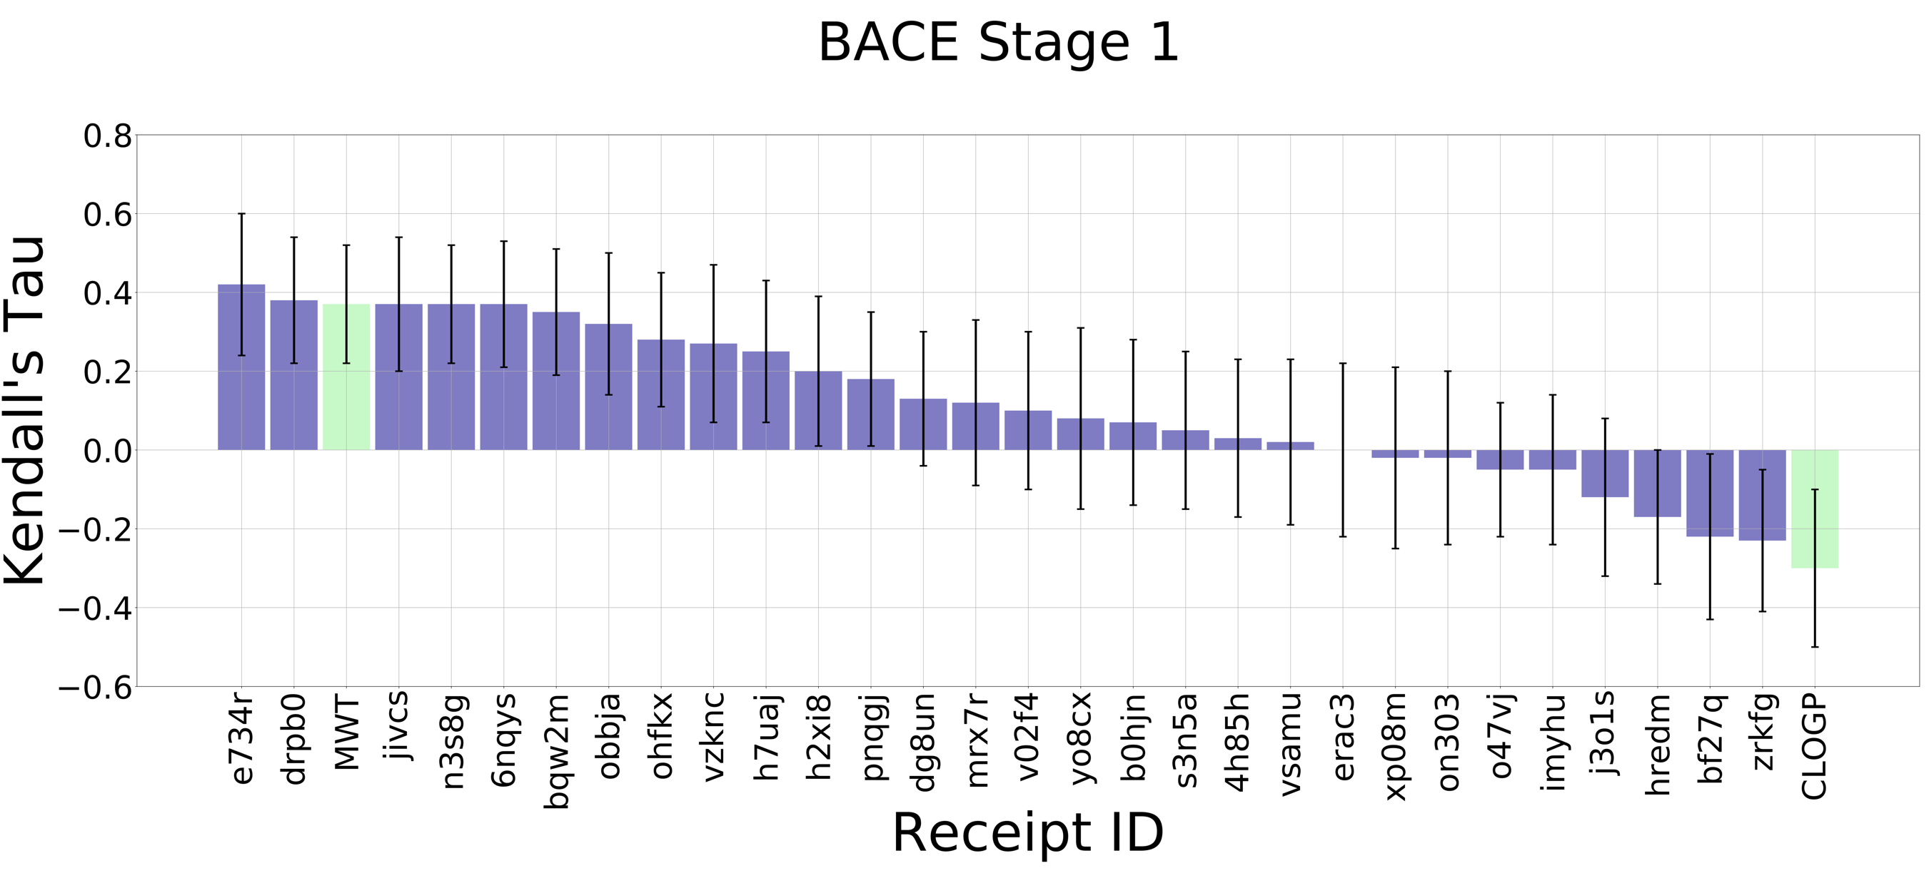
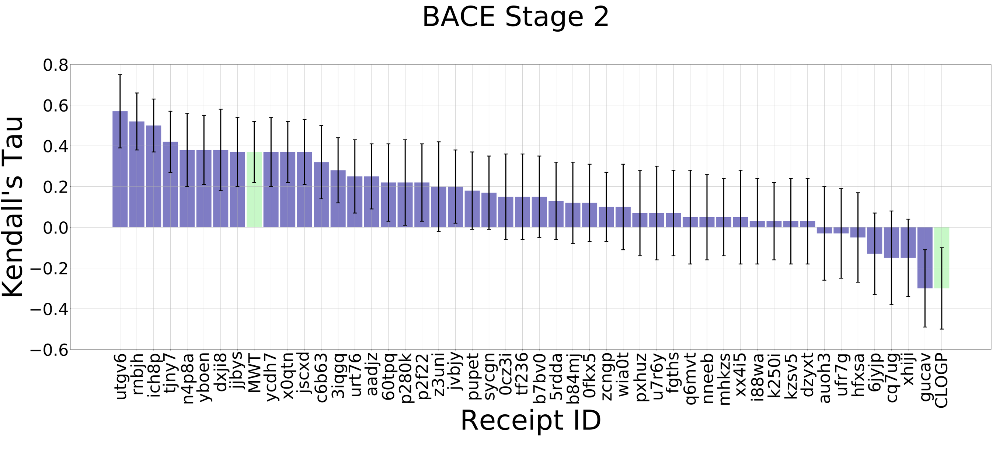
GC4: BACE1 Affinity Rankings Evaluation
Affinity Rankings Evaluation of Co-Crystal BACE1 Ligands:
BACE 1 and BACE 4 to 20, excluding BACE 17 and 18
Unlike much of we have seen in prior Grand Challenges, the availability of new structural data used in affinity rankings does improve the potency ranking accuracy for BACE1 in this challenge.
Structure-based scoring
Null Models

Slide 16
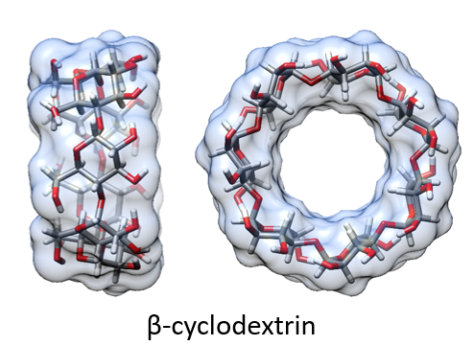
SAMPL Blinded Prediction Challenges
Started 2008
  Small molecule hydration free energies
  Nicholls, Mobley, Guthrie, Chodera, Bayly, Cooper, Pande
Simple model systems, e.g.,
  Host-guest binding affinities
  Water-organic phase partition coefficients
  Small molecule pKa values
  Small molecule hydration free energies
Advantages vs. protein-ligand challenges
  Calculations far easier to converge
  Troubleshooting by isolation of specific issues
  Reduced ambiguity (protonation states, missing residues…)
https://en.wikipedia.org/wiki/SAMPL_Challenge
Notes:
SAMPL6, part II for octanol water partition coefficients, or logP

Slide 17
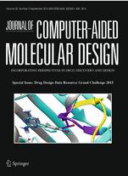
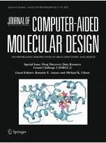
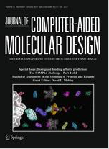
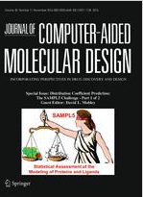
Special Issues in JCAMD
thanks to Terry Stouch, Senior Editor-in-Chief
GC 2015
14 articles, 2016
GC2
23 articles, 2017
SAMPL5 1/2
12 articles, 2016
SAMPL5 2/2
17 articles, 2017
+ GC3
~15 articles, 2018
+ GC4
In progress, 2019
Notes:
Our efforts are systematically entered into the original literature
14 articles in GC2015
23 papers in GC2 issue
SAMPL5 12 articles and 17 articles – 2 covers
**add years**

Slide 18
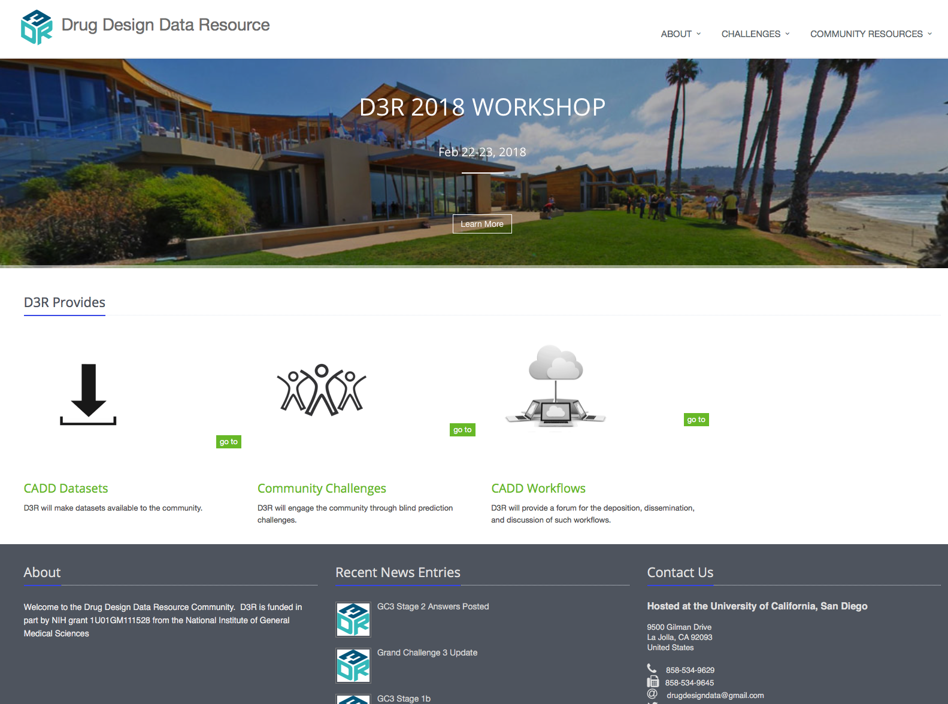
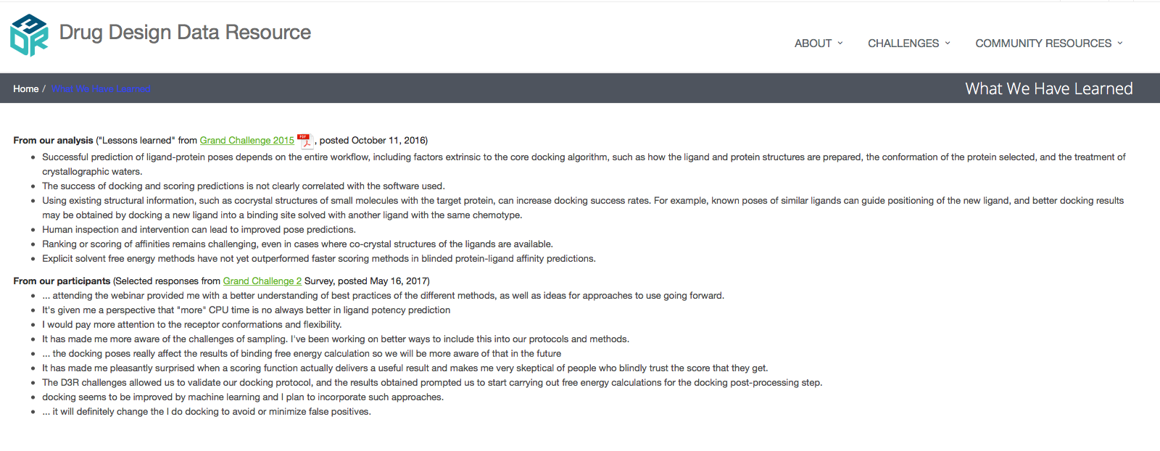
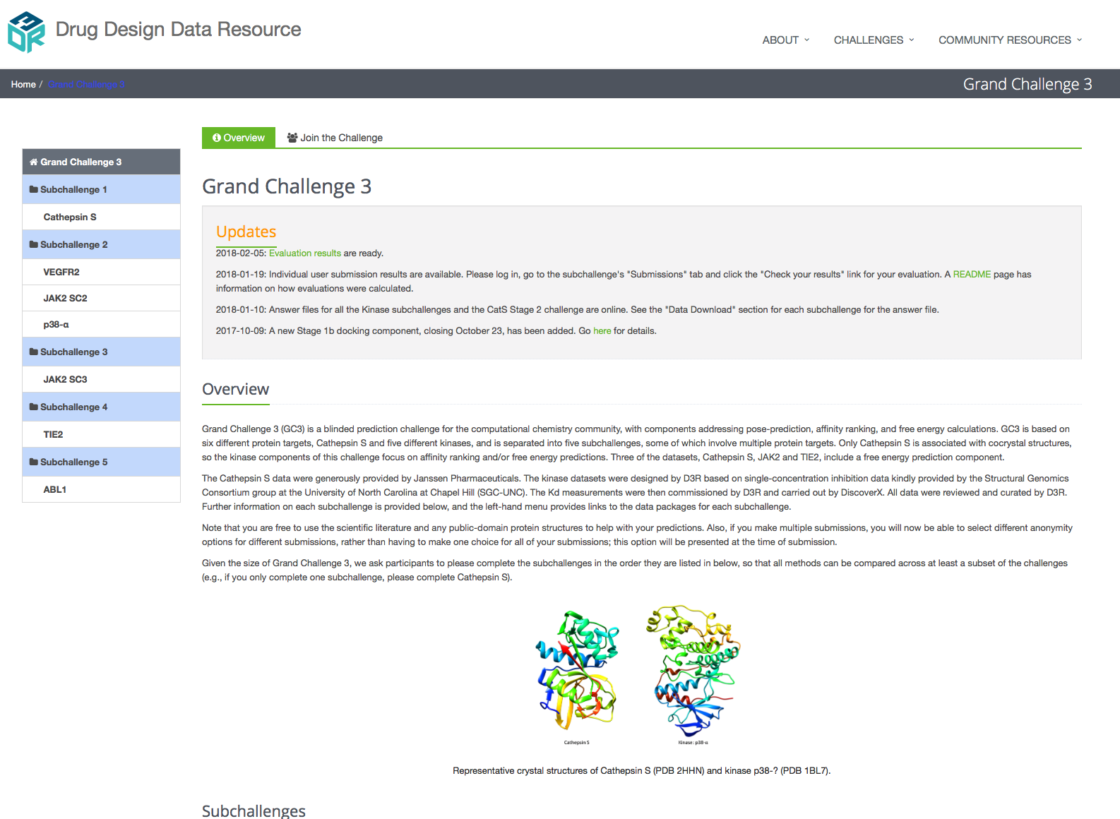
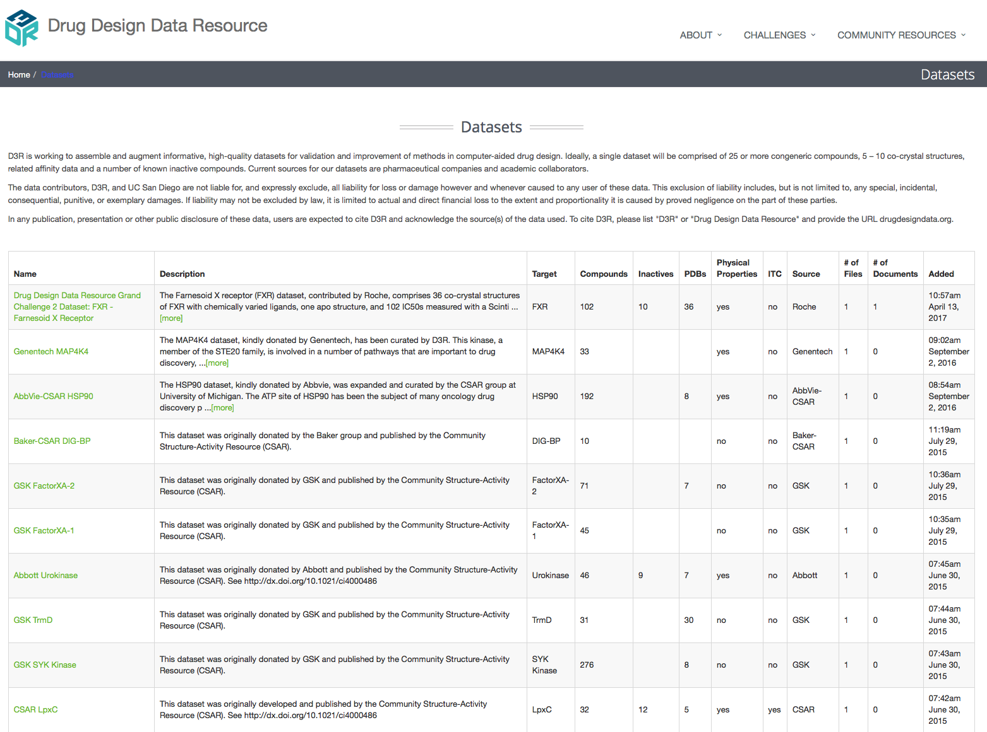
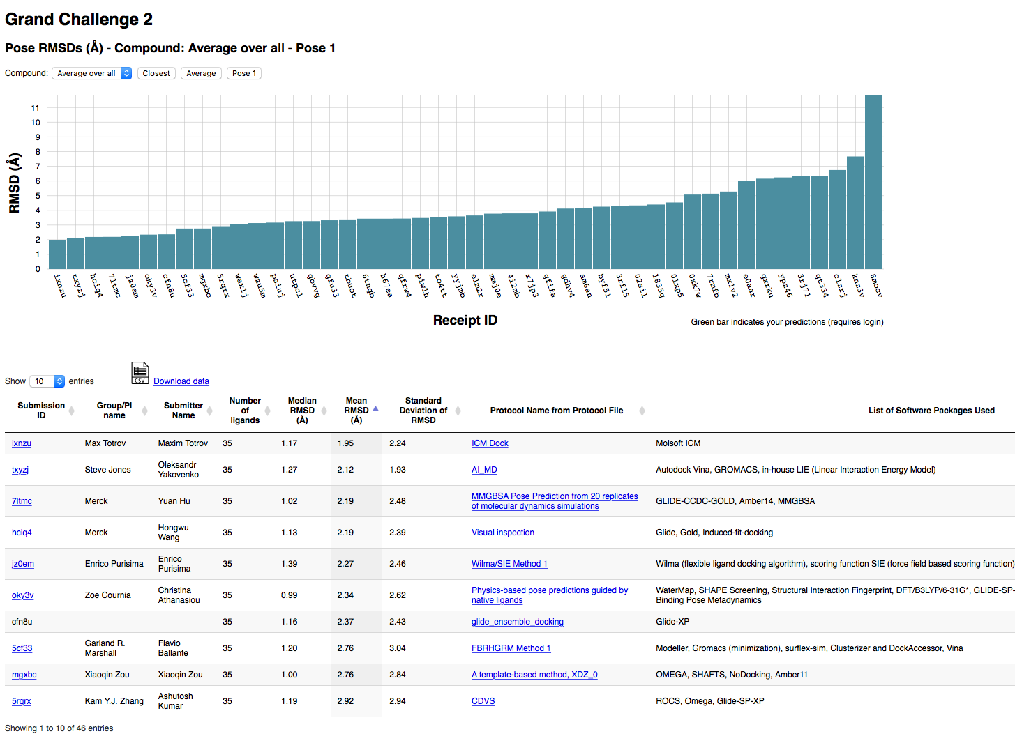
Web Portal for Data, Challenges, Community Activities
https://drugdesigndata.org
Notes:
This one is animated, just to cue us to walk through some features of our website.
We have an information-rich web portal for all activities
We run the challenges through the web portal, including validation of submissions, communications and FAQs about challenges
We maintain curated datasets developed through this initiative
We have added new evaluations pages
We have a landing page for ‘what we have learned’ that attempts to summarize what we know for the state of the fiel

Slide 19
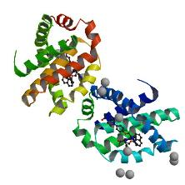
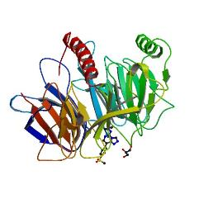
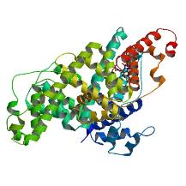
Toward Greater Statistical Power
Continuous Evaluation of Ligand Pose Predictions (CELPP)
Saturday
PDB pre-release
InChIs
Protein sequences
Forthcoming IDs
D3R scripts
Eliminate trivial ligands
Pick protein structures
Wednesday
Sunday
D3R evaluates predictions against released structures
D3R releases InChIs and protein structures for docking
D3R opens for submissions
Tuesday
D3R submission window closes
PDB releases structures
Notes:
Need more data for statistical solidity
What is apparent to us and many others, and what we expect will be an underlying theme in the evaluators talks and community discussion is the need to develop automated workflows in order to best test and develop our methods

Slide 20
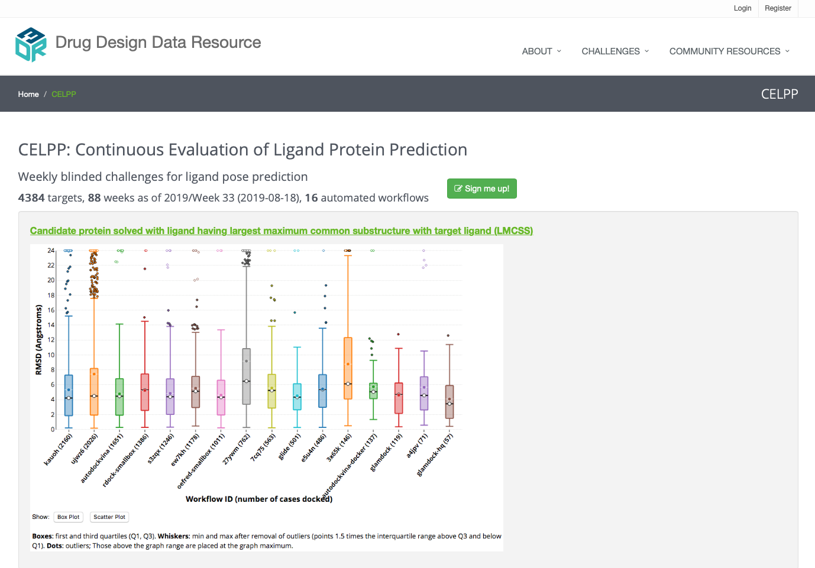
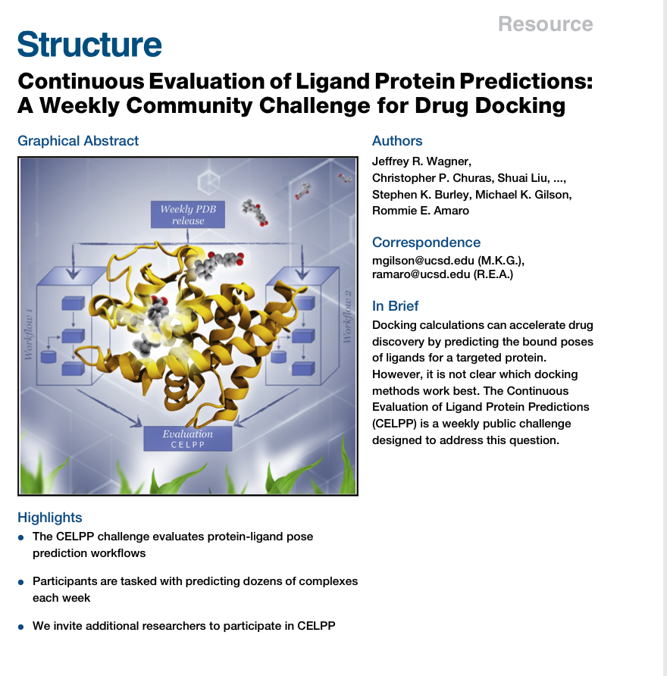
Updates to CELPP Challenge: Web and Publication
Notes:
Discussion of proposal and next steps

Slide 21
So. Ten years in…. What have we learned?
Accuracy of docking and scoring correlates poorly with software choice, and successful pose prediction depends on other methodological factors; e.g., ligand and protein prep, choice of protein confs, & treatment of xtal waters.
Pose prediction benefits from use of known ligand-protein cocrystal structures; e.g., by ligand overlay
Human inspection and intervention do not consistently improve results
Accuracy of poses used correlates poorly with scoring accuracy
Application of free energy methods to host-guest systems points to need for better force fields
Explicit solvent free energy methods may be starting to outperform faster scoring methods*
Rigorous evaluation of predictions is non-trivial and can be controversial

Slide 22
Obstacles to progress…
Current written descriptions of methods do not support
Rigorous replication
Ongoing interrogation of datasets across datasets and years
Dissemination of promising workflows
Current data throughput (~2-4 high quality data sets / yr) too low for
Statistically strong method comparisons
Interactive method optimization

Slide 23
Discussing the future of blinded prediction challenges….
The NIH U01 funding set-aside will sunset Aug 2020
First attempt to address what we viewed as the biggest challenges (retooled as NIH P41) did not score favorably enough to be funded in this round
Proposal Goals:
  Overcome data throughput challenge by tapping into two large, existing flows of data in a manner that will generate effectively blinded prediction challenges two orders of magnitude larger than are possible today.
  Create software and workflow frameworks that coordinate continuous, blinded prediction challenges and automatically archive the results, and we will also disseminate and evaluate the results
  Significantly enhance training and dissemination through unique mechanisms of P41
Full grant + summary statement available on D3R website under Publications page
Tomorrow afternoon session dedicated to discussing future of blinded challenges

Slide 24
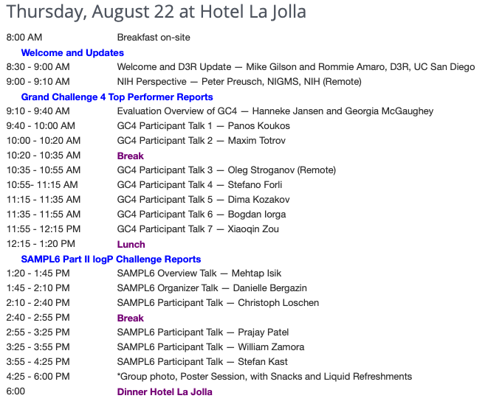
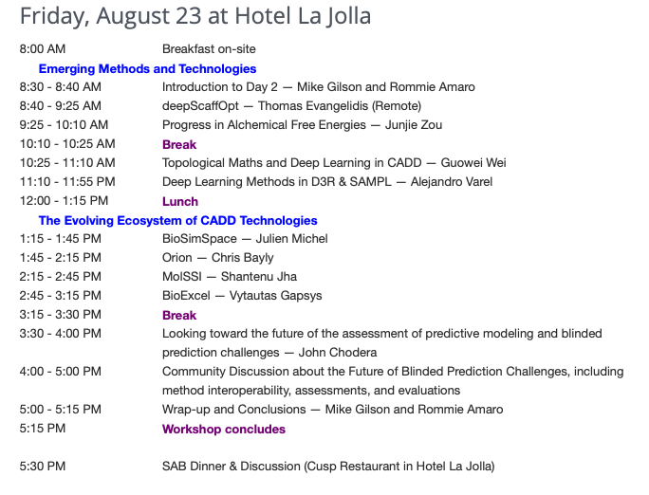
Our agenda for the next two days:
Notes:
Quick walk through of the agenda.

Slide 25
Practicalities
Meals
  Light breakfasts: today and tomorrow
  Lunch today and tomorrow
  Dinner today, here; on your own tomorrow
Talks / discussions
Note that talks and discussion will be recorded and disseminated on the D3R site, unless there is any objection**
Posters: Set up at break on poster boards
Contact People
  Megan Murphy
  Anyone from the D3R team
Notes:
Practical things to know on site. ** Please let us know by show of hands right now
add Iris

Slide 26

Acknowledgements
D3R Team at UCSD and Rutgers
D3R Scientific Advisory Board
SAMPL co-organizers: Profs. D. Mobley, J. Chodera; D. Bergazin, M. Isek
Dr. Terry Stouch and the JCAMD team
Drs. Peter Lyster, Peter Preusch, and Janna Wehrle, National Institutes of Health
Data Contributors: Janssen Pharma, Novartis, Chodera Lab, Merck, others
External evaluators: Drs. Johanna Jansen, Georgia McGaughey, Pat Walters
All challenge participants …. and you!
Notes:
Add thank you for data contributors for SAMPL

